Slide 1
2022 primaries
Key takeaways and results from every state’s 2022 midterm primaries
August 30, 2022
PRODUCER
National Journal Presentation Center

Slide 2
2022 congressional primary dates
AS OF JUNE 30, 2022
■ Primaries ■ Runoffs ■ Primaries and Runoffs
March
April
May
June
 |  | 1 | 2 | 3 | 4 | 5
6 | 7 | 8 | 9 | 10 | 11 | 12
13 | 14 | 15 | 16 | 17 | 18 | 19
20 | 21 | 22 | 23 | 24 | 25 | 26
27 | 28 | 29 | 30 | 31
 |  |  |  |  | 1 | 2
3 | 4 | 5 | 6 | 7 | 8 | 9
10 | 11 | 12 | 13 | 14 | 15 | 16
17 | 18 | 19 | 20 | 21 | 22 | 23
24 | 25 | 26 | 27 | 28 | 29 | 30
1 | 2 | 3 | 4 | 5 | 6 | 7
8 | 9 | 10 | 11 | 12 | 13 | 14
15 | 16 | 17 | 18 | 19 | 20 | 21
22 | 23 | 24 | 25 | 26 | 27 | 28
29 | 30 | 31
 |  |  | 1 | 2 | 3 | 4
5 | 6 | 7 | 8 | 9 | 10 | 11
12 | 13 | 14 | 15 | 16 | 17 | 18
19 | 20 | 21 | 22 | 23 | 24 | 25
26 | 27 | 28 | 29 | 30
July
August
September
November
 |  |  |  |  | 1 | 2
3 | 4 | 5 | 6 | 7 | 8 | 9
10 | 11 | 12 | 13 | 14 | 15 | 16
17 | 18 | 19 | 20 | 21 | 22 | 23
24 | 25 | 26 | 27 | 28 | 29 | 30
31
 | 1 | 2 | 3 | 4 | 5 | 6
7 | 8 | 9 | 10 | 11 | 12 | 13
14 | 15 | 16 | 17 | 18 | 19 | 20
21 | 22 | 23 | 24 | 25 | 26 | 27
28 | 29 | 30 | 31
 |  |  |  | 1 | 2 | 3
4 | 5 | 6 | 7 | 8 | 9 | 10
11 | 12 | 13 | 14 | 15 | 16 | 17
18 | 19 | 20 | 21 | 22 | 23 | 24
25 | 26 | 27 | 28 | 29 | 30
 |  | 1 | 2 | 3 | 4 | 5
6 | 7 | 8 | 9 | 10 | 11 | 12
13 | 14 | 15 | 16 | 17 | 18 | 19
20 | 21 | 22 | 23 | 24 | 25 | 26
27 | 28 | 29 | 30
March 1: TX | May 3: IN, OH May 10: NE, WV May 17: KY, OR, PA, NC May 19: ID May 24: AL, AR, GA, TX (runoffs) | June 7: CA*, IA, MS, MT, NJ, NM, SD June 14: ME, NV, ND, SC June 21: AL (runoffs), AR (runoffs), GA (runoffs), VA June 28: CO, IL, MS (runoffs) NY (gubernatorial), OK, SC (runoffs), UT | July 19: MD July 26: NC (runoffs)
Aug. 2: AZ, KS, MI, MO, WA* Aug. 4: TN Aug. 9: CT, MN, VT, WI Aug. 13: HI Aug. 16: AK*, SD (runoffs), WY Aug. 23: FL, NY(congressional), OK (runoffs) | Sep. 6: MA Sept. 13: DE, NH, RI Nov. 8: LA** | * Instead of traditional single party contests, these states put all candidates from all parties on a single ballot | ** Louisiana uses a hybrid system whereby no nominees are determined prior to an all-party primary. Candidates can win an election by receiving a majority of votes on that day.
SOURCE 270towin, NPR, NCSL
PRESENTATION CENTER 7/11/22
Notes:
Sources:
“2022 State Primary Election Dates and Filing Deadlines” NCSL, updated June 30, 2022
https://www.ncsl.org/research/elections-and-campaigns/2022-state-primary-election-dates-and-filing-deadlines.aspx
“2022 Midterm Election Calendar,” 270 to Win. Accessed March 9, 2022. https://www.270towin.com/2022-election-calendar/
“N.Y. Moves Some Primaries to August After a Judge Tosses Maps,” NPR, April, 29, 2022, https://www.npr.org/2022/04/29/1095657939/new-york-voting-august

Slide 3
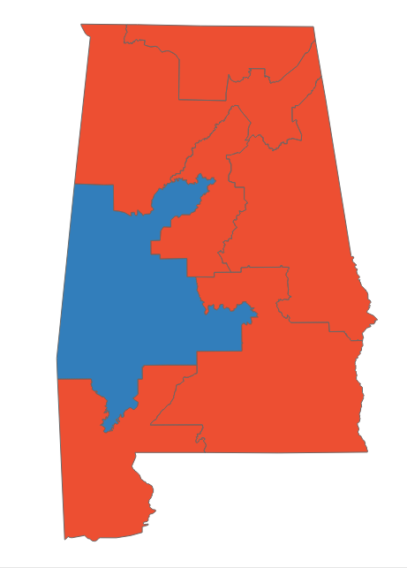
Alabama primary dashboard
Primaries held May 24, runoffs June 21
POSITIONS ON THE BALLOT
KEY TAKEAWAYS
Federal and gubernatorial office only
Office | Seats | Incumbent party
House | 7 | 1 D, 6 R
Senate | 1 | R
Governor | 1 | R
1
Trump’s Senate race judgment call
Rep. Mo Brooks (R), whose Trump endorsement was rescinded after poor polling predictions, lost to Katie Britt (R) in the June 21st runoff
Britt, who received 63% of the vote, will face Will Boyd (D) for the open AL Senate seat in November
2
US House District 5
The seat left open by Rep. Brooks attracted 6 GOP challengers, with Dale Strong defeating Casey Wardynski in the June 21st runoff
Strong, who received 63.4% of the vote, will face Kathy Warner-Stanton (D) in November
STATE DISTRICT MAP
Partisan coloring based on Cook Political Report with Amy Walter Race Rating
3
Governor’s race
Sitting Gov. Kay Ivey (R) easily defeated Lynda Blanchard, who failed to receive a Trump endorsement after serving as the former president’s ambassador to Slovenia
Gov. Ivey will face Yolanda Flowers (D) in November after Flowers received 55.1% of the vote in the runoff
SOURCE AP data as of 5/25/22, Ballotpedia CNN, New York Times, NBC
PRESENTATION CENTER 6/27/22
Notes:
Source:
“2022 House Race Ratings” The Cook Political Report with Amy Walter, updated June 6, 2022
https://www.cookpolitical.com/ratings/house-race-ratings
“United States congressional delegations from Alabama” Ballotpedia, accessed June 7, 2022
https://ballotpedia.org/United_States_congressional_delegations_from_Alabama
Bradner, E., Merica, D., & Krieg, G. (2022, May 25). 6 takeaways from primaries in Georgia, Alabama, Arkansas and Texas | CNN politics. CNN. Retrieved June 16, 2022, from https://www.cnn.com/2022/05/25/politics/georgia-arkansas-alabama-primary-takeaways/index.html
The New York Times. (2022, June 14). Alabama Fifth Congressional District Primary Election Results. The New York Times. Retrieved June 16, 2022, from https://www.nytimes.com/interactive/2022/05/24/us/elections/results-alabama-us-house-district-5.html
The New York Times. (2022, June 14). Alabama Primary Election Results. The New York Times. Retrieved June 16, 2022, from https://www.nytimes.com/interactive/2022/05/24/us/elections/results-alabama.html
NBCUniversal News Group. (2022, June 22). Live alabama senate runoff election results 2022 - NBC News. NBCNews.com. Retrieved June 22, 2022, from https://www.nbcnews.com/politics/2022-primary-elections/alabama-senate-runoff-results

Slide 4
Alabama primary results
Seat | Republican Primary Winner | Democratic Primary Winner | Cook Rating
AL-Senate | Katie Britt (Runoff 63%) | Will Boyd (63.7%) | Solid R
AL-Governor | Kay Ivey* (54.4%) | Yolanda Flowers (Runoff 55.1%) | Solid R
AL-1 | Jerry Carl* (Uncontested) | No Candidate | Solid R
AL-2 | Barry Moore* (Uncontested) | Phyllis Harvey-Hall (68.8%) | Solid R
AL-3 | Mike Rogers* (82.3%) | Karen Lin Veasey (Uncontested) | Solid R
AL-4 | Robert Aderholt* (Uncontested) | Rick Neighbors (54.1%) | Solid R
AL-5 | Dale Strong (Runoff 63.4%) | Kathy Warner-Stanton (57.2%) | Solid R
AL-6 | Gary Palmer* (Uncontested) | No Candidate | Solid R
AL-7 | Beatrice Nichols (Uncontested) | Terri Sewell* (Uncontested) | Solid D
*Incumbent
SOURCE AP data as of 6/22/22
PRESENTATION CENTER 7/20/22
Notes:
Source:
“AP Elections API”, Associated Press, Accessed June 22, 2022,
https://developer.ap.org/ap-elections-api/

Slide 5
Alaska primary dashboard
Primaries held August 16
POSITIONS ON THE BALLOT
KEY TAKEAWAYS
Federal and gubernatorial office only
Office | Seats | Incumbent party
House | 1 | 1 R
Senate | 1 | R
Governor | 1 | R
1
Top four finishers head to general election
Alaska’s nonpartisan primary system requires the top four candidates to move on to a ranked-choice general election
Sen. Lisa Murkowski (R-AK), one of seven GOP senators who voted to convict Trump during his second impeachment trial, is the top vote getter for the Senate primary and will face her biggest challenger in Trump endorsed candidate Kelly Tshibaka
The state’s at-large district general election will feature top vote-getter Mary Peltola (D), former Governor Sarah Palin (R), and businessman Nick Begich (R); the fourth candidate will likely be Tara Sweeney (R), former Assistant Secretary for Indian affairs at the US Interior Dept.
STATE DISTRICT MAP
Partisan coloring based on Cook Political Report with Amy Walter Race Rating
2
Governor race
Trump endorsed candidate and incumbent Gov. Mike Dunleavy (R) currently leads the primary election and will face the other top three vote getters, with his top opponent being Democratic nominee Les Gara, who was endorsed by Planned Parenthood Alliance Advocates
Nonpartisan candidate Bill Walker and GOP candidate Charlie Pierce will also head to the general election
SOURCE , CNN, The Cook Political Report with Amy Walter
PRESENTATION CENTER 8/17/22
Notes:
Source:
“2022 House Race Ratings” The Cook Political Report with Amy Walter, updated June 6, 2022
https://www.cookpolitical.com/ratings/house-race-ratings
Eric Bradner, “Six takeaways from primaries in Wyoming and Alaska” CNN, Aug 17, 2022
https://www.cnn.com/2022/08/16/politics/wyoming-alaska-primary-election-takeaways/index.html
“Alaska Primary Election Results” The New York Time, accessed August 17, 2022
https://www.nytimes.com/interactive/2022/08/16/us/elections/results-alaska.html?action=click&pgtype=Article&state=default&module=styln-elections-2022&region=TOP_BANNER&context=election_recirc

Slide 6
Alaska primary results
Seat | #1 Vote Getter | #2 Vote Getter | #3 Vote Getter | #4 Vote Getter | Cook Rating
AK-Senate | Lisa Murkowski* (45%) | Kelly Tshibaka (38.6%) | Pat Chesbro (6.8%) | Buzz Kelley (2.1%) | Solid R
AK-Governor | Mike Dunleavy* (40.4%) | Les Gara (23.1%) | Bill Walker (22.77%) | Charlie Pierce (6.6%) | Likely R
AK-AL | Mary Peltola (36.8%) | Sarah Palin (30.2%) | Nick Begich (26.2%) | Chris Bye (0.62%) | Likely R
*Incumbent
SOURCE AP data as of 8/17/22, KTOO
PRESENTATION CENTER 8/29/22
Notes:
Source:
“AP Elections API”, Associated Press, Accessed August 17, 2022
https://developer.ap.org/ap-elections-api/
Andrew Kitchenman. “Alaska primary count is done, as near-record voting sets fields for ranked choice election” KTOO, August 28, 2022
https://www.ktoo.org/2022/08/28/alaska-primary-count-is-done-as-near-record-voting-sets-fields-for-ranked-choice-election/

Slide 7
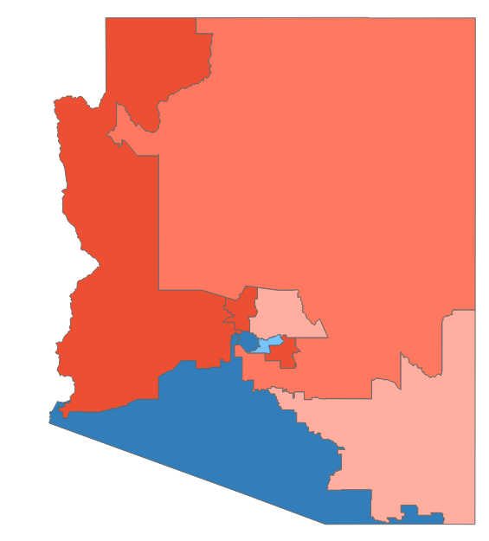
Arizona primary dashboard
Primaries held August 2
POSITIONS ON THE BALLOT
KEY TAKEAWAYS
Federal and gubernatorial office only
Office | Seats | Incumbent party
House | 9 | 5 D, 4 R
Senate | 1 | D
Governor | 1 | R
1
Trump endorsed candidates prevail
Venture capitalist Blake Masters was endorsed by former President Trump in June and easily won the GOP senate primary
Masters will run against incumbent Sen. Mark Kelly (D) in the upcoming general election in a fight for a key battleground state, that could lead determine partisan control of the Senate
Trump endorsed governor candidate and former Phoenix TV personality Kari Lake narrowly won the GOP primary for governor and will face Secretary of State Katie Hobbs (D) in November
STATE DISTRICT MAP
Partisan coloring based on Cook Political Report with Amy Walter Race Rating
2
Competitive race in the 6th CD
GOP leaders in DC anticipate Arizona’s 6th district has the potential to flip from Democrat to Republican, a key district that could affect partisan control of the House
Juan Ciscomani, former advisor to Gov. Doug Ducey (R), won the GOP nomination while former state senator Kirsten Engel won the Democratic nomination
SOURCE Ballotpedia, The Cook Political Report with Amy Walter, Fox, Arizona Public Media
PRESENTATION CENTER 8/3/22
Notes:
Source:
“2022 House Race Ratings” The Cook Political Report with Amy Walter, updated May 24, 2022
https://www.cookpolitical.com/ratings/house-race-ratings
“United States congressional delegations from Arizona” Ballotpedia, accessed August 3, 2022
https://ballotpedia.org/United_States_congressional_delegations_from_Arizona
Paul Steinhauser, Lawrence Richard, “Blake Masters wins Arizona's Republican Senate primary in key battleground state showdown” Fox News, August 3, 2022
https://www.foxnews.com/politics/blake-masters-wins-arizona-republican-senate-primary-key-battleground-state-showdown
“Five takeaways from Arizona's primary” Arizona Public Media, August 3, 2022
https://www.azpm.org/p/headlines/2022/8/2/212223-five-takeaways-from-arizonas-primary/

Slide 8
Arizona primary results
Seat | Republican Primary Winner | Democratic Primary Winner | Cook Rating
AZ-Senate | Blake Masters (39%) | Mark Kelly* (Uncontested) | Toss Up
AZ-Governor | Kari Lake (48%) | Katie Hobbs (72.8%) | Toss Up
AZ-1 | David Schweikert* (43.3%) | Jevin Hodge (61.4%) | Lean R
AZ-2 | Eli Crane (35.8%) | Tom O'Halleran* (Uncontested) | Likely R
AZ-3 | Jeff Zink (Uncontested) | Ruben Gallego* (Uncontested) | Solid D
AZ-4 | Kelly Cooper (28.4%) | Greg Stanton* (Uncontested) | Lean D
AZ-5 | Andy Biggs* (Uncontested) | Javier Ramos (Uncontested) | Solid R
AZ-6 | Juan Ciscomani (46.5%) | Kirsten Engel (59.5%) | Lean R
AZ-7 | Luis Pozzolo (67.6%) | Raul Grijalva* (Uncontested) | Solid D
AZ-8 | Debbie Lesko* (Uncontested) | No Candidate | Solid R
AZ-9 | Paul Gosar* (65.2%) | No Candidate | Solid R
*Incumbent
SOURCE AP data as of 8/17/22
PRESENTATION CENTER 8/3/22
Notes:
Source:
“AP Elections API”, Associated Press, Accessed August 3, 2022
https://developer.ap.org/ap-elections-api/

Slide 9
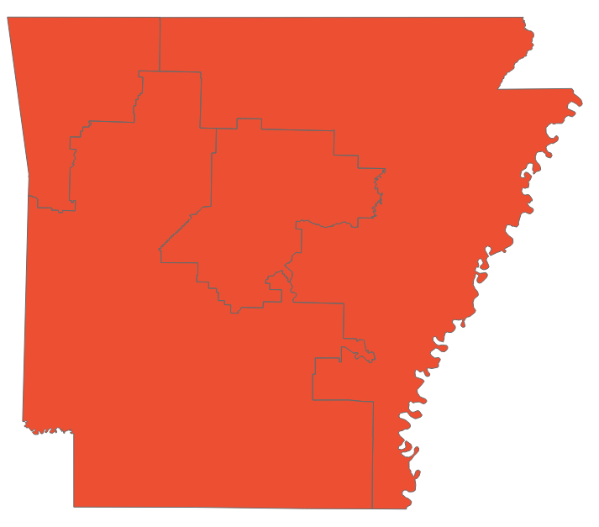
Arkansas primary dashboard
Primaries held May 24
POSITIONS ON THE BALLOT
KEY TAKEAWAYS
Federal and gubernatorial office only
Office | Seats | Incumbent party
House | 4 | 4 R
Senate | 1 | R
Governor | 1 | R
1
Governor race
Former White House Press Secretary Sarah Huckabee Sanders won the Republican nomination
Sanders was endorsed by former President Trump and ultimately faced just one primary challenger, whom she easily defeated
Her father previously served as Arkansas governor from 1996-2007
Sanders will face Democrat Chris Jones in November
STATE DISTRICT MAP
2
Solid GOP state
Partisan coloring based on Cook Political Report with Amy Walter Race Rating
Arkansas’ Senate seat and all four House districts are rated Solid Republican
The state’s five congressional incumbents all won renomination, with only Rep. Bruce Westermann (R-AR-4) running uncontested
SOURCE CNN, Ballotpedia, The Cook Political Report with Amy Walter, AP data as of 5/25/22
PRESENTATION CENTER 6/14/22
Notes:
Source:
“2022 House Race Ratings” The Cook Political Report with Amy Walter, updated May 24, 2022
https://www.cookpolitical.com/ratings/house-race-ratings
“2022 Senate Race Ratings” The Cook Political Report with Amy Walter, updated March 4, 2022
https://www.cookpolitical.com/ratings/senate-race-ratings
“Mike Huckabee” Ballotpedia, accessed May 25, 2022
https://ballotpedia.org/Mike_Huckabee
Eric Bradner, Dan Merica and Gregory Krieg. “6 takeaways from primaries in Georgia, Alabama, Arkansas and Texas” CNN, May 25, 2022
https://edition.cnn.com/2022/05/25/politics/georgia-arkansas-alabama-primary-takeaways/index.htmls
"AP Elections API" last accessed May 25, 2022
https://developer.ap.org/ap-elections-api/

Slide 10
Arkansas primary results
Seat | Republican Primary Winner | Democratic Primary Winner | Cook Rating
AR-Senate | John Boozman* (58.%) | Natalie James (54.2%) | Solid R
AR-Governor | Sarah Huckabee Sanders (83.1%) | Chris Jones (70.5%) | Solid R
AR-1 | Rick Crawford* (74.8%) | Monte Hodges (Uncontested) | Solid R
AR-2 | French Hill* (58.5%) | Quintessa Hathaway (Uncontested) | Solid R
AR-3 | Steve Womack* (78.7%) | Lauren Mallett-Hays (Uncontested) | Solid R
AR-4 | Bruce Westerman* (Uncontested) | John White (Uncontested) | Solid R
*Incumbent
SOURCE AP data as of 5/25/22
PRESENTATION CENTER 7/20/22
Notes:
Source:
“AP Elections API”, Associated Press, Accessed May 25, 2022,
https://developer.ap.org/ap-elections-api/

Slide 11
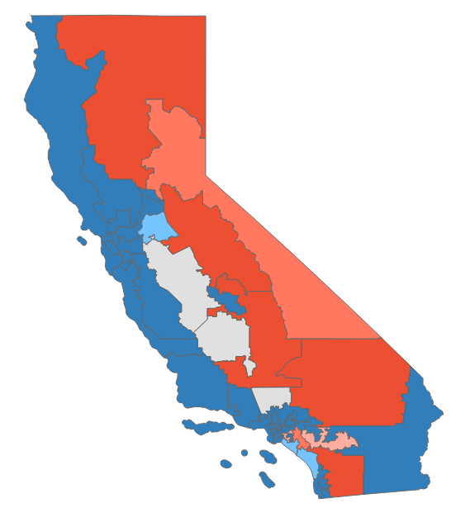
California primary dashboard
Primaries held June 7, runoffs June 21
POSITIONS ON THE BALLOT
KEY TAKEAWAYS
Federal and gubernatorial office only
Office | Seats | Incumbent party
House | 52 | 42 D, 11 R
Senate | 1 | D
Governor | 1 | D
1
Low turnout
As of June 7, just 19% of the 22 million ballots sent to California voters were returned
Low turnout could be a warning sign to Democrats that the party is losing engagement with its constituents
2
Move to the center
Voters in San Francisco recalled District Attorney Chesa Boudin for what they saw as progressive criminal justice policies that were ineffective at deterring crime
Meanwhile, voters in Los Angeles cast ballots for former Republican Rick Caruso in the mayor’s race, forcing a November runoff with Rep. Karen Bass (D-CA-37)
STATE DISTRICT MAP
Partisan coloring based on Cook Political Report with Amy Walter Race Rating
3
Republican challenges
California is one of the few states where multiple incumbent Republicans are vulnerable after redistricting
Reps. Young Kim (R-CA-39) and David Valadao (R-CA-21) ultimately defeated primary challenges from more Trumpian candidates that could have given Democrats an edge, but both candidates came in second in their district races
SOURCE AP data as of 6/8/22, Ballotpedia, LA Times, CNN, NY Times, The Cook Political Report with Amy Walter
PRESENTATION CENTER 6/27/22
Notes:
Source:
“2022 House Race Ratings” The Cook Political Report with Amy Walter, updated June 6, 2022
https://www.cookpolitical.com/ratings/house-race-ratings
“United States congressional delegations from California” Ballotpedia, accessed June 7, 2022
https://ballotpedia.org/United_States_congressional_delegations_from_California
"AP Elections API" last accessed June 7, 2022
https://developer.ap.org/ap-elections-api/
John Myers. “News Analysis: Ten years later, California’s ‘top two’ primary isn’t always what it seems” LA Times, June 9, 2022
https://www.latimes.com/california/story/2022-06-09/california-top-two-primary-tenth-anniversary-offers-few-promised-results-news-analysis
“California Primary Election Results” NY Times, accessed June 9, 2022
https://www.nytimes.com/interactive/2022/06/07/us/elections/results-california.html
Mark Z. Barabak. “Column: California election takeaways: Big money dominated as voters didn’t show up” LA Times, June 8, 2022
https://www.latimes.com/politics/story/2022-06-08/california-primary-election-chesa-boudin-rick-caruso-takeaways
Maeve Reston. “California voters send a stark message to Democrats on crime and homelessness” CNN, June 8, 2022
https://www.cnn.com/2022/06/07/politics/primary-elections-june-7-california-iowa/index.html

Slide 12
California primary results (1/3)
Seat | Top-Vote-Getter #1 | Top-Vote-Getter #2 | Cook Rating
CA-Senate | Alex Padilla* (54.5%) | Mark Meuser (14.7%) | Solid D
CA-Governor | Gavin Newsom* (56.3%) | Brian Dahle (17.4%) | Solid D
CA-1 | Doug LaMalfa* (57.%) | Max Steiner (33.%) | Solid R
CA-2 | Jared Huffman* (69.5%) | No candidate | Solid D
CA-3 | Kermit Jones (40.3%) | Kevin Kiley (37.3%) | Likely R
CA-4 | Mike Thompson* (66.9%) | Matt Brock (16.3%) | Solid D
CA-5 | Tom McClintock* (45.5%) | Michael Barkley (33.6%) | Solid R
CA-6 | Ami Bera* (54.1%) | Tamika Hamilton (17.7%) | Solid D
CA-7 | Doris Matsui* (64.%) | Max Semenenko (28.1%) | Solid D
CA-8 | John Garamendi* (63.3%) | Rudy Recile (20.6%) | Solid D
CA-9 | Josh Harder* (38.9%) | Tom Patti (28.2%) | Lean D
CA-10 | Mark DeSaulnier* (Uncontested) | Michael Kerr (Uncontested) | Solid D
CA-11 | Nancy Pelosi* (71.7%) | John Dennis (10.7%) | Solid D
CA-12 | Barbara Lee* (87.7%) | Stephen Slauson (5.3%) | Solid D
CA-13 | John Duarte (34.3%) | Adam Gray (30.9%) | Toss Up
CA-14 | Eric Swalwell* (63.6%) | Alison Hayden (10.3%) | Solid D
CA-15 | Kevin Mullin (41.7%) | David Canepa (23.9%) | Solid D
CA-16 | Anna Eshoo* (47.8%) | Rishi Kumar (15.6%) | Solid D
*Incumbent; percentages may appear skewed due to the format of California’s top-two primary
SOURCE AP data as of 6/21/22
PRESENTATION CENTER 7/20/22
Notes:
Source:
"AP Elections API" last accessed June 21, 2022
https://developer.ap.org/ap-elections-api/

Slide 13
California primary results (2/3)
Seat | Top-Vote-Getter #1 | Top-Vote-Getter #2 | Cook Rating
CA-17 | Ro Khanna* (66.%) | Ritesh Tandon (25.3%) | Solid D
CA-18 | Zoe Lofgren* (56.1%) | Peter Hernandez (31.4%) | Solid D
CA-19 | Jimmy Panetta* (68.%) | Jeff Gorman (22.7%) | Solid D
CA-20 | Kevin McCarthy* (59.4%) | Marisa Wood (25.%) | Solid R
CA-21 | Jim Costa* (46.9%) | Michael Maher (26.5%) | Solid D
CA-22 | Rudy Salas (45.4%) | David Valadao* (25.6%) | Toss Up
CA-23 | Jay Obernolte* (60.9%) | Derek Marshall (21.8%) | Solid R
CA-24 | Salud Carbajal* (60.8%) | Brad Allen (30.3%) | Solid D
CA-25 | Raul Ruiz* (56.5%) | Brian Hawkins (16.5%) | Solid D
CA-26 | Julia Brownley* (54.3%) | Matt Jacobs (38.4%) | Solid D
CA-27 | Mike Garcia* (47.2%) | Christy Smith (37.3%) | Toss Up
CA-28 | Judy Chu* (63.%) | Wes Hallman (29.4%) | Solid D
CA-29 | Tony Cardenas (56.9%) | Angelica Duenas (22.5%) | Solid D
CA-30 | Adam Schiff* (62.4%) | G. Pudlo (12.6%) | Solid D
CA-31 | Grace Napolitano* (55.4%) | Daniel Martinez (36.8%) | Solid D
CA-32 | Brad Sherman* (53.7%) | Lucie Volotzky (19.9%) | Solid D
CA-33 | Pete Aguilar* (59.9%) | John Porter (17.6%) | Solid D
CA-34 | Jimmy Gomez* (50.9%) | David Kim (38.7%) | Solid D
*Incumbent; percentages may appear skewed due to the format of California’s top-two primary
SOURCE AP data as of 6/21/22
PRESENTATION CENTER 7/20/22
Notes:
Source:
"AP Elections API" last accessed June 21, 2022
https://developer.ap.org/ap-elections-api/

Slide 14
California primary results (3/3)
Seat | Top-Vote-Getter #1 | Top-Vote-Getter #2 | Cook Rating
CA-35 | Norma Torres* (54.3%) | Mike Cargile (25.2%) | Solid D
CA-36 | Ted Lieu* (67.%) | Joe Collins (13.5%) | Solid D
CA-37 | Sydney Kamlager (43.7%) | Jan Perry (18.4%) | Solid D
CA-38 | Linda Sanchez (58.5%) | Eric Ching (30.7%) | Solid D
CA-39 | Mark Takano* (57.2%) | Aja Smith (12.6%) | Solid D
CA-40 | Asif Mahmood (40.9%) | Young Kim* (34.7%) | Likely R
CA-41 | Ken Calvert* (48.2%) | Will Rollins (30.5%) | Lean R
CA-42 | Robert Garcia (46.6%) | John Briscoe (26.4%) | Solid D
CA-43 | Maxine Waters* (74.1%) | Omar Navarro (11.9%) | Solid D
CA-44 | Nanette Barragan (68.5%) | Paul Jones (24.3%) | Solid D
CA-45 | Michelle Steel* (48.3%) | Jay Chen (43.1%) | Lean R
CA-46 | Lou Correa* (49.1%) | Christopher Gonzales (15.6%) | Solid D
CA-47 | Katie Porter* (51.7%) | Scott Baugh (30.9%) | Lean D
CA-48 | Darrell Issa* (61.5%) | Stephen Houlahan (27.8%) | Solid R
CA-49 | Mike Levin* (48.9%) | Brian Maryott (19.%) | Lean D
CA-50 | Scott Peters* (52.4%) | Corey Gustafson (29.9%) | Solid D
CA-51 | Sara Jacobs* (60.6%) | Stan Caplan (37.2%) | Solid D
CA-52 | Juan Vargas* (59.1%) | Tyler Geffeney (30.5%) | Solid D
*Incumbent; percentages may appear skewed due to the format of California’s top-two primary
SOURCE AP data as of 6/21/22
PRESENTATION CENTER 7/20/22
Notes:
Source:
"AP Elections API" last accessed June 21, 2022
https://developer.ap.org/ap-elections-api/

Slide 15
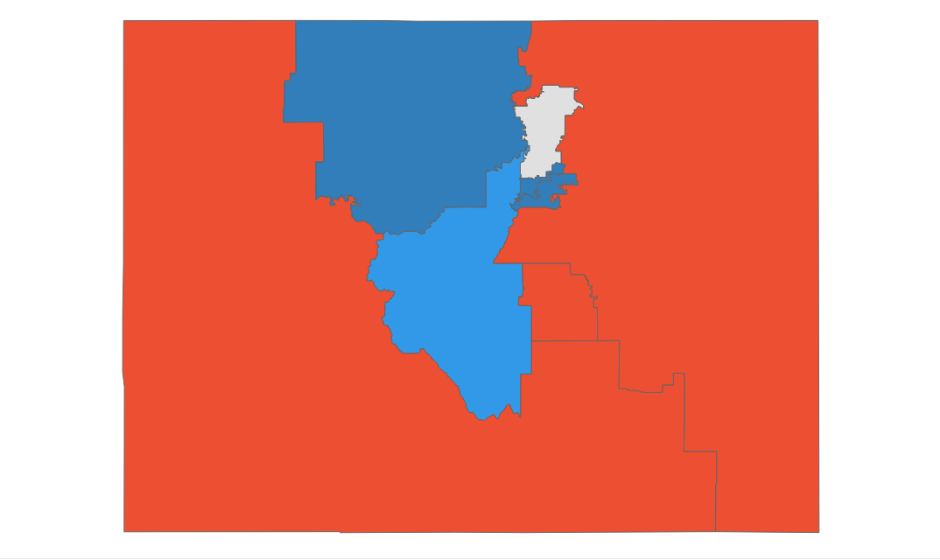
Colorado primary results
Primaries held June 28
POSITIONS ON THE BALLOT
KEY TAKEAWAYS
Federal and gubernatorial office only
Office | Seats | Incumbent party
House | 8 | 4 D, 3 R
Senate | 1 | D
Governor | 1 | D
1
GOP moderates advance
GOP Gov. candidate Heidi Ganahl refuses to voice an opinion on 2020 election integrity, but she bested an opponent who was vocal in perpetuating false election claims
Republican Senate primary winner Joe O’Dea supports early-term abortion rights, beating Ron Hanks, who marched on the Capitol on January 6 and is staunchly pro-life
2
Democratic dark money fails to deliver
Democrat-aligned campaign groups gave millions to extreme Republican candidates, but more moderate and electable candidates won GOP governor and Senate primaries
Colorado’s primary system allows unaffiliated voters to choose either party primary, and these ads may have influenced the record 30% of primary voters who voted for GOP candidates but were not registered Republicans
STATE DISTRICT MAP
Partisan coloring based on Cook Political Report with Amy Walter Race Rating
3
Incumbent advantage
Incumbent Gov. Jared Polis (D) and long-time Sen. Michael Bennet (D) remain popular in a state trending blue
Rep. Lauren Boebert (R-CO-3), easily survived a moderate challenger
SOURCE AP data as of 6/29/22, Ballotpedia, The Cook Political Report with Amy Walter, Colorado Public Radio, CNN, The Guardian, The Hill, US News
PRESENTATION CENTER 6/29/22
Notes:
Source:
“2022 House Race Ratings” The Cook Political Report with Amy Walter, updated June 20, 2022
https://www.cookpolitical.com/ratings/house-race-ratings
“United States congressional delegations from Colorado” Ballotpedia, accessed June 29, 2022
https://ballotpedia.org/United_States_congressional_delegations_from_Colorado
"AP Elections API" last accessed June 29, 2022
https://developer.ap.org/ap-elections-api/
Gregory Krieg, “Colorado Republicans reject 3 election deniers for statewide office,” CNN, June 29, 2022,
https://www.cnn.com/2022/06/28/politics/illinois-colorado-utah-ny-primary-election/index.html
Max Greenwood, “Five takeaways from races in Colorado, Illinois, New York and more,” The Hill, June 29, 2022,
https://thehill.com/homenews/campaign/3540832-five-takeaways-from-races-in-colorado-illinois-new-york-and-more/
Andrew Kenney, “Election denial is a losing message as centrist Republicans sweep statewide Colorado primaries,” CPR News, June 29, 2022,
https://www.cpr.org/2022/06/29/election-denial-is-a-losing-message-as-centrist-republicans-sweep-statewide-colorado-primaries/
Andrew Kenney, “Heidi Ganahl wins Colorado Republican primary election for governor,” CPR News, June 28, 2022,
https://www.cpr.org/2022/06/28/heidi-ganahl-leads-in-early-results-for-colorado-republican-primary-election-for-governor/
Martin Pengelly, “Republican Lauren Boebert wins in Colorado after denouncing separation of church and state,” The Guardian, June 29, 2022,
https://www.theguardian.com/us-news/2022/jun/29/republican-lauren-boebert-wins-colorado-primary-church-state
“In Colorado, a GOP Rarity: An Abortion Rights Candidate,” US News, June 23, 2022,
https://www.usnews.com/news/best-states/colorado/articles/2022-06-23/in-colorado-a-gop-rarity-an-abortion-rights-candidate

Slide 16
Colorado primary results
Seat | Republican Primary Winner | Democratic Primary Winner | Cook Rating
CO-Senate | Joe O'Dea (54.5%) | Michael Bennet* (Uncontested) | Lean D
CO-Governor | Heidi Ganahl (53.9%) | Jared Polis* (Uncontested) | Solid D
CO-1 | Jennifer Qualteri (Uncontested) | Diana DeGette* (81.2%) | Solid D
CO-2 | Marshall Dawson (Uncontested) | Joe Neguse* (Uncontested) | Solid D
CO-3 | Lauren Boebert* (65.8%) | Adam Frisch (42.6%) | Solid R
CO-4 | Ken Buck* (74.1%) | Ike McCorkle (Uncontested) | Solid R
CO-5 | Doug Lamborn* (47.3%) | David Torres (54.6%) | Solid R
CO-6 | Steven Monahan (Uncontested) | Jason Crow* (Uncontested) | Solid D
CO-7 | Erik Aadland (47.9%) | Brittany Pettersen (Uncontested) | Likely D
CO-8 | Barbara Kirkmeyer (39.%) | Yadira Caraveo (Uncontested) | Toss Up
*Incumbent
SOURCE AP data as of 6/29/22
PRESENTATION CENTER 7/20/22
Notes:
Source:
"AP Elections API" last accessed June 29, 2022
https://developer.ap.org/ap-elections-api/

Slide 17
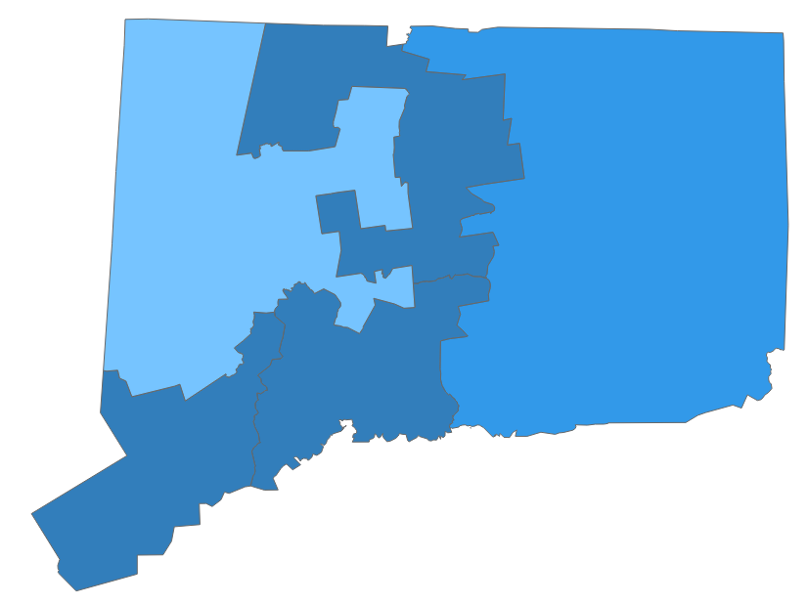
Connecticut primary dashboard
Primaries held August 9
POSITIONS ON THE BALLOT
KEY TAKEAWAYS
Federal and gubernatorial office only
Trump’s influence
Office | Seats | Incumbent party
House | 5 | 5 D
Senate | 1 | D
Governor | 1 | D
1
GOP national committee member Leora Levy (R), a strong opponent of gun restrictions and a pro-life advocate, won the Republican Senate primary after receiving a last-minute endorsement from former President Trump
Levy beat moderate Themis Klarides, with Democrats seeing this as an opportunity to pull votes from moderate Republicans and Republican-leaning independents who do not agree with more extreme GOP positions
Levy is set to face incumbent Sen. Richard Blumenthal (D-CT); Blumenthal is favored to win as the state has not elected a Republican Senator in nearly 30 years
STATE DISTRICT MAP
Partisan coloring based on Cook Political Report with Amy Walter Race Rating
2
GOP vs. Dem priorities in the governor race
Incumbent Gov. Ned Lamont (D) and GOP candidate Bob Stefanowski both ran uncontested in their primaries
Lamont has made his stance clear on gun control and abortion rights, while Stefanowski has indicated a focus towards tax policy, spending, and inflation
SOURCE Ballotpedia, The Cook Political Report with Amy Walter, Connecticut Public Radio, Connecticut Insider, Stamford Advocate
PRESENTATION CENTER 8/10/22
Notes:
Source:
“2022 House Race Ratings” The Cook Political Report with Amy Walter, updated June 20, 2022
https://www.cookpolitical.com/ratings/house-race-ratings
“United States congressional delegations from Colorado” Ballotpedia, accessed June 29, 2022
https://ballotpedia.org/United_States_congressional_delegations_from_Colorado
WSHU | By Ebong Udoma. (2022, August 11). Primary day signals connecticut GOP's shift toward trump. Connecticut Public. Retrieved August 11, 2022, from https://www.ctpublic.org/news/2022-08-11/primary-day-signals-connecticut-gops-shift-toward-trump
Bergman, J. (2022, August 10). Leora Levy wins U.S. Senate primary over Themis Klarides, set to challenge sen. Richard Blumenthal. CT Insider. Retrieved August 11, 2022, from https://www.ctinsider.com/news/article/Leora-Levy-claims-victory-in-U-S-Senate-primary-17363307.php?_ga=2.227695325.1731429541.1660228462-1612537735.1660228462
Brechlin, D. (2022, August 10). Connecticut primary election: Five takeaways after a whirlwind Tuesday night. StamfordAdvocate. Retrieved August 11, 2022, from https://www.stamfordadvocate.com/news/article/Connecticut-primary-election-Five-takeaways-17363853.php?t=250dca7904&src=sthppromostrip

Slide 18
Connecticut primary results
Seat | Republican Primary Winner | Democratic Primary Winner | Cook Rating
CT-Senate | Leora Levy (50.5%) | Richard Blumenthal* (Uncontested) | Solid D
CT-Governor | Bob Stefanowski (Uncontested) | Ned Lamont* (Uncontested) | Likely D
CT-1 | Larry Lazor (Uncontested) | John Larson* (Uncontested) | Solid D
CT-2 | Mike France (Uncontested) | Joe Courtney* (Uncontested) | Likely D
CT-3 | Lesley DeNardis (Uncontested) | Rosa DeLauro* (Uncontested) | Solid D
CT-4 | Jayme Stevenson (60.3%) | Jim Himes* (Uncontested) | Solid D
CT-5 | George Logan (Uncontested) | Jahana Hayes* (Uncontested) | Lean D
*Incumbent
SOURCE AP data as of 8/10/22
PRESENTATION CENTER 8/10/22
Notes:
Source:
"AP Elections API" last accessed August 10, 2022
https://developer.ap.org/ap-elections-api/

Slide 19
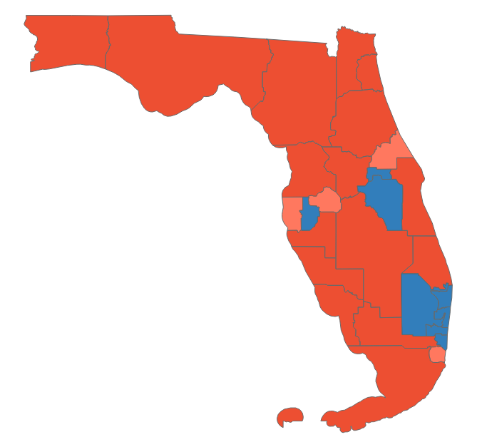
Florida primary dashboard
Primaries held August 23
POSITIONS ON THE BALLOT
KEY TAKEAWAYS
Federal and gubernatorial office only
Demings takes on Rubio
Office | Seats | Incumbent party
House | 28 | 11 D, 16 R
Senate | 1 | R
Governor | 1 | R
1
Rep. Val Demings (D-FL-10) will face incumbent Sen. Marco Rubio (R-FL) in a “Lean R” race, though some recent polls indicate Demings may have a slight edge
Demings has outraised Rubio thus far, a rare feat for a challenger taking on an incumbent senator and a reflection of analysts’ predictions that the race is one of Democrats’ best chances to pick up ground in the Senate
2
Governor race set
Democrats chose Rep. Charlie Crist (D-FL-13), Florida’s former Republican governor, to take on incumbent Gov. Ron DeSantis (R); Crist’s brand of politics reflects a Biden-esque moderation that Democrats hope will appeal to Independents over DeSantis’ firebrand image
DeSantis has raised more than any other non-self funded gubernatorial candidate in history
STATE DISTRICT MAP
Partisan coloring based on Cook Political Report with Amy Walter Race Rating
3
House leans Red
Florida’s new congressional map faced several legal challenges over partisan and minority vote dilution
Only four districts out of 28 are rated even mildly competitive in the general election, with all four rated “Likely R”
SOURCE The Cook Political Report with Amy Walter, ABC News, New York Times, CNN, BBC, NPR, Ballotpedia, Washington Post, Newsweek
PRESENTATION CENTER 8/24/22
Notes:
Sources:
“2022 House Ratings” Cook Political Report, August 2022. https://www.cookpolitical.com/ratings/house-race-ratings
Rick Cline, Averi Harper, Will McDuffie. “Center Holds for Democrats in Florida Primaries: The Note.” ABC News, August 24, 2022. https://abcnews.go.com/Politics/center-holds-democrats-florida-primaries-note/story?id=88751438
“Florida Primary Election Results.” New York Times, August 24, 2022. https://www.nytimes.com/interactive/2022/08/23/us/elections/results-florida.html
Gregory Krieg, Steve Contorno, Dan Merica. “Seven Takeaways from Primaries in Florida, New York, and Oklahoma Runoffs.” CNN, August 24, 2022. https://www.cnn.com/2022/08/23/politics/florida-new-york-oklahoma-election-takeaways/index.html
Jude Sheerin. “Charlie Crist: Florida Democrats Pick Challenger to Ron DeSantis.” BBC, August 24, 2022. https://www.bbc.com/news/world-us-canada-62655157
Andrew Stanton. “Val Demings Chances of Beating Marco Rubio, According to Polls. Newsweek, August 23, 2022. https://www.newsweek.com/val-demings-chances-beating-marco-rubio-according-polls-1736124
“The Senate Looks like A Jump Ball. Here are the 10 Seats that will Decide the Majority. NPR via All Things Considered, August 22, 2022. https://www.npr.org/2022/08/22/1118389494/top-10-us-senate-seats-pennsylvania-georgia-Arizona
“United States Congressional Delegations from Florida.” Ballotpedia, accessed August 24, 2022. https://ballotpedia.org/United_States_congressional_delegations_from_Florida
“2022 Florida Primary Elections Results.” Washington Post, accessed August 24, 2022. https://www.washingtonpost.com/elections/election-results/florida/2022-primaries/

Slide 20
Florida primary results (1/2)
Seat | Republican Primary Winner | Democratic Primary Winner | Cook Rating
FL-Senate | Marco Rubio* (Uncontested) | Val Demings (84.3%) | Lean R
FL-Governor | Ron DeSantis* (Uncontested) | Charlie Crist (59.7%) | Likely R
FL-1 | Matt Gaetz* (69.7%) | Rebekah Jones (62.5%) | Solid R
FL-2 | Neal Dunn* (Uncontested) | Al Lawson (Uncontested) | Solid R
FL-3 | Kat Cammack* (85.2%) | Danielle Hawk (67.6%) | Solid R
FL-4 | Aaron Bean (68.1%) | Not Yet Called | Solid R
FL-5 | John Rutherford* (65.7%) | No Candidate | Solid R
FL-6 | Michael Waltz* (77.4%) | No Candidate | Solid R
FL-7 | Cory Mills (33.8%) | Karen Green (44.9%) | Likely R
FL-8 | Bill Posey* (Uncontested) | Joanne Terry (54.7%) | Solid R
FL-9 | Scotty Moore (55.8%) | Darren Soto* (Uncontested) | Solid D
FL-10 | Calvin Wimbish (44.4%) | Maxwell Frost (34.7%) | Solid D
FL-11 | Daniel Webster* (51.1%) | Shante Munns (Uncontested) | Solid R
FL-12 | Gus Bilirakis* (79.7%) | Kimberly Walker (Uncontested) | Solid R
FL-13 | Anna Luna (44.5%) | Eric Lynn (Uncontested) | Likely R
*Incumbent
SOURCE AP data as of 8/29/22
PRESENTATION CENTER 8/29/22
Notes:
Source:
"AP Elections API" last accessed August 24, 2022
https://developer.ap.org/ap-elections-api/

Slide 21
Florida primary results (2/2)
Seat | Republican Primary Winner | Democratic Primary Winner | Cook Rating
FL-14 | James Judge (53.1%) | Kathy Castor* (90.4%) | Solid D
FL-15 | Laurel Lee (41.5%) | Alan Cohn (33.1%) | Likely R
FL-16 | Vern Buchanan* (86.2%) | Jan Schneider (Uncontested) | Solid R
FL-17 | Greg Steube* (Uncontested) | Andrea Kale (Uncontested) | Solid R
FL-18 | Scott Franklin* (73.1%) | No Candidate | Solid R
FL-19 | Byron Donalds* (83.7%) | Cindy Banyai (Uncontested) | Solid R
FL-20 | Drew-Montez Clark (Uncontested) | Sheila Cherfilus-McCormick* (65.6%) | Solid D
FL-21 | Brian Mast* (78.1%) | Corinna Balderramos Robinson (Uncontested) | Solid R
FL-22 | Not Yet Called | Lois Frankel* (Uncontested) | Solid D
FL-23 | Joe Budd (37.6%) | Jared Moskowitz (61.1%) | Solid D
FL-24 | Jesus Navarro (64.5%) | Frederica Wilson* (89.3%) | Solid D
FL-25 | Carla Spalding (71.6%) | Debbie Wasserman Schultz* (89.%) | Solid D
FL-26 | Mario Diaz-Balart* (84.3%) | Christine Olivo (Uncontested) | Solid R
FL-27 | Maria Elvira Salazar* (80.8%) | Annette Taddeo (67.8%) | Likely R
FL-28 | Carlos Gimenez* (73.4%) | Robert Asencio (69.3%) | Solid R
*Incumbent
SOURCE AP data as of 8/29/22
PRESENTATION CENTER 8/29/22
Notes:
Source:
"AP Elections API" last accessed August 24, 2022
https://developer.ap.org/ap-elections-api/

Slide 22
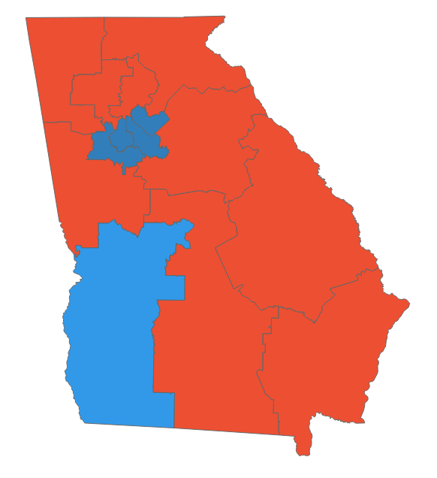
Georgia primary dashboard
Primaries held May 24, runoffs June 21
POSITIONS ON THE BALLOT
KEY TAKEAWAYS
Federal and gubernatorial office only
Office | Seats | Incumbent party
House | 14 | 6 D, 8 R
Senate | 1 | D
Governor | 1 | R
1
Defeat for Trump-endorsed candidates
Trump targeted incumbent Republicans who refused to cooperate with his election denial schemes
Gov. Brian Kemp, Secretary of State Brad Raffensperger, and Attorney General Chris Carr all handily defeated Trump-endorsed challengers
2
Stage set for a major senate battle
Herschel Walker (R) will face incumbent Sen. Raphael Warnock (D) two years after Warnock’s victory in a special election that sealed the Senate for Democrats
Walker emerged from a crowded primary field with help from a Trump endorsement and despite allegations of domestic violence
The toss up race will be one of the most expensive in 2022 and could decide control of the Senate
STATE DISTRICT MAP
Partisan coloring based on Cook Political Report with Amy Walter Race Rating
3
Two more Trump endorsements fall in runoffs
In two solidly Republican House districts, Trump-endorsed candidates qualified for runoffs but failed to advance
Trucking company owner Mike Collins thwarted former Democrat state lawmaker Vernon Jones
ER doctor Rich McCormick defeated attorney Jake Evans
SOURCE Politico, New York Times, The Cook Political Report with Amy Walter, Ballotpedia, The Hill
PRESENTATION CENTER 6/27/22
Notes:
Source:
By David Siders, Adam Wren and Ally Mutnick, “Trump Flops In Georgia: 5 Takeaways from A Big Primary Night,” Politico, May 25, 2022,
https://www.politico.com/news/2022/05/25/trump-georgia-five-takeaways-primary-2022-00035017
“AP Elections API”, Associated Press, Accessed May 25, 2022, https://developer.ap.org/ap-elections-api/
Jonathan Weisman, “Herschel Walker, backed by Trump, sails to the G.O.P. nomination in Georgia’s Senate race,” New York Times, May 24, 2022, https://www.nytimes.com/2022/05/24/us/politics/hershel-walker-georgia-senate.html
“2022 House Race Ratings” The Cook Political Report with Amy Walter, updated June 6, 2022
https://www.cookpolitical.com/ratings/house-race-ratings
Max Greenwood, “McCormick defeats Trump-backed Evans in Georgia GOP House primary,” The Hill, June 21, 2022,
https://thehill.com/homenews/campaign/3530514-mccormick-defeats-trump-backed-evans-in-georgia-gop-house-primary/
Maya King and Jazmine Ulloa, “Mike Collins beats the Trump-backed Vernon Jones in the G.O.P. runoff for a House seat in Georgia,” New York Times, June 21, 2022,
https://www.nytimes.com/2022/06/21/us/politics/mike-collins-gop-georgia.html

Slide 23
Georgia primary results (1/2)
Seat | Republican Primary Winner | Democratic Primary Winner | Cook Rating
GA-Senate | Herschel Walker (68.2%) | Raphael Warnock* (96.%) | Toss Up
GA-Governor | Brian Kemp* (73.7%) | Stacey Abrams (Uncontested) | Lean R
GA-Secretary of State | Brad Raffensperger* (52.3%) | Bee Nguyen (44.2%) | Not rated
GA-Attorney General | Chris Carr* (73.7%) | Jen Jordan (77.6%) | Not rated
GA-1 | Buddy Carter* (Uncontested) | Wade Herring (62%) | Solid R
GA-2 | Chris West (Runoff 51.3%) | Sanford Bishop* (93.5%) | Likely D
GA-3 | Drew Ferguson* (82.7%) | Val Almonord (Uncontested) | Solid R
GA-4 | Jonathan Chavez (78.3%) | Hank Johnson* (Uncontested) | Solid D
GA-5 | Christian Zimm (Uncontested) | Nikema Williams* (86.3%) | Solid D
GA-6 | Rich McCormick (Runoff 66.5%) | Bob Christian (55.5%) | Solid R
*Incumbent
SOURCE AP data as of 6/22/22
PRESENTATION CENTER 7/20/22
Notes:
Source:
"AP Elections API" last accessed June 22, 2022
https://developer.ap.org/ap-elections-api/

Slide 24
Georgia primary results (2/2)
Seat | Republican Primary Winner | Democratic Primary Winner | Cook Rating
GA-7 | Mark Gonsalves (70%) | Lucy McBath* (63.%) | Solid D
GA-8 | Austin Scott* (Uncontested) | Darrius Butler (Uncontested) | Solid R
GA-9 | Andrew Clyde* (76.4%) | Mike Ford (Uncontested) | Solid R
GA-10 | Mike Collins (Runoff 74.5%) | Tabitha Johnson-Green (Runoff 64.4%) | Solid R
GA-11 | Barry Loudermilk* (Uncontested) | Antonio Daza (Uncontested) | Solid R
GA-12 | Rick Allen* (Uncontested) | Elizabeth Johnson (Uncontested) | Solid R
GA-13 | Caesar Gonzales (57.4%) | David Scott* (65.8%) | Solid D
GA-14 | Marjorie Taylor Greene* (69.5%) | Marcus Flowers (74.7%) | Solid R
*Incumbent
SOURCE AP data as of 6/22/22
PRESENTATION CENTER 7/20/22
Notes:
Source:
"AP Elections API" last accessed June 22, 2022
https://developer.ap.org/ap-elections-api/

Slide 25
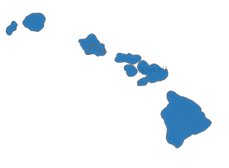
Hawaii primary dashboard
Primaries held August 13
POSITIONS ON THE BALLOT
KEY TAKEAWAYS
Federal and gubernatorial office only
Office | Seats | Incumbent party
House | 2 | 2 D
Senate | 1 | D
Governor | 1 | D
1
Governor race set
Lt. Gov. Josh Green (D) easily clinched the Democratic nomination, besting the state’s former first lady Vicky Cayetano and freshman US Rep. Kai Kahele (D-HI-2)
Green will face former Lt. Gov. Duke Aiona, with the former expected to win in November
2
Open seat in HI-02
Incumbent Rep. Kahele resigned to run for governor, leaving the rural Oahu and Neighbor Islands district open
The general election will feature former state Sen. Jill Tokuda (D) and former Air Force intelligence analyst Joe Akana (R); Tokuda, a progressive, overcame $1.2 million in outside spending against her and is supported by several congressional progressives
STATE DISTRICT MAP
Partisan coloring based on Cook Political Report with Amy Walter Race Rating
3
Solid Dem state
Hawaii has only elected Democrats to statewide and federal office since 2010 and the trend is expected to continue in 2022 with all races rated Solid D
While Democrats are almost certain to be elected in November, their policy positions and ideologies are diverse
SOURCE The Cook Political Report with Amy Walter, Ballotpedia, CBS, Roll Call, FiveThirtyEight
PRESENTATION CENTER 8/15/22
Notes:
Source:
“2022 House Race Ratings” The Cook Political Report with Amy Walter, updated June 6, 2022
https://www.cookpolitical.com/ratings/house-race-ratings
“United States congressional delegations from Hawaii” Ballotpedia, accessed August 15, 2022
https://ballotpedia.org/United_States_congressional_delegations_from_Hawaii
“David Ige” Ballotepdia, accessed August 15, 2022
https://ballotpedia.org/David_Ige
“Hawaii Lt. Gov. Josh Green wins Democratic primary for governor” CBS News, August 14, 2022
https://www.cbsnews.com/news/hawaii-primary-election-results-josh-green-brian-schatz-ed-case/
Mary Ellen McIntire and Herb Jackson. “Progressive Jill Tokuda nominated for Hawaii’s open 2nd District seat” Roll Call, August 14, 2022
https://rollcall.com/2022/08/14/progressive-jill-tokuda-nominated-for-hawaiis-open-2nd-district-seat/
Nathaniel Rakich. “What You Need To Know About Hawaii’s Primary” FiveThirtyEight, August 12, 2022
https://fivethirtyeight.com/features/everything-you-need-to-know-about-hawaiis-primary/

Slide 26
Hawaii primary results
Seat | Republican Primary Winner | Democratic Primary Winner | Cook Rating
HI-Senate | Bob McDermott (39.6%) | Brian Schatz* (93.6%) | Solid D
HI-Governor | Duke Aiona (49.6%) | Josh Green (62.9%) | Solid D
HI-1 | Conrad Kress (50.4%) | Ed Case* (83.2%) | Solid D
HI-2 | Joe Akana (83.9%) | Jill Tokuda (57.6%) | Solid D
*Incumbent
SOURCE AP data as of 8/15/22
PRESENTATION CENTER 8/15/22
Notes:
Source:
"AP Elections API" last accessed August 15, 2022
https://developer.ap.org/ap-elections-api/

Slide 27
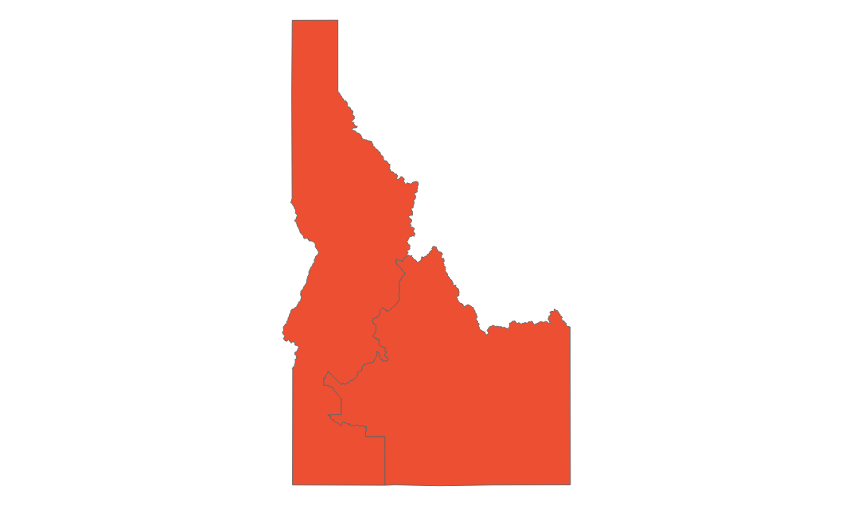
Idaho primary dashboard
Primaries held May 17
POSITIONS ON THE BALLOT
KEY TAKEAWAYS
Federal and gubernatorial office only
Office | Seats | Incumbent party
House | 2 | 2 R
Senate | 1 | R
Governor | 1 | R
1
Trump falls flat in governor race
Incumbent Gov. Brad Little (R) handily defeated a primary challenge from his own Lt. Gov. Janice McGeachin (R), who was endorsed by Trump
Little is one of only two sitting Republican governors Trump has opposed in the midterms
2
Labrador’s return to elected office
Incumbent AG Lawrence Wadsen (R) was ousted by former Rep. Raúl Labrador (R-ID), who helped found the House Freedom Caucus
Wadsen did not join some other Republican AGs in attempting to invalidate the 2020 election results
STATE DISTRICT MAP
Partisan coloring based on Cook Political Report with Amy Walter Race Rating
3
Simpson survives
12-term Rep. Mike Simpson (R-ID-2) won the GOP nomination against challenger Bryan Smith (R)
Ad spending in the race reached nearly $2 million, with Smith and the America Proud PAC accusing Simpson of being “liberal” and “anti-Trump”
SOURCE AP, Politico, NY Times, Idaho Statesman, The Cook Political Report with Amy Walter
PRESENTATION CENTER 6/14/22
Notes:
Source:
Jill Covin and Nicholas Riccardi. “Takeaways: Election denier wins, bad behavior dooms Cawthorn” AP News, May 18, 2022
https://apnews.com/article/2022-midterm-elections-may-17-takeaways-a56c76245e03bc88745e7286b524c92c
“Idaho Primary Election Results” NY Times, accessed May 18, 2022
https://www.nytimes.com/interactive/2022/05/17/us/elections/results-idaho.html
Kevin Fixler. “AP: Idaho Rep. Mike Simpson, Sen. Mike Crapo defend seats, win Republican primaries” Idaho Statesman, May 18, 2022
https://www.idahostatesman.com/news/politics-government/election/article261500077.html#storylink=cpy
Zach Montellaro and Ximena Bustillo. “Idaho GOP riven by primary civil war” Politico, May 7, 2022
https://www.politico.com/news/2022/05/07/idaho-gop-primary-elections-00030788

Slide 28
Idaho primary results
Seat | Republican Primary Winner | Democratic Primary Winner | Cook Rating
ID-Senate | Mike Crapo* (67.1%) | David Roth (57.8%) | Solid R
ID-Governor | Brad Little* (52.8%) | Stephen Heidt (Uncontested) | Solid R
ID-1 | Russ Fulcher* (Uncontested) | Kaylee Peterson (Uncontested) | Solid R
ID-2 | Mike Simpson* (54.6%) | Wendy Norman (Uncontested) | Solid R
*Incumbent
SOURCE AP data as of 5/18/22
PRESENTATION CENTER 7/20/22
Notes:
Source:
"AP Elections API" last accessed May 18, 2022
https://developer.ap.org/ap-elections-api/

Slide 29
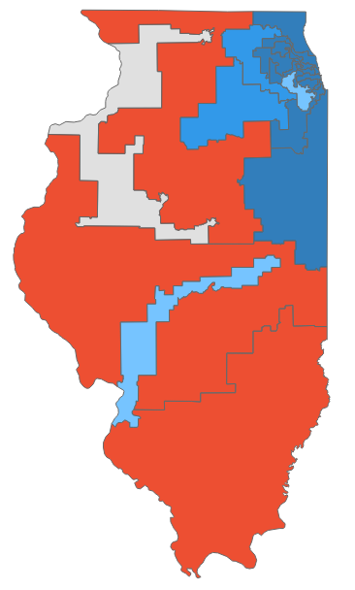
Illinois primary dashboard
Primaries held June 28
POSITIONS ON THE BALLOT
KEY TAKEAWAYS
Federal and gubernatorial office only
Office | Seats | Incumbent party
House | 17 | 13 D, 5 R
Senate | 1 | D
Governor | 1 | D
1
Dem meddling in governor’s race pays off
Democrats deployed an expensive and risky strategy to elevate the campaign of Trump-endorsed Darren Bailey (R) over the more moderate Aurora Mayor Richard Irvin (R)
Irvin would have been a more competitive candidate against incumbent Gov. J.B. Pritzker (D); Pritzker will now face Bailey in November after the latter’s resounding victory over Irvin
2
Casten defeats Newman in Dem. primary
Redistricting drew incumbent Reps. Sean Casten (D-IL-6) and Marie Newman (D-IL-3) into the same 6th CD; Newman currently faces an ethics probe
Casten beat progressive freshman Newman, despite the new district containing more of Newman’s constituents
STATE DISTRICT MAP
Partisan coloring based on Cook Political Report with Amy Walter Race Rating
3
Miller bests Davis in GOP primary
Rep. Mary Miller (R-IL-15) bested Rep. Rodney Davis (R-IL-13) in the new 15th CD which became much more Republican—a disadvantage to the more moderate Davis
Miller was backed by Trump while Davis had supported efforts to create an independent commission to investigate the Jan 6. Capitol riot
SOURCE AP, Ballotpedia, The Cook Political Report with Amy Walter, CNN, New York Times, NBC, Washington Post
PRESENTATION CENTER 6/29/22
Notes:
Source:
“2022 House Race Ratings” The Cook Political Report with Amy Walter, updated June 29, 2022
https://www.cookpolitical.com/ratings/house-race-ratings
“United States congressional delegations from Illinois” Ballotpedia, accessed June 29, 2022
https://ballotpedia.org/United_States_congressional_delegations_from_Illinois
"AP Elections API" last accessed June 29, 2022
https://developer.ap.org/ap-elections-api/
Amber Phillips. “6 takeaways from elections in Illinois, Colorado, Oklahoma and other states” Washington Post, June 29, 2022
https://www.washingtonpost.com/politics/2022/06/29/illinois-colorado-primaries-takeaways/
Eric Bradner. “5 takeaways from Tuesday's elections in Colorado, Illinois and more” CNN, June 29, 2022
https://www.cnn.com/2022/06/29/politics/illinois-colorado-utah-ny-election-takeaways/index.html
Reid J. Epstein. “Five Takeaways From Tuesday’s Elections” NY Times, June 29, 2022
https://www.nytimes.com/2022/06/29/us/politics/elections-takeaways-results-primaries.html
Alan Smith and Natasha Korecki. “Trump-backed Rep. Mary Miller defeats Rep. Rodney Davis in new Illinois district” NBC, June 29, 2022
https://www.nbcnews.com/politics/2022-election/mary-miller-defeats-rodney-davis-illinois-rcna35575

Slide 30
Illinois primary results (1/2)
Seat | Republican Primary Winner | Democratic Primary Winner | Cook Rating
IL-Senate | Kathy Salvi (30.2%) | Tammy Duckworth* (Uncontested) | Solid D
IL-Governor | Darren Bailey (57.7%) | JB Pritzker (91.8%) | Solid D
IL-1 | Eric Carlson (40.5%) | Jonathan Jackson (28.1%) | Solid D
IL-2 | Thomas Lynch (37.2%) | Robin Kelly* (Uncontested) | Solid D
IL-3 | Justin Burau (Uncontested) | Delia Ramirez (65.6%) | Solid D
IL-4 | James Falakos (Uncontested) | Chuy Garcia* (Uncontested) | Solid D
IL-5 | Tommy Hanson (55.4%) | Mike Quigley* (Uncontested) | Solid D
IL-6 | Keith Pekau (38.8%) | Sean Casten* (68.1%) | Lean D
IL-7 | No Candidate | Danny Davis* (52.1%) | Solid D
IL-8 | Chris Dargis (31.9%) | Raja Krishnamoorthi* (70.5%) | Solid D
IL-9 | Maxwell Rice (Uncontested) | Janice Schakowsky* (Uncontested) | Solid D
*Incumbent
SOURCE AP data as of 6/29/22
PRESENTATION CENTER 7/20/22
Notes:
Source:
"AP Elections API" last accessed June 29, 2022
https://developer.ap.org/ap-elections-api/

Slide 31
Illinois primary results (2/2)
Seat | Republican Primary Winner | Democratic Primary Winner | Cook Rating
IL-10 | Joseph Severino (Uncontested) | Brad Schneider* (Uncontested) | Solid D
IL-11 | Catalina Lauf (31.%) | Bill Foster* (Uncontested) | Likely D
IL-12 | Mike Bost* (Uncontested) | Homer Markel (56.8%) | Solid R
IL-13 | Regan Deering (34.7%) | Nikki Budzinski (75.8%) | Lean D
IL-14 | Scott Gryder (30.9%) | Lauren Underwood* (Uncontested) | Likely D
IL-15 | Mary Miller* (57.6%) | Paul Lange (Uncontested) | Solid R
IL-16 | Darin LaHood (66.3%) | No Candidate | Solid R
IL-17 | Esther Joy King (68.7%) | Eric Sorensen (37.8%) | Toss Up
*Incumbent
SOURCE AP data as of 6/29/22
PRESENTATION CENTER 7/20/22
Notes:
Source:
"AP Elections API" last accessed June 29, 2022
https://developer.ap.org/ap-elections-api/

Slide 32
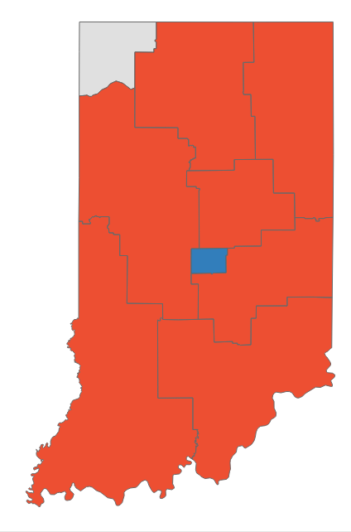
Indiana primary dashboard
Primaries held May 3
POSITIONS ON THE BALLOT
KEY TAKEAWAYS
Federal and gubernatorial office only
Office | Seats | Incumbent party
House | 9 | 2 D, 7 R
Senate | 1 | R
Governor | 0 | -
1
Trump’s influence
All six Republican candidates endorsed by former President Trump won their House primaries
This includes sitting Rep. Greg Pence (R-IN-6), brother of former Vice President Mike Pence, who defeated James Alspach (R) in the House primary
Rep. Pence was the only Trump-endorsed candidate in the Indiana primaries to run opposed
2
Redrawn districts
STATE DISTRICT MAP
Indiana’s 1st and 9th Congressional districts were redrawn by the GOP in 2020
Sitting House Rep. Frank Mrvan (D) will face Jennifer-Ruth Green (R), an Air Force Veteran looking to turn the Biden-leaning 1st district red
The open GOP candidacy for the 9th district that was expanded to the Ohio border was secured by Erin Houchin (R) with 37% of votes
Partisan coloring based on Cook Political Report with Amy Walter Race Rating
SOURCE CNN, FiveThirtyEight, Politico, NBC, Washington Post, Cook Political Report with Amy Walter, Ballotpedia, New York Times
PRESENTATION CENTER 6/14/22
Notes:
Source:
Chowdhury, M., Macaya, M., Lee, J. M., & Hayes, M. (2022, May 4). CNN projection: Greg Pence, the trump-endorsed brother of Mike Pence, fends off GOP Primary Challenge. CNN, Retrieved May 4, 2022
https://www.cnn.com/politics/live-news/ohio-indiana-primary-elections-results-2022/h_12ccc3e9c175916bd57b550b6bda249b?tab=Indiana
Fivethirtyeight. (2022, May 4). What went down during Ohio's and Indiana's primary elections. FiveThirtyEight,. Retrieved May 4, 2022
https://fivethirtyeight.com/live-blog/ohio-indiana-primary-election/
Here are the trump-backed candidates who won Tuesday's primaries. POLITICO. (n.d.). Retrieved May 4, 2022
https://www.politico.com/news/2022/05/04/trump-backed-candidates-that-won-ohio-indiana-primaries-00029645
NBCUniversal News Group. (2022, May 4). Indiana Senate Primary Election Live Results 2022. NBC News, Retrieved May 4, 2022
https://www.nbcnews.com/politics/2022-primary-elections/indiana-senate-results
The Washington Post. (2022, May 4). 2022 Indiana primaries. The Washington Post, Retrieved May 4, 2022
https://www.washingtonpost.com/elections/election-results/indiana/2022-primaries/
“2022 House Race Ratings” The Cook Political Report with Amy Walter, updated June 6, 2022
https://www.cookpolitical.com/ratings/house-race-ratings

Slide 33
Indiana primary results
Seat | Republican Primary Winner | Democratic Primary Winner | Cook Rating
IN-Senate | Todd Young* (Uncontested) | Thomas McDermott (Uncontested) | Solid R
IN-1 | Jennifer-Ruth Green (47.1%) | Frank J. Mrvan* (86.4%) | Toss Up
IN-2 | Jackie Walorski* (Uncontested) | Paul Steury (Uncontested) | Solid R
IN-3 | Jim Banks* (Uncontested) | Gary Snyder (56.2%) | Solid R
IN-4 | Jim Baird* (Uncontested) | Roger Day (68.2%) | Solid R
IN-5 | Victoria Spartz* (Uncontested) | Jeannine Lake (60.%) | Solid R
IN-6 | Greg Pence* (77.6%) | Cynthia Wirth (73.1%) | Solid R
IN-7 | Angela Grabovsky (53.6%) | Andre Carson* (93.9%) | Solid D
IN-8 | Larry Bucshon* (Uncontested) | Ray McCormick (68.6%) | Solid R
IN-9 | Erin Houchin (37.3%) | Matthew Fyfe (56.8%) | Solid R
*Incumbent
SOURCE AP data as of 5/5/22
PRESENTATION CENTER 7/20/22
Notes:
Source:
"AP Elections API" last accessed May 5, 2022
https://developer.ap.org/ap-elections-api/

Slide 34
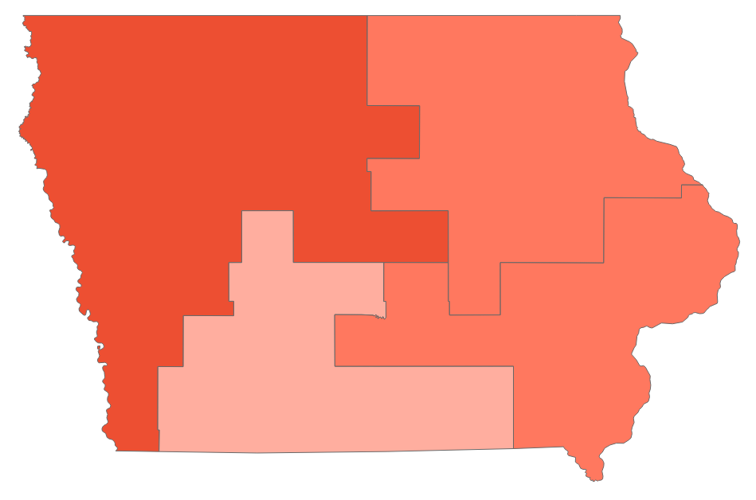
Iowa primary dashboard
Primaries held June 7
POSITIONS ON THE BALLOT
KEY TAKEAWAYS
Federal and gubernatorial office only
Office | Seats | Incumbent party
House | 4 | 1 D, 3 R
Senate | 1 | R
Governor | 1 | R
1
Washington insider fails to advance
Despite high-profile endorsements and a fundraising advantage of close to one million dollars, former US Rep. Abby Finkenauer lost to retired US Navy Vice Admiral Michael Franken in the Democratic Senate primary
Franken goes on to face long-time incumbent Sen. Chuck Grassley (R) in a race that is anticipated to be an easy Republican victory
2
Candidates set for a redistricting toss-up
STATE DISTRICT MAP
Incumbent Rep. Cindy Axne (D-IA-3) faces tough re-election prospects after redistricting added 5,000 Republican voters to her district
Former State Sen. Zach Nunn (R) won the opportunity to challenge Axne with support of the NRCC in a target district for Republicans
Partisan coloring based on Cook Political Report with Amy Walter Race Rating
SOURCE AP data as of 6/9/22, Ballotpedia, ABC, The Cook Political Report with Amy Walter
PRESENTATION CENTER 6/14/22
Notes:
Source:
“2022 House Race Ratings” The Cook Political Report with Amy Walter, updated June 6, 2022
https://www.cookpolitical.com/ratings/house-race-ratings
Brittany Shepard, “Key Takeaways from the June 7 Primaries,” ABC News, June 8, 2022,
https://abcnews.go.com/Politics/key-takeaways-jan-primaries/story?id=85166628
”United States Congressional Delegations from Iowa,” Ballotpedia, Accessed June 9, 2022,
https://ballotpedia.org/United_States_congressional_delegations_from_Iowa
“AP Elections API”, Associated Press, Accessed June 9, 2022, https://developer.ap.org/ap-elections-api/

Slide 35
Iowa primary results
Seat | Republican Primary Winner | Democratic Primary Winner | Cook Rating
IA-Senate | Chuck Grassley* (73.5%) | Michael Franken (55.2%) | Solid R
IA-Governor | Kim Reynolds* (Uncontested) | Deidre DeJear (Uncontested) | Solid R
IA-1 | Mariannette Miller-Meeks* (Uncontested) | Christina Bohannan (Uncontested) | Likely R
IA-2 | Ashley Hinson* (Uncontested) | Liz Mathis (Uncontested) | Likely R
IA-3 | Zach Nunn (65.9%) | Cindy Axne* (Uncontested) | Lean R
IA-4 | Randy Feenstra* (Uncontested) | Ryan Melton (Uncontested) | Solid R
*Incumbent
SOURCE AP data as of 6/8/22
PRESENTATION CENTER 7/20/22
Notes:
Source:
"AP Elections API" last accessed June 8, 2022
https://developer.ap.org/ap-elections-api/

Slide 36
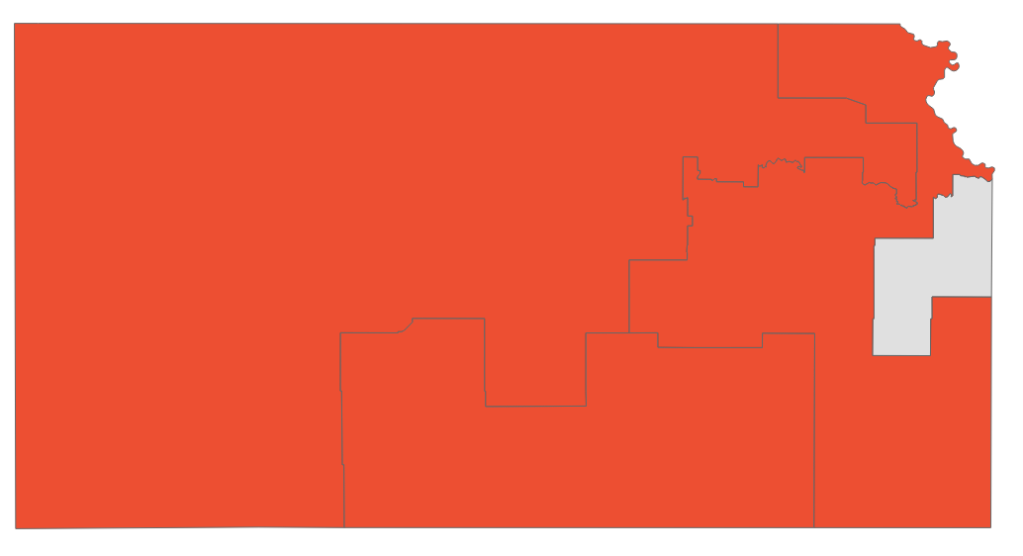
Kansas primary dashboard
Primaries held August 2
POSITIONS ON THE BALLOT
KEY TAKEAWAYS
Federal and gubernatorial office only
Office | Seats | Incumbent party
House | 4 | 1 D, 3 R
Senate | 1 | R
Governor | 1 | D-
1
Constituents vote to keep abortion rights
Many states surrounding Kansas implemented abortion bans following the reversal of Roe v. Wade, leaving left state a safe haven for abortion supporters. Opponents of abortion rights moved to put a measure on the ballot that, if passed, would have established a near total ban on abortions
Nearly 58% of voters rejected the measure
Democratic turnout was estimated to be up by more than 60%, playing a crucial hand in defeating the measure
STATE DISTRICT MAP
2
Incumbent strength
Partisan coloring based on Cook Political Report with Amy Walter Race Rating
Governor Laura Kelly won the Democratic primary in a landslide victory against opponent Richard Karnowski (D)
She will face the winner of the GOP primary, Attorney General Derek Schmidt (R), who is endorsed by former President Trump
SOURCE Ballotpedia, The Cook Political Report with Amy Walter, WaPo, NPR
PRESENTATION CENTER 8/3/22
Notes:
Source:
2022 House Race Ratings” The Cook Political Report with Amy Walter, updated June 6, 2022
https://www.cookpolitical.com/ratings/house-race-ratings
”United States Congressional Delegations from Iowa,” Ballotpedia, Accessed August 3, 2022
https://ballotpedia.org/United_States_congressional_delegations_from_Kansas
“Gov. Laura Kelly and Kansas AG Derek Schmidt to face one another in November” NPR, KQED
https://www.npr.org/sections/2022-live-primary-election-race-results/2022/08/02/1115323825/kansas-governor-primary-results-kelly-schmidt-democrat-republican
Amber Phillpis, “How Kansas became a bellwether for abortion rights” The Washington Post, August 3, 2022
https://www.washingtonpost.com/politics/2022/08/01/kansas-abortion-vote-ballot-initiative/
Amber Phillips, “Takeaways from primaries in Kansas, Michigan, Missouri and Arizona” The Washington Post, August 3, 2022
https://www.washingtonpost.com/politics/2022/08/03/takeaways-primaries-kansas-arizona/

Slide 37
Kansas primary results
Seat | Republican Primary | Democratic Primary | Cook Rating
KS-Senate | Jerry Moran* (80.5%) | Mark Holland (38.%) | Solid R
KS-Governor | Derek Schmidt (80.6%) | Laura Kelly* (93.8%) | Toss Up
KS-1 | Tracey Mann* (Uncontested) | James Beard (Uncontested) | Solid R
KS-2 | Jake LaTurner* (Uncontested) | Patrick Schmidt (Uncontested) | Solid R
KS-3 | Amanda Adkins (77.3%) | Sharice Davids* (Uncontested) | Toss Up
KS-4 | Ron Estes* (Uncontested) | Bob Hernandez (Uncontested) | Solid R
*Incumbent
SOURCE AP data as of 8/3/22
PRESENTATION CENTER 8/3/22
Notes:
Source:
"AP Elections API" last accessed August 3, 2022
https://developer.ap.org/ap-elections-api/

Slide 38
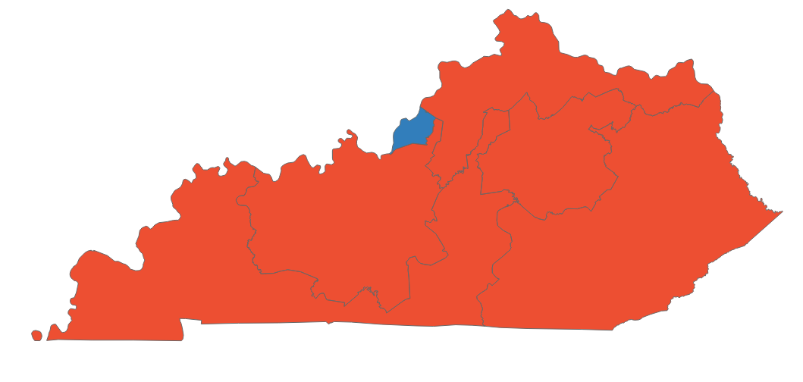
Kentucky primary dashboard
Primaries held May 17
POSITIONS ON THE BALLOT
KEY TAKEAWAYS
Federal and gubernatorial office only
Office | Seats | Incumbent party
House | 6 | 1 D, 5 R
Senate | 1 | R
Governor | 0 | -
1
Five Trump-backed candidates advance
Trump-backed incumbent Rep. James Comer won the 1st Congressional District primary in an uncontested race
Trump-endorsed incumbent Reps. Brett Guthrie (R-KY-2), Thomas Massie (R-KY-4), Harold Rogers (R-KY-5), and Andy Barr (R-KY-6) will go on to face Democrat challengers in November
2
Sen. Rand Paul defends his seat
STATE DISTRICT MAP
Sitting Sen. Rand Paul (R-KY) won the nomination to seek his third term and will face former State Rep. Charles Booker (D) in the general election
Partisan coloring based on Cook Political Report with Amy Walter Race Rating
SOURCE CNN, New York Times, Ballotpedia
PRESENTATION CENTER 6/14/22
Notes:
Source:
The New York Times. (2022, May 24). Kentucky Primary Election Results. The New York Times. Retrieved June 16, 2022, from https://www.nytimes.com/interactive/2022/05/17/us/elections/results-kentucky.html
Cable News Network. (n.d.). Kentucky Democratic and Republican primary election results and maps 2022 | CNN politics. CNN. Retrieved June 16, 2022, from https://www.cnn.com/election/2022/results/kentucky/primaries
2022 House Race Ratings” The Cook Political Report with Amy Walter, updated June 6, 2022
https://www.cookpolitical.com/ratings/house-race-ratings
”United States Congressional Delegations from Iowa,” Ballotpedia, Accessed June 9, 2022,
https://ballotpedia.org/United_States_congressional_delegations_from_Iowa

Slide 39
Kentucky primary results
Seat | Republican Primary Winner | Democratic Primary Winner | Cook Rating
KY-Senate | Rand Paul* (86.3%) | Charles Booker (73.2%) | Solid R
KY-1 | James Comer* (Uncontested) | Jimmy Ausbrooks (Uncontested) | Solid R
KY-2 | Brett Guthrie* (78.1%) | Hank Linderman (58.2%) | Solid R
KY-3 | Morgan McGarvey (63.3%) | Morgan McGarvey (63.3%) | Solid D
KY-4 | Thomas Massie* (75.2%) | Matthew Lehman (Uncontested) | Solid R
KY-5 | Harold Rogers* (82.6%) | Conor Halbleib (Uncontested) | Solid R
KY-6 | Andy Barr* (87.8%) | Geoffrey Young (51.7%) | Solid R
*Incumbent
SOURCE AP data as of 5/18/22
PRESENTATION CENTER 7/20/22
Notes:
Source:
"AP Elections API" last accessed May 18, 2022
https://developer.ap.org/ap-elections-api/

Slide 40
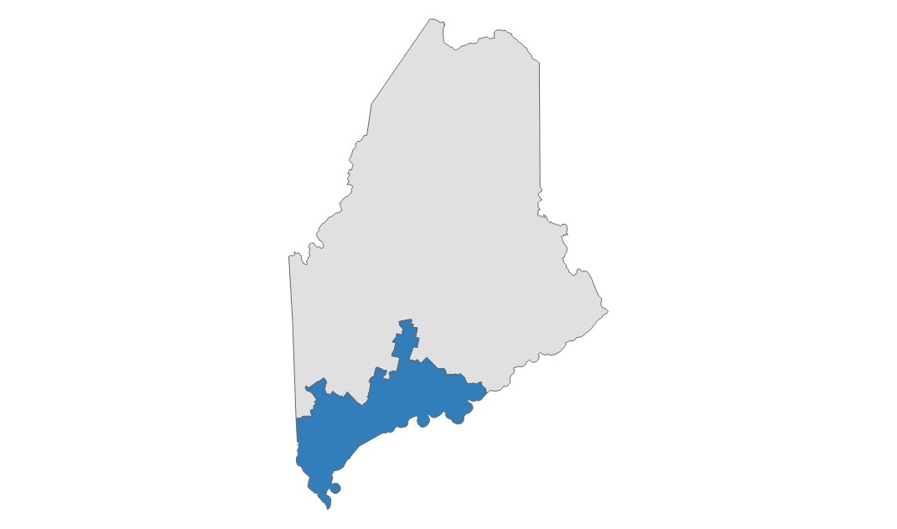
Maine primary dashboard
Primaries held June 14
POSITIONS ON THE BALLOT
KEY TAKEAWAYS
Federal and gubernatorial office only
Office | Seats | Incumbent party
House | 2 | 2 D
Senate | 0 | -
Governor | 1 | D
1
2020 rematch set
In Maine’s only contested federal primary, former Rep. Bruce Poliquin (R) won the opportunity to take back his seat from Rep. Jared Golden (D-ME-2)
Poliquin tapped connections from his experience in the House, including Congressional Leadership Fund support, to try to return to a seat he held from 2015 through 2019
2
Governor’s race preview
Both gubernatorial candidates, incumbent Gov. Janet Mills (D) and former Gov. Paul LePage (R), ran unopposed in their parties’ primaries
Candidates are focusing on state budget issues and Mills’ actions to this point in the COVID-19 pandemic
June filings showed Mills had more than twice the campaign cash of LePage, but polls indicate a tight race
STATE DISTRICT MAP
Partisan coloring based on Cook Political Report with Amy Walter Race Rating
SOURCE Bangor Daily News, Ballotpedia, Vox, The Cook Political Report with Amy Walter
PRESENTATION CENTER 6/16/22
Notes:
Sources:
Li Shou and Christian Paz, “4 Winners and 2 Losers from the Maine, Nevada, North Dakota, and South Carolina Primaries,” Vox, Jun 15, 2022,
https://www.vox.com/23168730/winners-losers-june-14-primaries-maine-nevada-north-dakota-south-Carolina
Associated Press, “A Look at Maine’s Primary Elections,” Bangor Daily News, June 14, 2022,
https://bangordailynews.com/2022/06/14/politics/a-look-at-maines-primary-elections/
Jessica Piper, “Janet Mills Raises Twice as Much as Paul LePage for 2022 Showdown,” Bangor Daily News, June 3, 2022,
https://bangordailynews.com/2022/06/03/politics/janet-mills-paul-lepage-primary-funding/
“United States Congressional Delegations from Maine,” Ballotpedia, accessed June 15, 2022,
https://ballotpedia.org/United_States_congressional_delegations_from_Maine
“2022 House Race Ratings” The Cook Political Report with Amy Walter, updated June 8, 2022
https://www.cookpolitical.com/ratings/house-race-ratings

Slide 41
Maine primary results
Seat | Republican Primary Winner | Democratic Primary Winner | Cook Rating
ME-Governor | Paul LePage (Uncontested) | Janet Mills* (Uncontested) | Lean D
ME-1 | Edwin Thelander (Uncontested) | Chellie Pingree* (Uncontested) | Solid D
ME-2 | Bruce Poliquin (60.4%) | Jared Golden* (Uncontested) | Toss Up
*Incumbent
SOURCE AP data as of 6/15/22
PRESENTATION CENTER 7/20/22
Notes:
Source:
"AP Elections API" last accessed June 15, 2022
https://developer.ap.org/ap-elections-api/

Slide 42
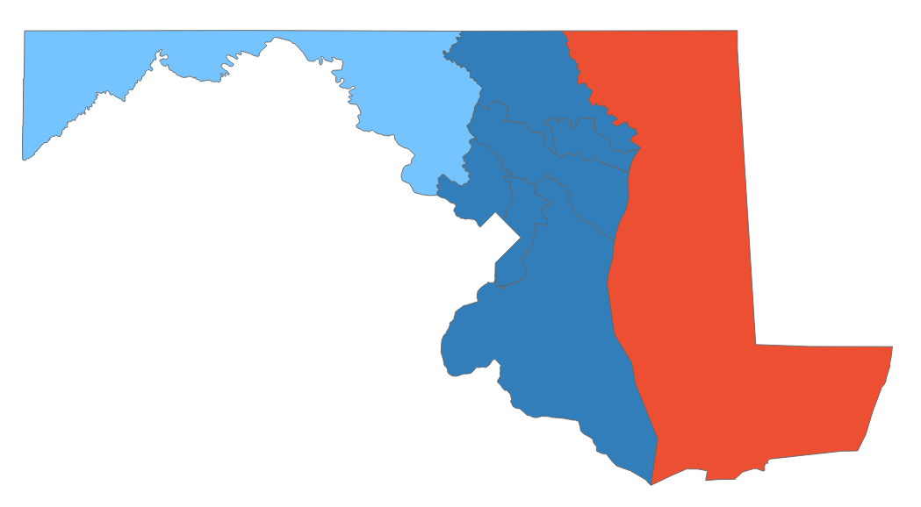
Maryland primary dashboard
Primaries held July 19
POSITIONS ON THE BALLOT
KEY TAKEAWAYS
Federal and gubernatorial office only
Office | Seats | Incumbent party
House | 8 | 7 D, 1 R
Senate | 1 | D
Governor | 1 | D
1
Trump wins in the Governor’s race
Trump endorsed candidate state lawmaker Dan Cox defeated former state Commerce Secretary Kelly Schulz for the GOP gubernatorial primary; Schulz was backed by Gov. Larry Hogan (R), an outspoken Trump critic
Cox received significant funding from Democrats who view him as a weaker candidate. He will face likely face either author Wes Moore or National Committee Chair Tom Perez in November
2
Open seat in the Democratic 4th CD
STATE DISTRICT MAP
Former prosecutor Glenn Ivey (D) received 51.2% of the vote to beat former congresswoman Donna Edwards (D) Ivey was endorsed by a super PAC in association with the American-Israel Public Affairs Committee, which spent close to $6 million on his race
Partisan coloring based on Cook Political Report with Amy Walter Race Rating
3
Van Hollen secures Dem. Senate primary
Sen. Chris Van Hollen (D-MD) anticipates a second term in the Senate as Democrats outnumber the GOP two to one in Maryland; the state has not elected a GOP senator in three decades
SOURCE AP data as of 7/20/22, Ballotpedia, The Cook Political Report with Amy Walter, Washington Post, The Hill, CNN, New York Times
PRESENTATION CENTER 7/20/22
Notes:
Sources:
Eric Bradner and Shania Shelton, “CNN projects Trump-backed Dan Cox will win GOP gubernatorial primary in Maryland” CNN, July 20, 2022
https://www.cnn.com/2022/07/19/politics/maryland-primary-election/index.html
Julia Manchester and Brandon Conradis, “Early takeaways from the Maryland primaries” July 20, 2022
https://thehill.com/homenews/campaign/3566855-early-takeaways-from-the-maryland-primaries/
Meagan Flynn, “Ivey defeats Edwards in bitter, high-profile Md. primary for House” Washington Post, Washington Post, July 20, 2022
https://www.washingtonpost.com/dc-md-va/2022/07/19/edwards-maryland-primary-elections-congress/
Max Greenwood, “Five races to watch in Maryland’s primaries” The Hill, July 19, 2022
https://thehill.com/homenews/campaign/3564884-five-races-to-watch-in-marylands-primaries/
“United States Congressional Delegations from Maryland,” Ballotpedia, accessed July 19, 2022,
https://ballotpedia.org/United_States_congressional_delegations_from_Maryland
“2022 House Race Ratings” The Cook Political Report with Amy Walter, updated July 19, 2022
https://www.cookpolitical.com/ratings/house-race-ratings

Slide 43
Maryland primary results
Seat | Republican Primary Winner | Democratic Primary Winner | Cook Rating
MD-Senate | Chris Chaffee (20.8%) | Chris Van Hollen* (80.8%) | Solid D
MD-Governor | Dan Cox (52.%) | Wes Moore (32.4%) | Solid D
MD-1 | Andy Harris* (Uncontested) | Heather Mizeur (68.8%) | Solid R
MD-2 | Nicolee Ambrose (32.3%) | Dutch Ruppersberger* (75.5%) | Solid D
MD-3 | Yuripzy Morgan (33.6%) | John Sarbanes* (84.6%) | Solid D
MD-4 | Jeff Warner (58.7%) | Glenn Ivey (51.8%) | Solid D
MD-5 | Chris Palombi (67.5%) | Steny Hoyer* (71.3%) | Solid D
MD-6 | Neil Parrott (62.6%) | David Trone* (79.%) | Lean D
MD-7 | Scott Collier (34.6%) | Kweisi Mfume* (85.2%) | Solid D
MD-8 | Gregory Coll (83.6%) | Jamie Raskin* (93.9%) | Solid D
*Incumbent
SOURCE AP data as of 8/29/22
PRESENTATION CENTER 8/29/22
Notes:
Source:
"AP Elections API" last accessed July 22, 2022
https://developer.ap.org/ap-elections-api/

Slide 44
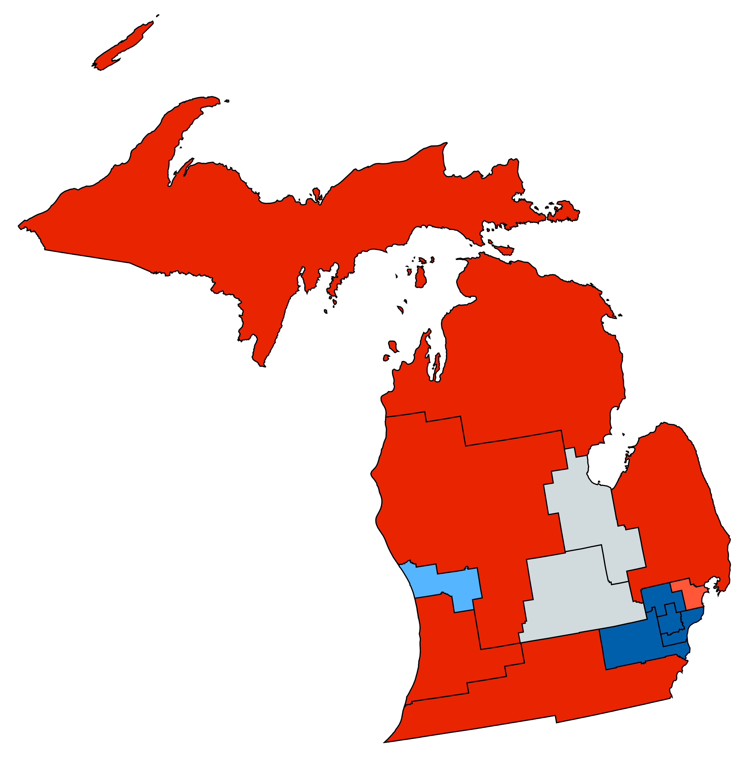
Michigan primary dashboard
Primaries held August 2
POSITIONS ON THE BALLOT
KEY TAKEAWAYS
Federal and gubernatorial office only
Office | Seats | Incumbent party
House | 13 | 7 D, 7 R
Senate | 0 | -
Governor | 1 | D
1
Trump’s influence
Rep. Peter Meijer (R-03), who voted to impeach former President Trump after the Jan. 6 Capitol riots, lost his primary to Trump-backed Candidate John Gibbs (R); Gibbs will face Hillary Scholten (D) in November
Democrats financially supported Gibbs’ campaign as part of a broader attempt to elect more extreme GOP candidates to boost Democrats’ chances of winning in November
The newly drawn congressional map has renewed Democratic hopes of winning the traditionally GOP leaning district
Conservative media personality Tudor Dixon, who also received a Trump endorsement, won her primary and will face incumbent Gov. Gretchen Whitmer (D) in November
STATE DISTRICT MAP
Partisan coloring based on Cook Political Report with Amy Walter Race Rating
2
Mixed bag for progressive Democrats
The new congressional map pit two sitting Democrats against each other, with moderate Rep. Haley Stevens (D-MI-11) defeating progressive Rep. Andy Levin (D-MI-9
Progressive Rep. Rashida Tlaib (D-MI-12) easily defeated three others in the Democratic primary and will be face Marine veteran Steven Elliot (R) in November
SOURCE AP data as of 8/3/22, Ballotpedia, The Cook Political Report with Amy Walter, NPR, Vox, Bridge Michigan, NBC News, Michigan Live
PRESENTATION CENTER 8/3/22
Notes:
Source:
“2022 House Race Ratings” The Cook Political Report with Amy Walter, updated June 6, 2022
https://www.cookpolitical.com/ratings/house-race-ratings
“United States congressional delegations from Michigan” Ballotpedia, accessed August 3, 2022
https://ballotpedia.org/United_States_congressional_delegations_from_Mississippi
Zhou, L., & Jennings, N. (2022, August 3). 4 winners and 1 loser from the Kansas, Missouri, Arizona, and Michigan primaries. Vox. Retrieved August 3, 2022, from https://www.vox.com/policy-and-politics/2022/8/3/23289752/kansas-arizona-michigan-missouri-and-washington-primaries
Michigan primary takeaways: Big night for trump, Bad night for black democrats. Bridge Michigan. (n.d.). Retrieved August 3, 2022, from https://www.bridgemi.com/michigan-government/michigan-primary-takeaways-big-night-trump-bad-night-black-democrats
NBCUniversal News Group. (2022, July 30). Trump endorses Tudor Dixon in Michigan governor's race. NBCNews.com. Retrieved August 3, 2022, from https://www.nbcnews.com/politics/2022-election/trump-endorses-tudor-dixon-michigan-governors-race-rcna39914
jhermani@mlive.com, J. H. |. (2022, August 3). Tlaib wins Mi-12′s Democratic Congressional Primary, AP projects. mlive. Retrieved August 3, 2022, from https://www.mlive.com/politics/2022/08/tlaib-wins-mi-12s-democratic-congressional-primary-ap-projects.html

Slide 45
Michigan primary results
Seat | Republican Primary Winner | Democratic Primary Winner | Cook Rating
MI-Governor | Tudor Dixon (40.6%) | Gretchen Whitmer* (Uncontested) | Lean D
MI-1 | Jack Bergman* (Uncontested) | Bob Lorinser (Uncontested) | Solid R
MI-2 | John Moolenaar* (65.2%) | Jerry Hilliard (Uncontested) | Solid R
MI-3 | John Gibbs (51.8%) | Hillary Scholten (Uncontested) | Lean D
MI-4 | Bill Huizenga* (Uncontested) | No Candidate | Solid R
MI-5 | Tim Walberg* (67.2%) | Bart Goldberg (Uncontested) | Solid R
MI-6 | Whittney Williams (53.7%) | Debbie Dingell* (Uncontested) | Solid D
MI-7 | Tom Barrett (Uncontested) | Elissa Slotkin* (Uncontested) | Toss Up
MI-8 | Paul Junge (53.7%) | Daniel Kildee* (Uncontested) | Toss Up
MI-9 | Lisa McClain* (78.7%) | Brian Jaye (Uncontested) | Solid R
MI-10 | John James (86.3%) | Carl Marlinga (47.8%) | Likely R
MI-11 | Mark Ambrose (70.5%) | Haley Stevens* (59.9%) | Solid D
MI-12 | Steven Elliott (52.9%) | Rashida Tlaib* (63.8%) | Solid D
MI-13 | Martell Bivings (Uncontested) | Shri Thanedar (28.3%) | Solid D
*Incumbent
SOURCE AP data as of 8/3/22
PRESENTATION CENTER 8/3/22
Notes:
Source:
"AP Elections API" last accessed August 3, 2022
https://developer.ap.org/ap-elections-api/

Slide 46
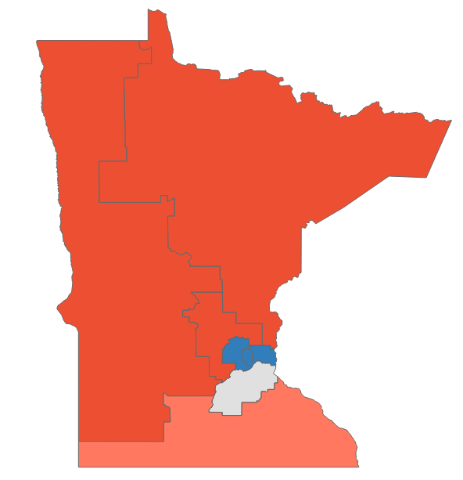
Minnesota primary dashboard
Primaries held August 9
POSITIONS ON THE BALLOT
KEY TAKEAWAYS
Federal and gubernatorial office only
Office | Seats | Incumbent party
House | 8 | 4 D, 4 R
Senate | 0 | -
Governor | 1 | D
1
Progressive v. moderate Dems. in the 5th CD
Sitting Rep. Ilhan Omar (D-MN-5), a staunch progressive Democrat, narrowly defeated her challengers in the primary for Minnesota’s 5th CD
Her challenger, Don Samuels (D), focused on pro-policing initiatives and increasing funding for police which seemingly closed the gap in a race most considered a “long-shot”
The closeness of this race has renewed moderate Dems’ hopes of winning the seat in 2024
Rep. Omar will face Cicely Davis (R) in November
STATE DISTRICT MAP
Partisan coloring based on Cook Political Report with Amy Walter Race Rating
SOURCE AP data as of 8/10/22, Ballotpedia, The Cook Political Report with Amy Walter, CNN, The Hill
PRESENTATION CENTER 8/10/22
Notes:
Source:
“2022 House Race Ratings” The Cook Political Report with Amy Walter, updated June 6, 2022
https://www.cookpolitical.com/ratings/house-race-ratings
“United States congressional delegations from Minnesota” Ballotpedia, accessed August 10, 2022
https://ballotpedia.org/United_States_congressional_delegations_from_Minnesota
Bradner, E. (2022, August 10). Omar survives surprising nail-biter to win Democratic nomination for Minnesota's 5th Congressional District, CNN projects | CNN politics. CNN. Retrieved August 10, 2022, from https://www.cnn.com/2022/08/09/politics/ilhan-omar-democratic-nomination-minnesota-5th-congressional-district/index.html
Manchester, J. (2022, August 10). Five takeaways from primaries in Wisconsin, Minnesota and beyond. The Hill. Retrieved August 10, 2022, from https://thehill.com/homenews/campaign/3595329-five-takeaways-from-primaries-in-wisconsin-minnesota-and-beyond/

Slide 47
Minnesota primary results
Seat | Republican Primary Winner | Democratic Primary Winner | Cook Rating
MN-Governor | Scott Jensen (89.3%) | Tim Walz* (96.5%) | Likely D
MN-1 | Brad Finstad (76.%) | Jeff Ettinger (92.1%) | Likely R
MN-2 | Tyler Kistner (Uncontested) | Angie Craig* (Uncontested) | Toss Up
MN-3 | Tom Weiler (Uncontested) | Dean Phillips* (Uncontested) | Solid D
MN-4 | May Lor Xiong (44.1%) | Betty McCollum* (83.4%) | Solid D
MN-5 | Cicely Davis (48%) | Ilhan Omar* (50.3%) | Solid D
MN-6 | Tom Emmer* (Uncontested) | Jeanne Hendricks (Uncontested) | Solid R
MN-7 | Michelle Fischbach* (Uncontested) | Jill Abahsain (59.%) | Solid R
MN-8 | Pete Stauber* (91.%) | Jen Schultz (86.1%) | Solid R
*Incumbent
SOURCE AP data as of 8/10/22
PRESENTATION CENTER 8/10/22
Notes:
Source:
"AP Elections API" last accessed August 10, 2022
https://developer.ap.org/ap-elections-api/

Slide 48
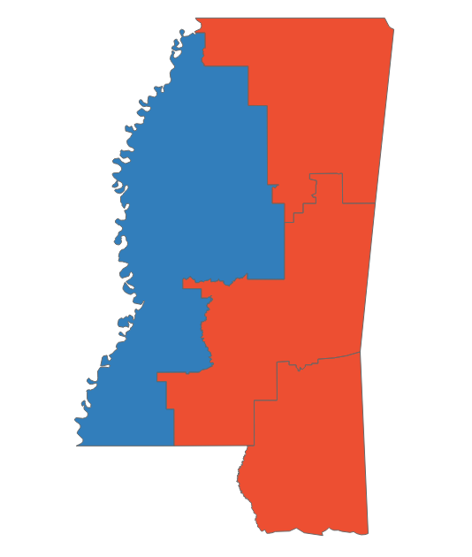
Mississippi primary dashboard
Primaries held June 7, runoffs June 28
POSITIONS ON THE BALLOT
KEY TAKEAWAYS
Federal and gubernatorial office only
Office | Seats | Incumbent party
House | 4 | 1 D, 3 R
Senate | 0 | -
Governor | 0 | -
1
Runoff in the 3rd CD
Incumbent Rep. Michael Guest faced a tough primary after voting to establish a congressional committee investing the Jan 6 capital attacks
Opposing GOP candidate Michael Cassidy slightly beat Guest in the primary, focusing his campaign on the idea of Guest not being conservative enough
However, both candidates received less than 50% of the vote, forcing a runoff
On June 28, Guest clinched the GOP nomination after receiving 67.3% of the vote
STATE DISTRICT MAP
2
Incumbent struggles
Partisan coloring based on Cook Political Report with Amy Walter Race Rating
Rep. Steven Palazzo (R-MS-4) went into a runoff election against Sheriff Mike Ezell after receiving just 32% of the GOP vote
Palazzo’s lowered vote rate has been attributed to fighting off challenges from alleged accounts of misused funds
Ezell ultimately beat Palazzo in the runoff, earning 53.6% of the vote
SOURCE AP data as of 6/29/22, Ballotpedia, The Cook Political Report with Amy Walter, Washington Post, Anchorage Daily News
PRESENTATION CENTER 6/29/22
Notes:
Source:
Colby Itkowitz, “GOP Miss. congressman faces run-off over support for Jan. 6 commission” The Washington Post, June 8, 2022
https://www.washingtonpost.com/politics/2022/06/08/gop-miss-congressman-faces-run-off-over-support-jan-6-commission/
Aaron Blake, “Six takeaways from primaries in California, Mississippi and other states” Anchorage Daily News, June 8, 2022
https://www.adn.com/nation-world/2022/06/08/six-takeaways-from-primaries-in-california-mississippi-and-other-states/
“2022 House Race Ratings” The Cook Political Report with Amy Walter, updated June 6, 2022
https://www.cookpolitical.com/ratings/house-race-ratings
“United States congressional delegations from Mississippi” Ballotpedia, accessed June 9, 2022
https://ballotpedia.org/United_States_congressional_delegations_from_Mississippi
"AP Elections API" last accessed June 9, 2022
https://developer.ap.org/ap-elections-api/
Mississippi Primary Runoff Election Results, accessed June 28, 2022
https://www.nytimes.com/interactive/2022/06/28/us/elections/results-mississippi-runoff.html

Slide 49
Mississippi primary results
Seat | Republican Primary Winner | Democratic Primary Winner | Cook Rating
MS-1 | Trent Kelly* (89.8%) | Dianne Black (79.1%) | Solid R
MS-2 | Brian Flowers (58%) | Bennie Thompson* (96.3%) | Solid D
MS-3 | Michael Guest* (67.3%) | Shuwaski Young (Uncontested) | Solid R
MS-4 | Mike Ezell (53.6%) | Johnny DuPree (84.9%) | Solid R
*Incumbent
SOURCE AP data as of 6/29/22
PRESENTATION CENTER 7/20/22
Notes:
Source:
"AP Elections API" last accessed June 29, 2022
https://developer.ap.org/ap-elections-api/

Slide 50
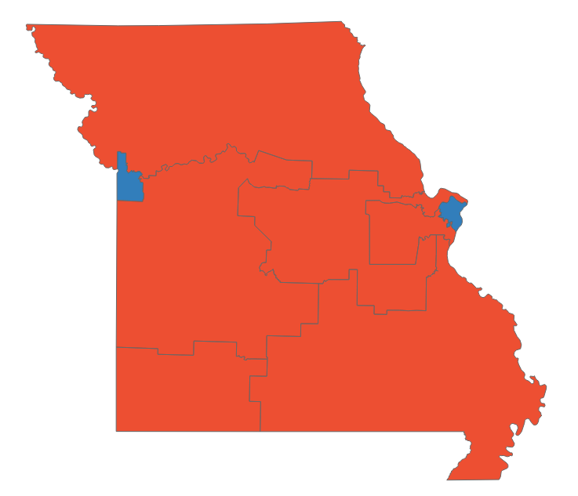
Missouri primary dashboard
Primaries held August 2
POSITIONS ON THE BALLOT
KEY TAKEAWAYS
Federal and gubernatorial office only
Office | Seats | Incumbent party
House | 8 | 2 D, 6 R
Senate | 1 | R
Governor | 0 | -
1
Former front-runner loses Senate primary
Attorney General Eric Schmitt (R) prevailed over current US Rep. Vicky Hartzler and former Missouri governor Eric Greitens (R), who was formerly the front-runner until allegations of his sexual misconduct and child abuse were publicized
A less controversial candidate, Schmitt will face off against Trudy Busch Valentine (D) in the November general election
2
Fundraising upset
STATE DISTRICT MAP
Despite raising significantly less than her nearest competitor Lucas Kunce, Busch Valentine narrowly won the Democratic Senate primary due to name recognition and key endorsements, including from Rep. Emanuel Cleaver (D-MO-5)
The heiress to the Busch beer fortune faces an uphill battle AG Schmitt in a solidly Republican state
Partisan coloring based on Cook Political Report with Amy Walter Race Rating
SOURCE AP data as of 6/29/22, Ballotpedia, WaPo, River Front Times
PRESENTATION CENTER 8/3/22
Notes:
Source:
“2022 House Race Ratings” The Cook Political Report with Amy Walter, updated June 6, 2022
https://www.cookpolitical.com/ratings/house-race-ratings
“United States congressional delegations from Missouri” Ballotpedia, accessed August 3, 2022
https://ballotpedia.org/United_States_congressional_delegations_from_Missouri
Amber Phillips, “Takeaways from primaries in Kansas, Michigan, Missouri and Arizona” Washington Post, August 3, 2022
https://www.washingtonpost.com/politics/2022/08/03/takeaways-primaries-kansas-arizona/
Rosalind Early. “Trudy Busch Valentine Ekes Out Victory in Democratic Primary for U.S. Senate” River Front Times, August 2, 2022
https://www.riverfronttimes.com/news/trudy-busch-valentine-ekes-out-victory-in-democratic-primary-for-us-senate-38220133

Slide 51
Missouri primary results
Seat | Republican Primary Winner | Democratic Primary Winner | Cook Rating
MO-Senate | Eric Schmitt (45.7%) | Trudy Busch Valentine (43.2%) | Solid R
MO-1 | Andrew Jones (42.4%) | Cori Bush* (69.5%) | Solid D
MO-2 | Ann Wagner* (67.1%) | Trish Gunby (85.2%) | Solid R
MO-3 | Blaine Luetkemeyer* (69.6%) | Bethany Mann (62.3%) | Solid R
MO-4 | Mark Alford (35%) | Jack Truman* (Uncontested) | Solid R
MO-5 | Jacob Turk (51.8%) | Emanuel Cleaver* (85.6%) | Solid D
MO-6 | Sam Graves* (76%) | Henry Martin (46.2%) | Solid R
MO-7 | Eric Burlison (38.2%) | Kristen Radaker-Sheafer (63.3%) | Solid R
MO-8 | Jason Smith* (82.0%) | Randi McCallian (uncontested) | Solid R
*Incumbent
SOURCE AP data as of 8/3/22
PRESENTATION CENTER 8/3/22
Notes:
Source:
"AP Elections API" last accessed August 3, 2022
https://developer.ap.org/ap-elections-api/

Slide 52
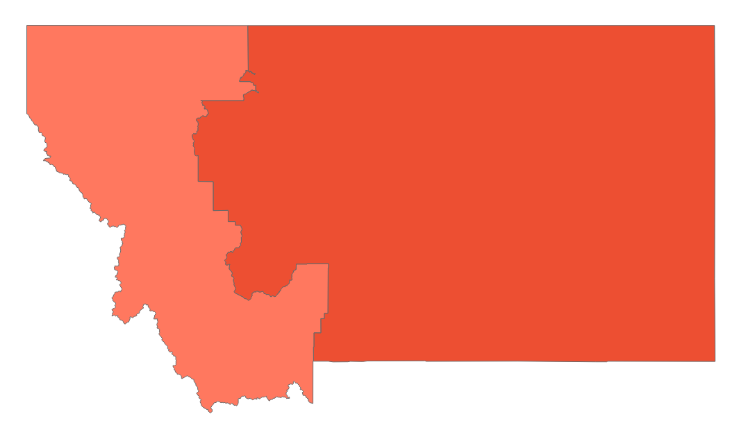
Montana primary dashboard
Primaries held June 7
POSITIONS ON THE BALLOT
KEY TAKEAWAYS
Federal and gubernatorial office only
Office | Seats | Incumbent party
House | 2 | 1 R
Senate | 0 | -
Governor | 0 | -
1
A second seat
Redistricting took Montana from one congressional seat to two. While both districts lean Republican, the first district is slightly more competitive
Monica Tranel, a former attorney on the Montana Public Service Commission, won the Democratic contest for the new House seat while former Interior Secretary Ryan Zinke took the GOP nomination
2
Challengers defeated
STATE DISTRICT MAP
Incumbent Rep. Matt Rosendale (R-MT-1) fended off three challengers in the Republican contest for Montana’s second congressional seat. He will face Democratic primary winner Penny Ronning, a former Billings City Councilwoman, in the solidly Republican district
Partisan coloring based on Cook Political Report with Amy Walter Race Rating
SOURCE FiveThirtyEight, NPR, NBCMontana, Montana Free Press, Ballotpedia, The Cook Political Report with Amy Walter
PRESENTATION CENTER 6/14/22
Notes:
Sources:
Eric Dietrich / Montana Free Press. “Monica Tranel – 2022 Montana Election Guide.” Monica Tranel | 2022 Montana election guide, June 3, 2022. https://apps.montanafreepress.org/election-guide-2022/monica-tranel.
Eric Dietrich / Montana Free Press. “Penny Ronning – 2022 Montana Election Guide.” Penny Ronning | 2022 Montana election guide, June 3, 2022. https://apps.montanafreepress.org/election-guide-2022/penny-ronning.
“Here Are the Key Primary Election Results from Montana.” NPR. NPR, June 7, 2022. https://www.npr.org/2022/06/07/1102193554/montana-primary-election-results.
Press, The Associated. “Incumbent Rosendale Wins Republican House Primary.” KECI. KECI, June 8, 2022. https://nbcmontana.com/news/local/incumbent-rosendale-wins-republican-house-primary.
Ryanabest. “What Redistricting Looks like in Every State - Montana.” FiveThirtyEight, June 7, 2022. https://projects.fivethirtyeight.com/redistricting-2022-maps/montana/.
“Montana Primary Election Results.” The New York Times. The New York Times, June 8, 2022. https://www.nytimes.com/interactive/2022/06/07/us/elections/results-montana.html.
“United States Congressional Delegations from Montana.” Ballotpedia. Accessed June 8, 2022. https://ballotpedia.org/United_States_congressional_delegations_from_Montana.
Wendy Underhill, Dan Diorio. State primary election types. Accessed June 8, 2022. https://www.ncsl.org/research/elections-and-campaigns/primary-types.aspx.

Slide 53
Montana primary results
Seat | Republican Primary Winner | Democratic Primary Winner | Cook Rating
MT-1 | Ryan Zinke (41.7%) | Monica Tranel (64.9%) | Likely R
MT-2 | Matt Rosendale* (75.7%) | Penny Ronning (58.5%) | Solid R
*Incumbent
SOURCE AP data as of 6/8/22
PRESENTATION CENTER 7/20/22
Notes:
Source:
"AP Elections API" last accessed June 8, 2022
https://developer.ap.org/ap-elections-api/

Slide 54

Nebraska primary dashboard
Primaries held May 10
POSITIONS ON THE BALLOT
KEY TAKEAWAYS
Federal and gubernatorial office only
Office | Seats | Incumbent party
House | 2 | 2 R
Senate | 0 | -
Governor | 1 | R
1
Trump loss
Nebraska’s governor race pitted scandal-ridden Trump endorsed candidate Charles Herbster against term-limited Gov. Pete Rickett’s (R) candidate of choice, University of Nebraska Regent Jim Pillen
Pillen won the nomination, making Herbster the first Trump-backed candidate to lose a primary
2
Urban-rural divide
The urban-rural divide between Democrats and Republicans has long been apparent, but there is also a divide within the Republican party, with moderate candidates receiving more support in urban centers
STATE DISTRICT MAP
Partisan coloring based on Cook Political Report with Amy Walter Race Rating
3
Fortenberry’s vacancy
Former Rep. Jeff Fortenberry's (R-NE-1) name remained on the ballot despite his resignation following felony convictions for lying to the FBI
State Sen. Mike Flood easily won the GOP primary, carried by endorsements from Gov. Pete Ricketts (R) and former Gov. Dave Heineman (R)
SOURCE CNN, NPR, NY Times, WaPo, Cook Political Report with Amy Walter, Ballotpedia
PRESENTATION CENTER 6/14/22
Notes:
Source:
Elena Moore. “3 primary contests to watch Tuesday in West Virginia and Nebraska” NPR, May 10, 2022
https://www.npr.org/2022/05/10/1097731791/west-virginia-nebraska-republican-races-to-watch
Maureen Chowdhury, Meg Wagner, JiMin Lee and Melissa Macaya. “West Virginia and Nebraska 2022 primary elections” CNN, May 10, 2022
https://www.cnn.com/politics/live-news/primary-election-results-west-virginia-nebraska-2022/index.html
Shane Goldmacher. “4 Takeaways From Tuesday’s Primaries in Nebraska and West Virginia” NY Times, May 11, 2022
https://www.nytimes.com/2022/05/11/us/politics/takeaways-nebraska-west-virginia-primary.html
Amber Phillips. “Takeaways from West Virginia and Nebraska GOP primaries” Washington Post, May 11, 2022
https://www.washingtonpost.com/politics/2022/05/11/west-virginia-nebraska-republicans/

Slide 55
Nebraska primary results
Seat | Republican Primary Winner | Democratic Primary Winner | Cook Rating
NE-Governor | Jim Pillen (33.9%) | Carol Blood (88.7%) | Solid R
NE-1 | Mike Flood (73.9%) | Patty Pansing Brooks (86.7%) | Solid R
NE-2 | Don Bacon* (77.2%) | Tony Vargas (68.7%) | Toss Up
NE-3 | Adrian Smith* (76.%) | David Else (52.2%) | Solid R
*Incumbent
SOURCE AP data as of 5/11/22
PRESENTATION CENTER 7/20/22
Notes:
Source:
"AP Elections API" last accessed May 11, 2022
https://developer.ap.org/ap-elections-api/

Slide 56
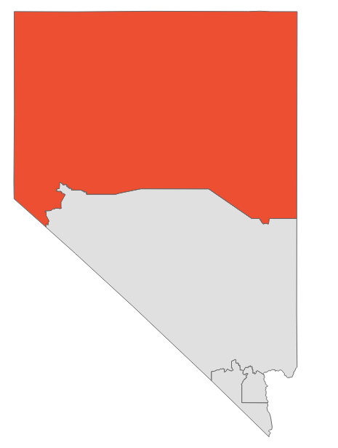
Nevada primary dashboard
Primaries held June 14
POSITIONS ON THE BALLOT
KEY TAKEAWAYS
Federal and gubernatorial office only
Office | Seats | Incumbent party
House | 4 | 3 D, 1 R
Senate | 1 | D
Governor | 1 | D
1
Election deniers win
Former state AG Adam Laxalt easily won the GOP nomination for Senate; Laxalt was endorsed by Trump and tried to overturn the 2020 election results in the state
Jim Marchant, an election denier, clinched the GOP nomination for secretary of state and is now one step closer to serving as the state’s chief elections officer
Rep. Steven Horsford (D-NV-4) will either face a candidate who was at the Jan. 6 riot or one who is skeptical of the legitimacy of the 2020 election
STATE DISTRICT MAP
2
Governor’s race set
Partisan coloring based on Cook Political Report with Amy Walter Race Rating
Clark County Sheriff Joe Lombardo bested a field of 14 other candidates to win the Republican nomination; Lombardo was endorsed by Trump
Incumbent Gov. Steve Sisolak (D) is vulnerable to a GOP challenge, with recent polls showing him and Lombardo neck and neck
Sisolak does have a significantly higher approval rating than President Biden, at 51%
SOURCE NY Times, Washington Post, NBC, Morning Consult, LA Times, Ballotpedia, The Cook Political Report with Amy Walter
PRESENTATION CENTER 6/16/22
Notes:
Sources:
“2022 House Race Ratings” The Cook Political Report with Amy Walter, updated June 8, 2022
https://www.cookpolitical.com/ratings/house-race-ratings
“Secretary of State (state executive office)” Ballotpedia, accessed June 15, 2022
https://ballotpedia.org/Secretary_of_State_(state_executive_office)#Election-related_duties
Katie Glueck. “5 Takeaways From Tuesday’s Voting” NY Times, June 15, 2022
https://www.nytimes.com/2022/06/15/us/politics/south-carolina-nevada-primary-mayra-flores.html
“Nevada Primary Election Results” NY Times, accessed June 15, 2022
https://www.nytimes.com/interactive/2022/06/14/us/elections/results-nevada.html
Aaron Blake. “4 takeaways from the elections in Texas, South Carolina and Nevada” Washington Post, June 15, 2022
https://www.washingtonpost.com/politics/2022/06/15/june-14-primary-takeaways/
“Most Governors Facing Re-Election This Year Are Quite Popular” Morning Consult, April 28, 2022
https://morningconsult.com/2022/04/28/governor-approval-ratings-2022-election/
Adam Edelman. “Joe Lombardo wins Nevada GOP primary for governor, will challenge Sisolak” NBC, June 15, 2022
https://www.nbcnews.com/politics/2022-election/joe-lombardo-wins-nevada-republican-primary-governor-rcna33606
Melanie Mason. “Nevada election denier wins primary, will compete to run state elections” LA Times, June 14, 2022

Slide 57
Nevada primary results
Seat | Republican Primary Winner | Democratic Primary Winner | Cook Rating
NV-Senate | Adam Laxalt (55.7%) | Catherine Cortez Masto* (90.8%) | Toss Up
NV-Governor | Joe Lombardo (38.3%) | Steve Sisolak* (89.3%) | Toss Up
NV-1 | Mark Robertson (30.1%) | Dina Titus* (81.5%) | Toss Up
NV-2 | Mark Amodei* (54.7%) | Elizabeth Krause (48.6%) | Solid R
NV-3 | April Becker (65.%) | Susie Lee* (89.6%) | Toss Up
NV-4 | Sam Peters (48.%) | Steven Horsford* (Uncontested) | Toss Up
*Incumbent
SOURCE AP data as of 6/15/22
PRESENTATION CENTER 7/20/22
Notes:
Source:
"AP Elections API" last accessed June 15, 2022
https://developer.ap.org/ap-elections-api/

Slide 58
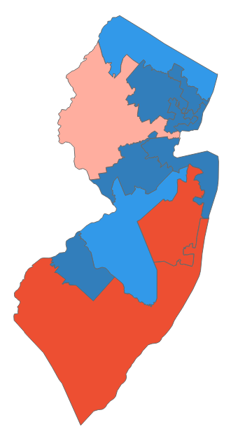
New Jersey primary dashboard
Primaries held June 7
POSITIONS ON THE BALLOT
KEY TAKEAWAYS
Federal and gubernatorial office only
Office | Seats | Incumbent party
House | 12 | 10 D, 2 R
Senate | 0 | -
Governor | 0 | -
1
5th Congressional District
Incumbent Rep. Josh Gottheimer (D) won the Democratic primary in an uncontested race
In the Republican primary, four candidates competed for the chance to take on Gottheimer in November
Candidate Frank Pallotta, who ran against Gottheimer in 2020 and lost, ultimately won the nomination with 50.3% of the vote
2
Move to the center
STATE DISTRICT MAP
Thomas Kean Jr. (R), son of former NJ Governor Tom Kean (R), won the 7th CD’s GOP primary and will face incumbent Rep. Tom Malinowski (D) in a 2020 rematch
Rob Menendez Jr. (D), son of sitting Sen. Robert Menendez (D-NJ), beat out two other candidates and will face Marcos Arroyo (R) in November for the 8th district seat
Partisan coloring based on Cook Political Report with Amy Walter Race Rating
SOURCE AP data as of 6/8/22, Ballotpedia, The Cook Political Report with Amy Walter, New York Times, Washington Post
PRESENTATION CENTER 6/14/22
Notes:
Sources:
The New York Times. (2022, June 8). New Jersey Fifth congressional district primary election results. The New York Times. Retrieved June 8, 2022, from https://www.nytimes.com/interactive/2022/06/07/us/elections/results-new-jersey-us-house-district-5.html
The Washington Post. (2022, June 8). 2022 New Jersey primary elections results. The Washington Post. Retrieved June 8, 2022, from https://www.washingtonpost.com/elections/election-results/new-jersey/2022-primaries//
“2022 House Race Ratings” The Cook Political Report with Amy Walter, updated June 6, 2022
https://www.cookpolitical.com/ratings/house-race-ratings
“United States congressional delegations from New Jersey” Ballotpedia, accessed June 7, 2022
https://ballotpedia.org/United_States_congressional_delegations_from_New_Jersey

Slide 59
New Jersey primary results
Seat | Republican Primary Winner | Democratic Primary Winner | Cook Rating
NJ-1 | Claire Gustafson (68.8%) | Donald Norcross* (77.3%) | Solid D
NJ-2 | Jeff Van Drew* (86.1%) | Tim Alexander (62.%) | Solid R
NJ-3 | Bob Healey (52.8%) | Andy Kim* (92.9%) | Likely D
NJ-4 | Christopher Smith* (57.6%) | Matthew Jenkins (Uncontested) | Solid R
NJ-5 | Frank Pallotta (50.3%) | Josh Gottheimer* (Uncontested) | Likely D
NJ-6 | Susan Kiley (57.%) | Frank Pallone* (Uncontested) | Solid D
NJ-7 | Thomas Kean Jr. (45.6%) | Tom Malinowski* (94.4%) | Lean R
NJ-8 | Marcos Arroyo (Uncontested) | Robert Menendez (83.6%) | Solid D
NJ-9 | Billy Prempeh (Uncontested) | Bill Pascrell* (Uncontested) | Solid D
NJ-10 | David Pinckney (82.6%) | Donald Payne Jr.* (83.7%) | Solid D
NJ-11 | Paul DeGroot (39.4%) | Mikie Sherrill* (Uncontested) | Solid D
NJ-12 | Darius Mayfield (Uncontested) | Bonnie Watson Coleman* (Uncontested) | Solid D
*Incumbent
SOURCE AP data as of 6/8/22
PRESENTATION CENTER 7/20/22
Notes:
Source:
"AP Elections API" last accessed June 8, 2022
https://developer.ap.org/ap-elections-api/

Slide 60
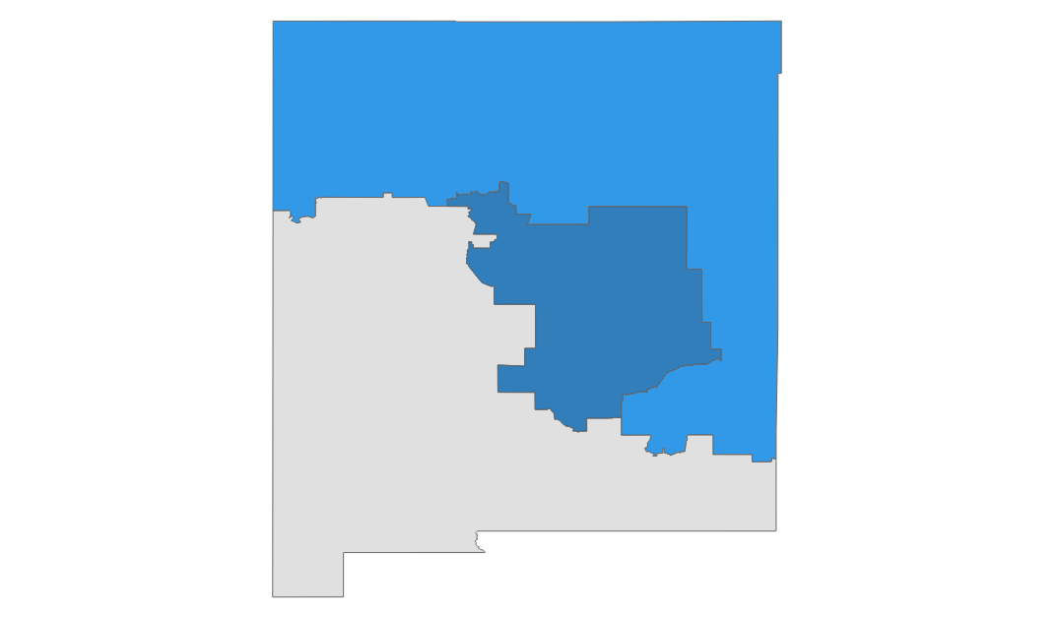
New Mexico primary dashboard
Primaries held June 7
POSITIONS ON THE BALLOT
KEY TAKEAWAYS
Federal and gubernatorial office only
Office | Seats | Incumbent party
House | 3 | 2 D, 1 R
Senate | 0 | -
Governor | 1 | D
1
A vulnerable Democrat governor
Although New Mexico voted for Biden over Trump by 11 points in 2020, lukewarm polling for incumbent Gov. Michelle Lujan Grisham (D) led to a crowded Republican primary
Low midterm turnout for Democrats could leave the governor’s mansion vulnerable; the Cook Political Report rates the matchup as Likely Democrat
2
Redistricting bites
A Democrat-drawn map shifted incumbent Representative Yvette Herrell’s (R-NM-2) district from R+14 to D+4 on FiveThirtyEight’s partisan index
The Cook Political Report currently rates the upcoming battle with Democratic primary winner Gabriel Vasquez as a toss-up
STATE DISTRICT MAP
Partisan coloring based on Cook Political Report with Amy Walter Race Rating
SOURCE Ballotpedia, Fivethirtyeight, The Cook Political Report with Amy Walter
PRESENTATION CENTER 6/14/22
Notes:
Sources:
Geoffrey Skelley, “16 Primaries To Watch In Iowa, Mississippi, Montana, New Jersey, New Mexico And South Dakota,” FiveThirtyEight,
https://fivethirtyeight.com/features/16-primaries-to-watch-in-iowa-mississippi-montana-new-jersey-new-mexico-and-south-dakota/
”Presidential Election in New Mexico, 2020,” Ballotpedia, Accessed June 8, 2022, https://ballotpedia.org/Presidential_election_in_New_Mexico,_2020
“2022 House Race Ratings,” The Cook Political Report with Amy Walter, Accessed June 8, 2022, https://www.cookpolitical.com/ratings/house-race-ratings
“2022 Governor Race Ratings,” The Cook Political Report with Amy Walter, Accessed June 8, 2022,
https://www.cookpolitical.com/ratings/governor-race-ratings
”United States Congressional Delegations from New Mexico,” Ballotpedia, Accessed June 8, 2022, https://ballotpedia.org/United_States_congressional_delegations_from_New_Mexico

Slide 61
New Mexico primary results
Seat | Republican Primary Winner | Democratic Primary Winner | Cook Rating
NM-Governor | Mark Ronchetti (58.4%) | Michelle Lujan Grisham* (Uncontested) | Lean D
NM-1 | Michelle Garcia Holmes (58.7%) | Melanie Stansbury* (Uncontested) | Solid D
NM-2 | Yvette Herrell* (Uncontested) | Gabriel Vasquez (76.1%) | Toss Up
NM-3 | Alexis Martinez Johnson (Uncontested) | Teresa Leger Fernandez* (Uncontested) | Likely D
*Incumbent
SOURCE AP data as of 6/8/22
PRESENTATION CENTER 7/20/22
Notes:
Source:
"AP Elections API" last accessed June 8, 2022
https://developer.ap.org/ap-elections-api/

Slide 62
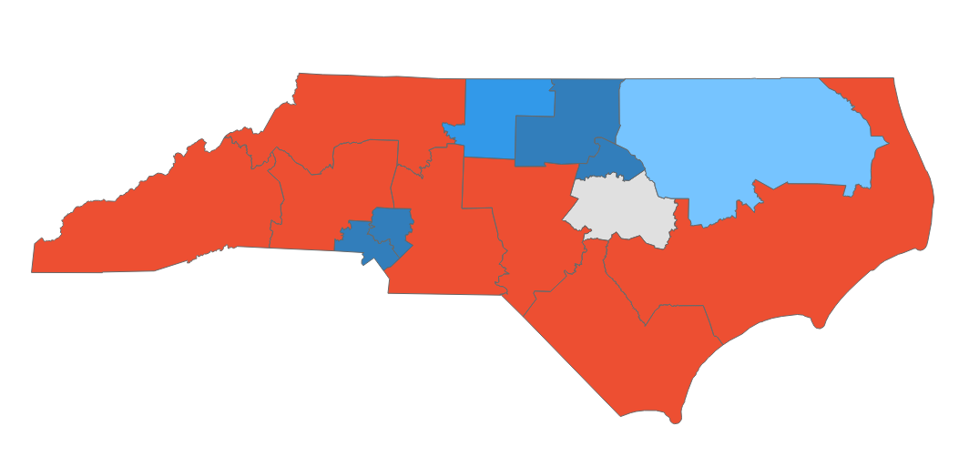
North Carolina primary dashboard
Primaries held May 17, runoffs July 26
POSITIONS ON THE BALLOT
KEY TAKEAWAYS
Federal and gubernatorial office only
Office | Seats | Incumbent party
House | 14 | 5 D, 8 R
Senate | 1 | R
Governor | 0 | -
1
Senate race
Trump-endorsed candidate Rep. Ted Budd (R-NC-13) easily defeated his numerous primary challengers
Former chief justice of the state Supreme Court Cheri Beasley won the Democratic nomination and would be the first Black Senator from North Carolina if she defeats Budd
2
Mixed bag for Trump endorsements
Trump’s endorsement of Budd helped clear the path for him in a crowded primary field that included some big names, including former Governor Pat McCrory (R)
However, Trump’s last minute advocacy for Rep. Madison Cawthorn’s (R-NC-11) fell short
STATE DISTRICT MAP
Partisan coloring based on Cook Political Report with Amy Walter Race Rating
3
Progressive defeat
Outside groups donated generously to moderate Democratic candidates in the state
Progressives saw primary defeats in the 1st and 4th districts; in the latter, candidate Nida Allam (D) was bested despite endorsements from Sen. Bernie Sanders (I-VT) and Rep. Alexandria Ocasio-Cortez (D-NY-14)
SOURCE CNN, LA Times, The Hill, Vox, AP, The Cook Political Report with Amy Walter
PRESENTATION CENTER 6/14/22
Notes:
Source:
Eric Bradner, Dan Merica and Gregory Krieg. “6 takeaways from primaries in Pennsylvania, North Carolina and more” CNN, May 18, 2022
https://edition.cnn.com/2022/05/18/politics/pa-nc-may-17-primary-election-takeaways/index.html
Tal Axelrod and Max Greenwood. “Five takeaways from the Pennsylvania, North Carolina primaries” The Hill, May 18, 2022
https://thehill.com/news/campaign/3492387-five-takeaways-from-the-pennsylvania-north-carolina-primaries/
Li Zhou, Nicole Narea, and Christian Paz. “2 winners and 2 losers from the Pennsylvania and North Carolina primaries” Vox, May 18, 2022
https://www.vox.com/2022/5/18/23106123/pennsylvania-north-carolina-primaries
Jill Covin and Nicholas Riccardi. “Takeaways: Election denier wins, bad behavior dooms Cawthorn” AP News, May 18, 2022
https://apnews.com/article/2022-midterm-elections-may-17-takeaways-a56c76245e03bc88745e7286b524c92c
Melanie Mason and Arit John. “7 takeaways from primaries in Pennsylvania, North Carolina, Oregon” LA Times, May 18, 2022
https://www.latimes.com/politics/story/2022-05-17/takeaways-primaries-pennsylvania-north-carolina-fetterman-cawthorn-oz

Slide 63
North Carolina primary results
Seat | Republican Primary Winner | Democratic Primary Winner | Cook Rating
NC-Senate | Ted Budd (58.6%) | Cheri Beasley (81.1%) | Lean R
NC-1 | Sandy Smith (31.4%) | Don Davis (63.2%) | Lean D
NC-2 | Christine Villaverde (55.2%) | Deborah Ross* (Uncontested) | Solid D
NC-3 | Greg Murphy* (75.7%) | Barbara Gaskins (80.4%) | Solid R
NC-4 | Courtney Geels (64.5%) | Valerie Foushee (46.1%) | Solid D
NC-5 | Virginia Foxx* (76.6%) | Kyle Parrish (Uncontested) | Solid R
NC-6 | Christian Castelli (36.2%) | Kathy Manning* (Uncontested) | Likely D
NC-7 | David Rouzer* (79.2%) | Charles Graham (31.2%) | Solid R
NC-8 | Dan Bishop* (Uncontested) | Scott Huffman (Uncontested) | Solid R
NC-9 | Richard Hudson* (79.2%) | Ben Clark (Uncontested) | Solid R
NC-10 | Patrick McHenry* (68.1%) | Pam Genant (77.4%) | Solid R
NC-11 | Chuck Edwards (33.4%) | Jasmine Beach-Ferrara (59.7%) | Solid R
NC-12 | Tyler Lee (42.9%) | Alma Adams* (91.6%) | Solid D
NC-13 | Bo Hines (32.1%) | Wiley Nickel (51.6%) | Toss Up
NC-14 | Pat Harrigan (75.7%) | Jeff Jackson (86.2%) | Solid D
*Incumbent
SOURCE AP data as of 5/18/22
PRESENTATION CENTER 7/20/22
Notes:
Source:
"AP Elections API" last accessed May 18, 2022
https://developer.ap.org/ap-elections-api/

Slide 64
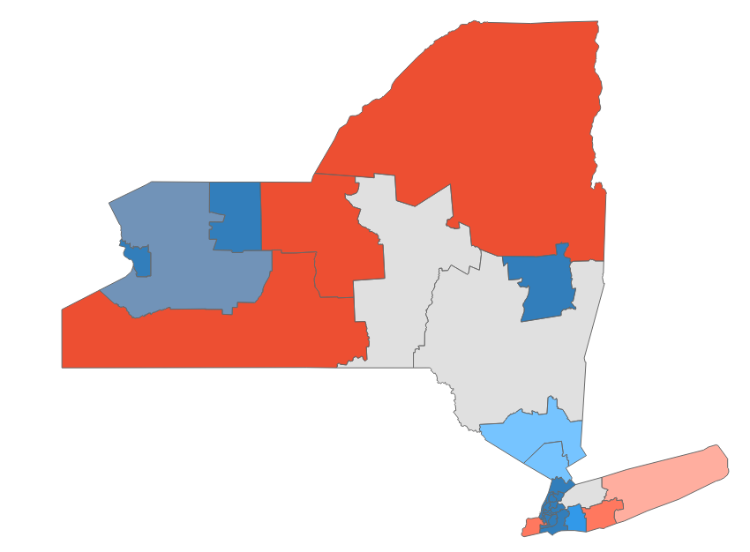
New York primary dashboard
Gubernatorial primary held June 28; Congressional primaries held Aug. 23
POSITIONS ON THE BALLOT
KEY TAKEAWAYS
Federal and gubernatorial office only
Office | Seats | Incumbent party
House | 26 | 19 D, 8 R
Senate | 0 | -
Governor | 1 | D
1
Governor race set
Incumbent Gov. Kathy Hochul (D) easily won her party’s nomination and will face Rep. Lee Zeldin (R-NY-1) While
Hochul is favored to win in a state that has more than twice as many registered Democrats as Republicans; she would be the first woman elected to the governor’s office
2
Redistricting woes
A court-ordered congressional map created tensions between incumbents, with Rep. Jerry Nadler (D-NY-10) ousting Rep. Carolyn Maloney (D-NY-12) and Rep. Mondaire Jones (D-NY-17) losing the new 10th CD’s primary race after moving to the district to avoid a member-on-member primary with DCCC Chair Rep. Sean Patrick Maloney (D-NY-18)
STATE DISTRICT MAP
Partisan coloring based on Cook Political Report with Amy Walter Race Rating
3
NY establishment strength
Rep. Maloney easily bested progressive challenger Alessandra Biaggi, who was endorsed by Rep. Alexandria Ocasio-Cortez (D-NY-14)
In the 23rd CD, Chair of the NY State Republican Committee Nick Langworthy defeated Carl Paladino, who was endorsed by Trump-aligned House Republicans
SOURCE NYT, CNN, AP News, Spectrum News
PRESENTATION CENTER 8/24/22
Notes:
Sources:
Katie Glueck. “Five Takeaways From Tuesday’s Elections” NY Times, August 24, 2022
https://www.nytimes.com/2022/08/24/us/politics/five-takeaways-from-tuesdays-elections.html
Gregory Krieg, Steve Contorno and Dan Merica. ” Seven takeaways from primaries in Florida, New York and Oklahoma runoffs” CNN, August 24, 2022
https://www.cnn.com/2022/08/23/politics/florida-new-york-oklahoma-election-takeaways/index.html
Michelle L. Price. “NY Democrats choose Hochul for governor; GOP picks Zeldin” AP News, June 29, 2022
https://apnews.com/article/2022-midterms-new-york-governor-hochul-ce7f0524772c31696279ab1deb3ef1fb
“What redistricting looks like in every state: New York” FiveThirtyEight, May 23, 2022
https://projects.fivethirtyeight.com/redistricting-2022-maps/new-york/
Luke Parsnow. “Vocal early on, Trump's voice largely absent from New York's heated races for Congress” Spectrum Local News, August 19, 2022
https://spectrumlocalnews.com/nys/central-ny/politics/2022/08/19/trump-largely-absent-from-new-york-s-hot-races-for-congress
Katie Glueck. “Sean Patrick Maloney Repels Challenge to Win Bitterly Fought Primary” NY Times, August 23, 2022
https://www.nytimes.com/2022/08/23/nyregion/maloney-alessandra-biaggi-primary.html

Slide 65
New York primary results (1/2)
Seat | Republican Primary Winner | Democratic Primary Winner | Cook Rating
NY-Governor | Lee Zeldin (43.9%) | Kathy Hochul* (67.8%) | Solid D
NY-1 | Nicholas LaLota (47.2%) | Bridget Fleming (Uncontested) | Lean R
NY-2 | Andrew Garbarino* (53.7%) | Jackie Gordon (Uncontested) | Likely R
NY-3 | George Santos (Uncontested) | Robert Zimmerman (35.8%) | Toss Up
NY-4 | Anthony D'Esposito (Uncontested) | Laura Gillen (63.1%) | Likely D
NY-5 | Paul King (Uncontested) | Gregory Meeks* (Uncontested) | Solid D
NY-6 | Thomas Zmich (Uncontested) | Grace Meng* (Uncontested) | Solid D
NY-7 | Juan Pagan (Uncontested) | Nydia Velazquez* (84.3%) | Solid D
NY-8 | Yuri Dashevsky (Uncontested) | Hakeem Jeffries* (87.4%) | Solid D
NY-9 | No Candidate | Yvette Clarke* (Uncontested) | Solid D
NY-10 | Benine Hamdan (Uncontested) | Daniel Goldman (25.8%) | Solid D
NY-11 | Nicole Malliotakis* (78.5%) | Max Rose (75.%) | Likely R
NY-12 | Michael Zumbluskas (Uncontested) | Jerrold Nadler* (55.4%) | Solid D
*Incumbent
SOURCE AP data as of 8/24/22
PRESENTATION CENTER 8/24/22
Notes:
Source:
"AP Elections API" last accessed August 24, 2022
https://developer.ap.org/ap-elections-api/

Slide 66
New York primary results (2/2)
Seat | Republican Primary Winner | Democratic Primary Winner | Cook Rating
NY-13 | No Candidate | Adriano Espaillat* (81.%) | Solid D
NY-14 | Tina Forte (67.9%) | Alexandria Ocasio-Cortez* (Uncontested) | Solid D
NY-15 | Stylo Sapaskis (Uncontested) | Ritchie Torres* (Uncontested) | Solid D
NY-16 | John Ciampoli (Uncontested) | Jamaal Bowman* (57.1%) | Solid D
NY-17 | Michael Lawler (75.8%) | Sean Patrick Maloney* (66.7%) | Lean D
NY-18 | Colin Schmitt (Uncontested) | Pat Ryan (84.1%) | Lean D
NY-19 | Marcus Molinaro (Uncontested) | Josh Riley (63.5%) | Toss Up
NY-20 | Elizabeth Joy (Uncontested) | Paul Tonko* (88.3%) | Solid D
NY-21 | Elise Stefanik* (Uncontested) | Matt Castelli (81.1%) | Solid R
NY-22 | Brandon Williams (57.7%) | Francis Conole (39.5%) | Toss Up
NY-23 | Nick Langworthy (52.1%) | Max Della Pia (Uncontested) | Solid R
NY-24 | Claudia Tenney* (53.9%) | Steven Holden (Uncontested) | Solid R
NY-25 | La'Ron Singletary (Uncontested) | Joseph Morelle* (Uncontested) | Solid D
NY-26 | Steven Sams (Uncontested) | Brian Higgins* (91.3%) | Solid D
*Incumbent
SOURCE AP data as of 8/24/22
PRESENTATION CENTER 8/24/22
Notes:
Source:
"AP Elections API" last accessed August 24, 2022
https://developer.ap.org/ap-elections-api/

Slide 67

North Dakota primary dashboard
Primaries held June 14
POSITIONS ON THE BALLOT
KEY TAKEAWAYS
Federal and gubernatorial office only
Office | Seats | Incumbent party
House | 1 | R
Senate | 1 | R
Governor | 0 | -
1
Landslide Senate races
Incumbent Sen. John Hoeven easily won the GOP primary, receiving 78.4% of the vote compared to his opponent Riley Kuntz, who received 21.6% of the vote
On the Democratic side, Katrina Christiansen sailed to victory, gaining 76.8% of the vote compared to her opponent Michael Steele’s 23.2%
2
Uncontested victories
STATE DISTRICT MAP
Incumbent Rep. Kelly Armstrong (R-ND-AL) and Democratic challenger Mark Haugen (D) won their respective party’s primary bids, running uncontested in both races
November’s general election is likely to be won by Armstrong, with analysts categorizing North Dakota’s House race as safely Republican
Partisan coloring based on Cook Political Report with Amy Walter Race Rating
SOURCE NPR, Insider, Ballotpedia, The Cook Political Report with Amy Walter
PRESENTATION CENTER 6/16/22
Notes:
Sources:
Madison Hall “Results: North Dakota holds primary elections” , Insider, June 14, 2022
https://www.businessinsider.com/results-north-dakota-holds-primary-elections-2022-6
“Here are the key primary election results from North Dakota” NPR, accessed June 15, 2022
https://www.npr.org/2022/06/14/1103746428/north-dakota-primary-election-results
“United States Congressional Delegations from North Dakota.” Ballotpedia. Accessed June 15, 2022.
https://ballotpedia.org/United_States_congressional_delegations_from_North_Dakota
“2022 House race ratings” The Cook Political Report with Amy Walter, accessed June 15, 2022
https://www.cookpolitical.com/ratings/house-race-ratings

Slide 68
North Dakota primary results
Seat | Republican Primary Winner | Democratic Primary Winner | Cook Rating
ND-Senate | John Hoeven* (78.4%) | Katrina Christiansen (76.8%) | Solid R
ND-AL | Kelly Armstrong* (Uncontested) | Mark Haugen (Uncontested) | Solid R
*Incumbent
SOURCE AP data as of 6/15/22
PRESENTATION CENTER 7/20/22
Notes:
Source:
"AP Elections API" last accessed June 15, 2022
https://developer.ap.org/ap-elections-api/

Slide 69
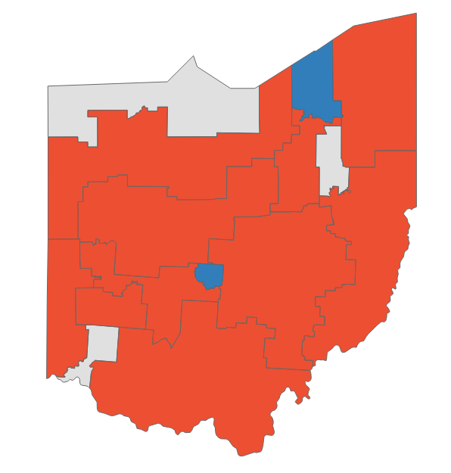
Ohio primary dashboard
Primaries held May 3
POSITIONS ON THE BALLOT
KEY TAKEAWAYS
Federal and gubernatorial office only
Office | Seats | Incumbent party
House | 15 | 4 D, 12 R
Senate | 1 | R
Governor | 1 | R
1
Trump’s influence
Former President Trump’s late endorsement of venture capitalist J.D. Vance played a large role in securing him the GOP nomination
OH-7 candidate Max Miller (R), endorsed by Trump in a crowded GOP primary, also sailed to victory
2
Mixed bag for the GOP establishment
Incumbent Governor Mike DeWine (R-OH) secured his party’s nomination for another term, beating back challenges and criticisms from more Trumpian wings of the GOP
However, DeWine failed to receive more than 50% of votes, with pro-Trump candidates largely splitting remaining votes
STATE DISTRICT MAP
Partisan coloring based on Cook Political Report with Amy Walter Race Rating
3
Dems back moderate candidates
Senate candidate and sitting House Rep. Tim Ryan (D-OH-13) won the Democratic nomination, easily besting progressive challenger Morgan Harper (D)
A second showdown between progressive Nina Turner (D) and incumbent Shontel Brown (D) resulted in an overwhelming victory for the more moderate Brown
SOURCE CNN, New York Times, The Hill, ABC, Roll Call, Ballotpedia
PRESENTATION CENTER 6/14/22
Notes:
Sources:
Nathan L. Gonzales. “New Ohio map leaves Chabot, Kaptur facing tough races this fall” Roll Call, May 2, 2022
https://rollcall.com/2022/05/02/new-ohio-map-leaves-chabot-kaptur-facing-tough-races-this-fall/
Eric Bradner, Dan Merica and Gregory Krieg. “6 takeaways from Ohio and Indiana primaries” CNN, May 4, 2022
https://www.cnn.com/2022/05/04/politics/ohio-indiana-primary-takeaways/index.html
Jonathan Weisman and Maggie Haberman. “5 Takeaways From Ohio’s Primary Elections” NY Times, May 4, 2022
https://www.nytimes.com/2022/05/04/us/elections/ohio-indiana-primary-elections-takeaways.html
Brittany Shepherd. “3 key takeaways from the Ohio, Indiana primaries” ABC, May 4, 2022
https://abcnews.go.com/Politics/key-takeaways-ohio-indiana-primaries/story?id=84448689
Tal Axelrod and Julia Manchester. “Five takeaways from the Ohio primaries” The Hill, May 4, 2022
https://thehill.com/news/campaign/3476558-five-takeaways-from-the-ohio-primaries/
httpshttps://www.nytimes.com/interactive/2022/05/03/us/elections/results-ohio.html

Slide 70
Ohio primary results
Seat | Republican Primary Winner | Democratic Primary Winner | Cook Rating
OH-Senate | J.D. Vance (32.2%) | Tim Ryan (69.7%) | Lean R
OH-Governor | Mike DeWine* (48.1%) | Nan Whaley (65.%) | Likely R
OH-1 | Steve Chabot* (Uncontested) | Greg Landsman (Uncontested) | Toss Up
OH-2 | Brad Wenstrup* (77.3%) | Samantha Meadows (72.1%) | Solid R
OH-3 | Lee Stahley (Uncontested) | Joyce Beatty* (Uncontested) | Solid D
OH-4 | Jim Jordan* (Uncontested) | Tamie Wilson (51.7%) | Solid R
OH-5 | Bob Latta* (Uncontested) | Craig Swartz (55.2%) | Solid R
OH-6 | Bill Johnson* (77.3%) | Louis Lyras (31.3%) | Solid R
OH-7 | Max Miller (71.8%) | Matthew Diemer (55.%) | Solid R
OH-8 | Warren Davidson* (71.2%) | Vanessa Enoch (Uncontested) | Solid R
OH-9 | J.R. Majewski (35.8%) | Marcy Kaptur* (Uncontested) | Toss Up
OH-10 | Mike Turner* (Uncontested) | David Esrati (31.3%) | Solid R
OH-11 | Eric Brewer (57.6%) | Shontel Brown* (66.3%) | Solid D
OH-12 | Troy Balderson* (82.4%) | Amy Rippel-Elton (56.6%) | Solid R
OH-13 | Madison Gesiotto Gilbert (28.6%) | Emilia Sykes (Uncontested) | Toss Up
OH-14 | David Joyce* (75.7%) | Matt Kilboy (Uncontested) | Solid R
OH-15 | Mike Carey (Uncontested) | Gary Josephson (Uncontested) | Solid R
*Incumbent
SOURCE AP data as of 6/15/22
PRESENTATION CENTER 7/20/22
Notes:
Source:
"AP Elections API" last accessed June 15, 2022
https://developer.ap.org/ap-elections-api/

Slide 71
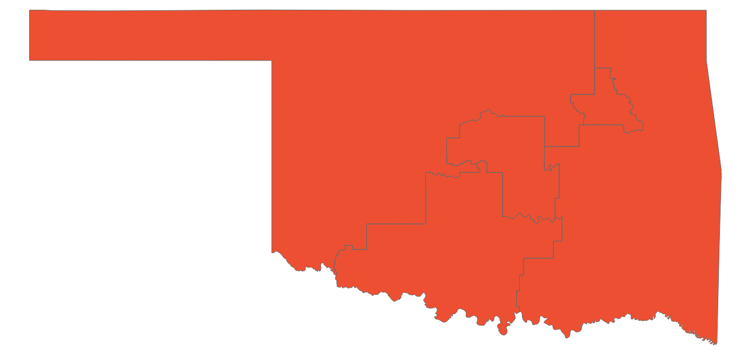
Oklahoma primary dashboard
Primaries held June 28, runoffs August 23
POSITIONS ON THE BALLOT
KEY TAKEAWAYS
Federal and gubernatorial office only
Office | Seats | Incumbent party
House | 5 | 5 R
Senate | 1 | R
Governor | 1 | R
1
Competitive Governor primary
Incumbent Governor Kevin Stitt defeated three opponents to win the GOP primary, receiving 69% of the vote
Stitt will face off with Democrat Superintendent Joy Hofmeister in the general election come November; Stitt is expected to win easily
2
Senate runoffs
Madison Horn defeated Jason Bollinger in the runoffs for the Democrat Senate primary
Horn will face incumbent Sen. James Lankford (R-OK) in the November general election
Every Oklahoma race strongly favors republicans
STATE DISTRICT MAP
Partisan coloring based on Cook Political Report with Amy Walter Race Rating
SOURCE AP data as of 8/24/22, Ballotpedia, The Cook Political Report with Amy Walter,
PRESENTATION CENTER 8/24/22
Notes:
Source:
“AP Elections API”, Associated Press, Accessed August 24, 2022
https://developer.ap.org/ap-elections-api/
“2022 House Ratings,” Cook Political Report, Accessed June 29, 2022,
https://www.cookpolitical.com/ratings/house-race-ratings
“United State Congressional Delegations from Oklahoma,” Ballotpedia, Accessed June 29, 2022,
https://ballotpedia.org/United_States_congressional_delegations_from_Oklahoma
Carmen Forman, “Kevin Stitt, Joy Hofmeister to face off in Oklahoma governor's race come November” The Oklahoman, June 28, 2022
https://www.oklahoman.com/story/news/2022/06/28/oklahoma-governor-election-primary-results-republican-kevin-stitt-democrat-joy-hofmeister/7697828001/
Karoline Leonard, “Lankford wins U.S. Senate seat Republican primary; Horn, Bollinger enter runoff election” OU Daily, June 28, 2022
https://www.oudaily.com/news/lankford-wins-u-s-senate-seat-republican-primary-horn-bollinger-enter-runoff-election/article_639923f6-f744-11ec-9325-27843b285400.html

Slide 72
Oklahoma primary results
Seat | Republican Primary Winner | Democratic Primary Winner | Cook Rating
OK-Senate | James Lankford (67.8%) | Madison Horn (65.5%) | Solid R
OK-Senate | Markwayne Mullin (65.1%) | Kendra Horn (Uncontested) | Solid R
OK-Governor | Kevin Stitt (69.1%) | Joy Hoffmeister (60.7%) | Solid R
OK-1 | Kevin Hern (Uncontested) | Adam Martin (Uncontested) | Solid R
OK-2 | Josh Brecheen (52.2%) | Naomi Andrews (Uncontested) | Solid R
OK-3 | Frank Lucas (61.1%) | Jeremiah Ross (Uncontested) | Solid R
OK-4 | Tom Cole (69.8%) | Mary Brannon (Uncontested) | Solid R
OK-5 | Stephanie Bice (68.4%) | Joshua Harris-Till (Uncontested) | Solid R
*Incumbent
SOURCE AP data as of 8/24/22
PRESENTATION CENTER 8/24/22
Notes:
Source:
"AP Elections API" last accessed August 24, 2022
https://developer.ap.org/ap-elections-api/

Slide 73
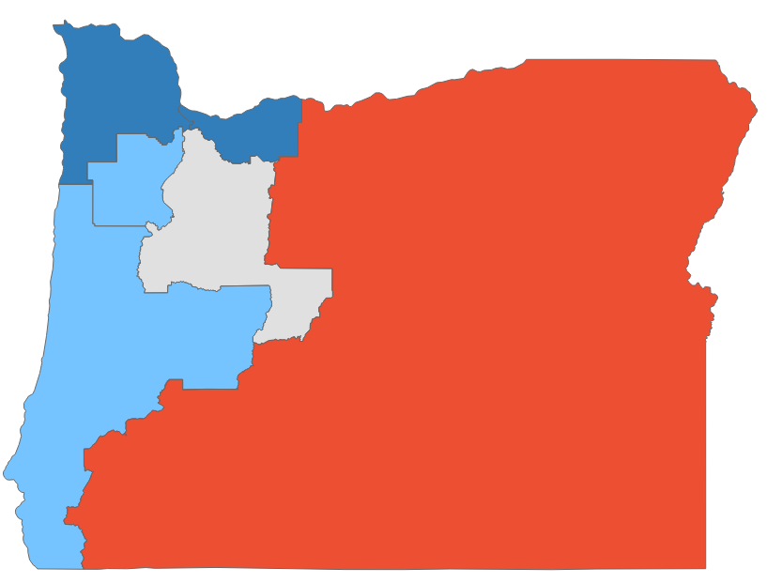
Oregon primary dashboard
Primaries held May 17
POSITIONS ON THE BALLOT
KEY TAKEAWAYS
Federal and gubernatorial office only
Kotek wins the Dem. primary in the Governor race
Office | Seats | Incumbent party
House | 6 | 4 D, 1 R
Senate | 1 | D
Governor | 1 | D
1
Former Oregon House Speaker Tina Kotek (D) beat out State Treasurer Tobias Read (D)
Kotek and GOP nominee Christine Drazan will face off in November, with long-time state Senator Betsy Johnson running as in independent in the general election
2
Big spending does not pay off for Flynn
House Candidate Carrick Flynn (D) lost the race for Oregon’s 6th Congressional district despite receiving nearly $11 million in campaign donations from FTX CEO and crypto billionaire Sam Bankman-Fried
Flynn conceded to Rep. Andrea Salinas (D), who aims to become Oregon’s first Hispanic woman in Congress
STATE DISTRICT MAP
Partisan coloring based on Cook Political Report with Amy Walter Race Rating
3
Wyden surpasses the competition
Sitting Sen. Ron Wyden (D) won the Democratic nomination, claiming almost 91% of votes
Wyden will face Jo Rae Perkins (R) in the November general election
SOURCE AP, Seattle Times, Market Watch, Register Guard, The Cook Political Report with Amy Walter
PRESENTATION CENTER 6/14/22
Notes:
Source:
Sara Cline, “Kotek wins Democratic nod in Oregon governor’s race” Seattle Times, AP News, May 18, 2022
https://www.seattletimes.com/seattle-news/oregon-governor-primary-will-test-democratic-party/
Weston Blasi, “Despite $11 million in donations from a crypto billionaire, Carrick Flynn loses big in Oregon primary”, MarketWatch, May 18, 2022
https://www.marketwatch.com/story/despite-11-million-in-donations-from-a-crypto-billionaire-carrick-flynn-loses-big-in-oregon-primary-11652887087
Adam Duvernay “Oregon US Senate 2022 primary results: Ron Wyden wins Dem race; GOP contender undetermined” Register Guard, May 17, 2022
https://www.registerguard.com/story/news/2022/05/17/election-results-2022-us-senate-race-in-oregon-for-ron-wyden-seat/65355883007/

Slide 74
Oregon primary results
Seat | Republican Primary Winner | Democratic Primary Winner | Cook Rating
OR-Senate | Jo Rae Perkins (33.3%) | Ron Wyden* (89.5%) | Solid D
OR-Governor | Christine Drazan (23.%) | Tina Kotek (57.9%) | Lean D
OR-1 | Christopher Mann (68.4%) | Suzanne Bonamici* (88.5%) | Solid D
OR-2 | Cliff Bentz* (75.4%) | Joe Yetter (70.5%) | Solid R
OR-3 | Joanna Harbour (Uncontested) | Earl Blumenauer* (94.8%) | Solid D
OR-4 | Alek Skarlatos (Uncontested) | Val Hoyle (64.1%) | Lean D
OR-5 | Lori Chavez-DeRemer (43.%) | Jamie McLeod-Skinner (57.1%) | Toss Up
OR-6 | Mike Erickson (34.9%) | Andrea Salinas (36.6%) | Lean D
*Incumbent
SOURCE AP data as of 5/18/22
PRESENTATION CENTER 7/20/22
Notes:
Source:
"AP Elections API" last accessed May 18, 2022
https://developer.ap.org/ap-elections-api/

Slide 75
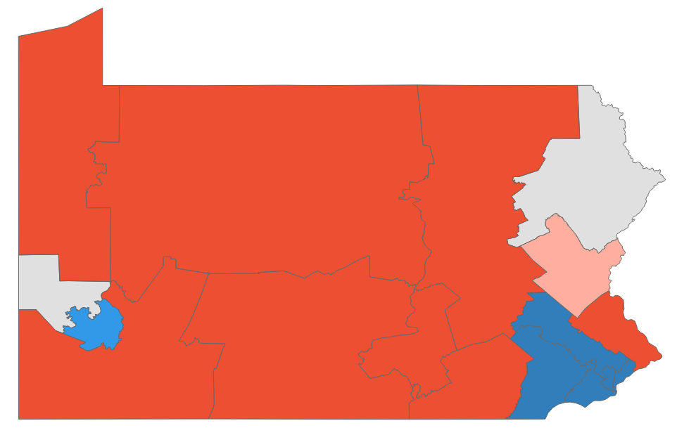
Pennsylvania primary dashboard
Primaries held May 17
POSITIONS ON THE BALLOT
KEY TAKEAWAYS
Federal and gubernatorial office only
Office | Seats | Incumbent party
House | 17 | 9 D, 9 R
Senate | 1 | R
Governor | 1 | D
1
Dr. Oz wins after recount
The high profile Republican primary between celebrity doctor Mehmet Oz and Dave McCormick went to an automatic recount, with McCormick ultimately conceding on June 3
Oz goes on to face Democratic candidate John Fetterman in a race that could decide party control of the Senate
2
An anti-establishment Democrat
Lieutenant Governor John Fetterman (D) easily outmatched Rep. Conor Lamb (D-PA-17) in a primary for the state’s open Senate seat
Lamb fit the moderate establishment profile while Fetterman campaigned with an unconventional style and a working class narrative
STATE DISTRICT MAP
Partisan coloring based on Cook Political Report with Amy Walter Race Rating
3
A referendum on abortion
With Roe V. Wade struck down this summer, Pennsylvania voters could decide the fate of abortion in their state with their vote for governor
Democratic gubernatorial candidate Josh Shapiro has started running ads targeting GOP opponent Douglas Mastriano’s hard-line stance against abortion access
SOURCE New York Times, The Philadelphia Inquirer, 6ABC, The Cook Political Report with Amy Walter
PRESENTATION CENTER 6/14/22
Notes:
Source:
“Pennsylvania Primary Election Results” NY Times, accessed May 18, 2022
https://www.nytimes.com/interactive/2022/05/17/us/elections/results-pennsylvania.html?action=click&pgtype=Article&state=default&module=styln-elections-2022&region=BOTTOM_NAV&context=election_recirc
Johnathan Tamari and Andrew Seidman, “5 takewaways from the Pennsylvania primary election,” The Philadelphia Inquirer, May 18, 2022, https://www.inquirer.com/politics/election/pennsylvania-primary-election-2022-takeaways-analysis-20220518.html
Julia Terruso, “John Fetterman Does Just Have Supporters - He Has Fans. His Celebrity Could Make Him a Senator.” The Philadelphia Inquirer, April 20, 2022, https://www.inquirer.com/politics/election/john-fetterman-fans-pa-democratic-senate-primary-20220420.html
Marc Levy and Mark Scolforo, “Recount Begins in Pennsylvania’s GOP Primary for Senate,” 6ABC, May 30, 2022, https://6abc.com/pennsylvania-election-primary-recount-dr-mehmet-oz-david-mccormick/11906753/
“David McCormick Concedes to Mehmet Oz in Pennsylvania Republican Senate Primary,” The Philadelphia Inquirer, June 3, 2022, https://www.inquirer.com/politics/election/david-mccormick-concede-pa-senate-primary-mehmet-oz-20220603.html

Slide 76
Pennsylvania primary results (1/2)
Seat | Republican Primary Winner | Democratic Primary Winner | Cook Rating
PA-Senate | Mehmet Oz (31.2%) | John Fetterman (58.6%) | Lean D
PA-Governor | Douglas Mastriano (43.8%) | Josh Shapiro (Uncontested) | Lean D
PA-1 | Brian Fitzpatrick* (65.6%) | Ashley Ehasz (Uncontested) | Solid R
PA-2 | Aaron Bashir (Uncontested) | Brendan Boyle* (Uncontested) | Solid D
PA-3 | No Candidate | Dwight Evans* (75.7%) | Solid D
PA-4 | Christian Nascimento (69.1%) | Madeleine Dean* (Uncontested) | Solid D
PA-5 | David Galluch (Uncontested) | Mary Gay Scanlon* (Uncontested) | Solid D
PA-6 | Guy Ciarrocchi (33.2%) | Chrissy Houlahan* (Uncontested) | Solid D
PA-7 | Lisa Scheller (51.3%) | Susan Wild* (Uncontested) | Lean R
PA-8 | Jim Bognet (68.7%) | Matt Cartwright* (Uncontested) | Toss Up
PA-9 | Dan Meuser* (Uncontested) | Amanda Waldman (Uncontested) | Solid R
PA-10 | Scott Perry* (Uncontested) | Shamaine Daniels (52.5%) | Solid R
*Incumbent
SOURCE AP data as of 5/18/22
PRESENTATION CENTER 7/20/22
Notes:
Source:
"AP Elections API" last accessed May 18, 2022
https://developer.ap.org/ap-elections-api/

Slide 77
Pennsylvania primary results (2/2)
Seat | Republican Primary Winner | Democratic Primary Winner | Cook Rating
PA-11 | Lloyd Smucker* (Uncontested) | Bob Hollister (Uncontested) | Solid R
PA-12 | Mike Doyle* (Uncontested) | Summer Lee (41.9%) | Likely D
PA-13 | John Joyce* (Uncontested) | No Candidate | Solid R
PA-14 | Guy Reschenthaler* (Uncontested) | No Candidate | Solid R
PA-15 | Glenn Thompson* (Uncontested) | No Candidate | Solid R
PA-16 | Mike Kelly* (Uncontested) | Dan Pastore (69.1%) | Solid R
PA-17 | Jeremy Shaffer (58.7%) | Chris Deluzio (63.7%) | Toss Up
*Incumbent
SOURCE AP data as of 5/18/22
PRESENTATION CENTER 7/20/22
Notes:
Source:
"AP Elections API" last accessed May 18, 2022
https://developer.ap.org/ap-elections-api/

Slide 78
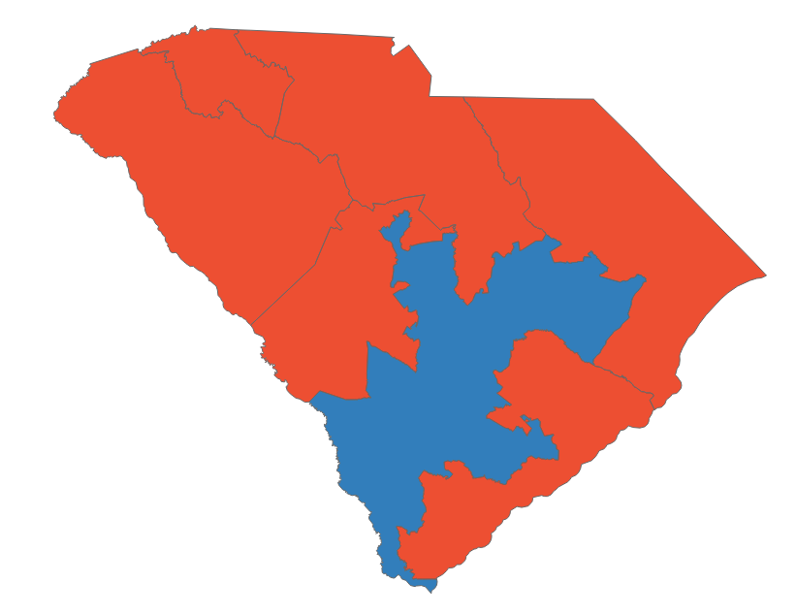
South Carolina primary dashboard
Primaries held June 14
POSITIONS ON THE BALLOT
KEY TAKEAWAYS
Federal and gubernatorial office only
Office | Seats | Incumbent party
House | 7 | 1 D, 6 R
Senate | 1 | R
Governor | 1 | R
1
Race around Trump
Rep. Nancy Mace (R-SC-1) defeated Trump-endorsed challenger Katie Arrington (R). Although Mace stated Trump was responsible for the Capitol riots, she did not vote to impeach him
Sitting Rep. Tom Rice (R-SC-7) was defeated by Trump-endorsed candidate Russel Fry after Rice voted in favor of impeachment in 2021
Sitting Sen. Tim Scott (R), who confirmed his 2024 support for Trump, ran unopposed and is expected to maintain his seat in November
STATE DISTRICT MAP
2
Governor’s race preview
Partisan coloring based on Cook Political Report with Amy Walter Race Rating
Incumbent Governor Henry McMaster (R) easily defeated challenger Harrison Musselwhite, securing 83% of the vote
He will face former Rep. Joe Cunningham (D), a moderate Democrat defeated by Rep. Mace (R-SC-1) in his 2020 re-election bid
Cunningham received an endorsement from SC House Minority Leader Todd Rutherford, but a Democrat has not been elected governor since 1998. The seat is not expected to flip in November
SOURCE ABC, CNN, New York Times, Ballotpedia, The Cook Political Report with Amy Walter
PRESENTATION CENTER 6/16/22
Notes:
Source:
AP elections API: AP developer. AP Elections API | AP Developer. (2022, June 15). Retrieved June 15, 2022, from https://developer.ap.org/ap-elections-api/
“2022 House Race Ratings” The Cook Political Report with Amy Walter, updated June 8, 2022
https://www.cookpolitical.com/ratings/house-race-ratings
“United States congressional delegations from South Carolina” Ballotpedia, accessed June 15, 2022
https://ballotpedia.org/United_States_congressional_delegations_from_South_Carolina
Glueck, K. (2022, June 15). 5 takeaways from Tuesday's voting. The New York Times. Retrieved June 15, 2022,
https://www.nytimes.com/2022/06/15/us/politics/south-carolina-nevada-primary-mayra-flores.html
ABC News Network. (n.d.). ABC News. Retrieved June 15, 2022,
https://abcnews.go.com/Politics/south-carolina-2022-primary-election-results/story?id=85315142
Cable News Network. (n.d.). Live south carolina democratic & republican primary election results and maps 2022 | CNN politics. CNN. Retrieved June 15, 2022,
https://www.cnn.com/election/2022/results/south-carolina/primaries

Slide 79
South Carolina primary results
Seat | Republican Primary Winner | Democratic Primary Winner | Cook Rating
SC-Senate | Tim Scott* (Uncontested) | Krystle Matthews (55.8%) | Solid R
SC-Governor | Henry McMaster* (83.3%) | Joe Cunningham (56.5%) | Solid R
SC-1 | Nancy Mace* (53.1%) | Annie Andrews (Uncontested) | Solid R
SC-2 | Joe Wilson* (Uncontested) | Judd Larkins (Uncontested) | Solid R
SC-3 | Jeff Duncan* (Uncontested) | No Candidate | Solid R
SC-4 | William Timmons* (52.7%) | Ken Hill (Uncontested) | Solid R
SC-5 | Ralph Norman* (Uncontested) | Evangeline Hundley (57.6%) | Solid R
SC-6 | Duke Buckner (74.4%) | James Clyburn* (88.1%) | Solid D
SC-7 | Russell Fry (51.1%) | Daryl Scott (Uncontested) | Solid R
*Incumbent
SOURCE AP data as of 6/15/22
PRESENTATION CENTER 7/20/22
Notes:
Source:
"AP Elections API" last accessed June 15, 2022
https://developer.ap.org/ap-elections-api/

Slide 80

South Dakota primary dashboard
Primaries held June 7
POSITIONS ON THE BALLOT
KEY TAKEAWAYS
Federal and gubernatorial office only
Office | Seats | Incumbent party
House | 1 | R
Senate | 1 | R
Governor | 1 | R
1
Incumbents win
Republican Gov. Kristi Noem easily clinched a victory, receiving over 76% of the vote. She will face uncontested Democrat Jamie Smith
Incumbent Republican Sen. John Thune secured a strong victory with over 72% of the vote; he will face Democrat Brian Bengs
Republican Representative Dusty Johnson also secured a victory over his primary challenger for the only South Dakota House seat, with 59% of the vote
STATE DISTRICT MAP
2
Failed ballot question
Partisan coloring based on Cook Political Report with Amy Walter Race Rating
Republicans in the state legislature put forward a ballot question ahead of a November referendum on expanding Medicaid in South Dakota
The ballot question asked whether voter-initiated referendums should have a higher threshold of support in order to pass (from a majority to 60%). The question failed, with “No” receiving 67% of the tally
SOURCE The New York Times, Ballotpedia, The Cook Political Report with Amy Walter
PRESENTATION CENTER 6/14/22
Notes:
Sources:
“South Dakota Constitutional Amendment Election Results.” The New York Times. The New York Times, June 8, 2022. https://www.nytimes.com/interactive/2022/06/07/us/elections/results-south-dakota-constitutional-amendment.html.
“South Dakota Medicaid Expansion Amendment (2022).” Ballotpedia. Accessed June 9, 2022. https://ballotpedia.org/South_Dakota_Medicaid_Expansion_Amendment_(2022).
“South Dakota Primary Election Results.” The New York Times. The New York Times, June 8, 2022. https://www.nytimes.com/interactive/2022/06/07/us/elections/results-south-dakota.html.
“United States Congressional Delegations from South Dakota.” Ballotpedia. Accessed June 9, 2022. https://ballotpedia.org/United_States_congressional_delegations_from_South_Dakota.

Slide 81
South Dakota primary results
Seat | Republican Primary Winner | Democratic Primary Winner | Cook Rating
SD-Governor | Kristi Noem* (76.4%) | Jamie Smith (Uncontested) | Solid R
SD-Senate | John Thune* (72.2%) | Brian Bengs (Uncontested) | Solid R
SD-AL | Dusty Johnson* (59.3%) | No candidate | Solid R
*Incumbent
SOURCE AP data as of 6/8/22
PRESENTATION CENTER 7/20/22
Notes:
Source:
"AP Elections API" last accessed June 8, 2022
https://developer.ap.org/ap-elections-api/

Slide 82
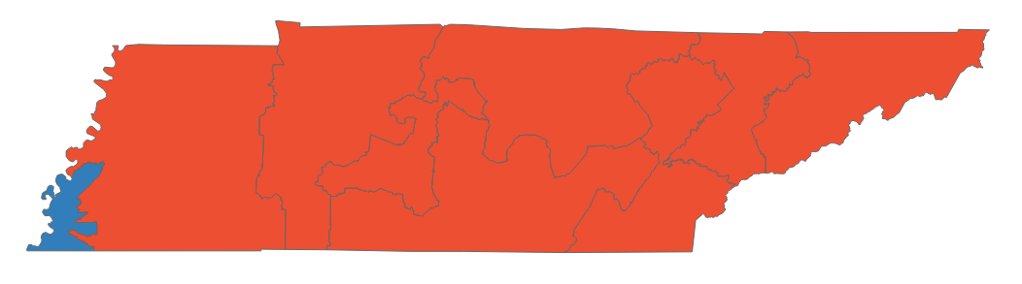
Tennessee primary dashboard
Primaries held August 4
POSITIONS ON THE BALLOT
KEY TAKEAWAYS
Federal and gubernatorial office only
Office | Seats | Incumbent party
House | 9 | 2 D, 7 R
Senate | 0 | -
Governor | 1 | R
1
Open seat in TN-05
Sitting Rep. Jim Cooper (D) retired after redistricting dismantled his seat, turning the 5th CD more solidly Republican
State Senator Heidi Campbell (D) ran uncontested and will face Maury County Mayor Andy Ogles (R) in November
Ogles prevailed in a crowded GOP primary field, ultimately receiving 37% of the vote
GOP runner-up Beth Harwell raised more in individual donations, but on-air spending favored Ogles
STATE DISTRICT MAP
2
Governor race set
Partisan coloring based on Cook Political Report with Amy Walter Race Rating
The Democratic primary featured three candidates, with Nashville physician Jason Martin narrowly beating Memphis lawyer and city councilman JB Smiley
Martin will face Incumbent Gov. Bill Lee (R); Lee ran uncontested and is favored to win in November
SOURCE Ballotpedia, The Cook Political Report with Amy Walter, WaPo, NYT
PRESENTATION CENTER 8/5/22
Notes:
Source:
“2022 House Race Ratings” The Cook Political Report with Amy Walter, updated May 24, 2022
https://www.cookpolitical.com/ratings/house-race-ratings
“United States congressional delegations from Tennessee” Ballotpedia, accessed May 25, 2022
https://ballotpedia.org/United_States_congressional_delegations_from_Tennessee
David Weigel. “Ogles wins closely watched GOP primary for U.S. House in Tennessee” Washington Post, August 5, 2022
https://www.washingtonpost.com/politics/2022/08/04/tennessee-primaries-abortion-republicans-democrats/
“Tennessee Primary Election Results” NYT, August 5, 2022
https://www.nytimes.com/interactive/2022/08/04/us/elections/results-tennessee.html

Slide 83
Tennessee primary results
Seat | Republican Primary Winner | Democratic Primary Winner | Cook Rating
TN-Governor | Bill Lee* (Uncontested) | Jason Martin (39.4%) | Solid R
TN-1 | Diana Harshbarger* (Uncontested) | Cameron Parsons (Uncontested) | Solid R
TN-2 | Tim Burchett* (Uncontested) | Mark Harmon (Uncontested) | Solid R
TN-3 | Chuck Fleischmann* (79.3%) | Meg Gorman (Uncontested) | Solid R
TN-4 | Scott DesJarlais* (Uncontested) | Wayne Steele (65.1%) | Solid R
TN-5 | Andy Ogles (36.9%) | Heidi Campbell (Uncontested) | Solid R
TN-6 | John Rose* (Uncontested) | Randal Cooper (74.6%) | Solid R
TN-7 | Mark Green* (Uncontested) | Odessa Kelly (Uncontested) | Solid R
TN-8 | David Kustoff* (83.7%) | Lynnette Williams (63.3%) | Solid R
TN-9 | Charlotte Bergmann (51.5%) | Steve Cohen* (88.%) | Solid D
*Incumbent
SOURCE AP data as of 8/29/22
PRESENTATION CENTER 8/29/22
Notes:
Source:
"AP Elections API" last accessed August 5, 2022
https://developer.ap.org/ap-elections-api/

Slide 84
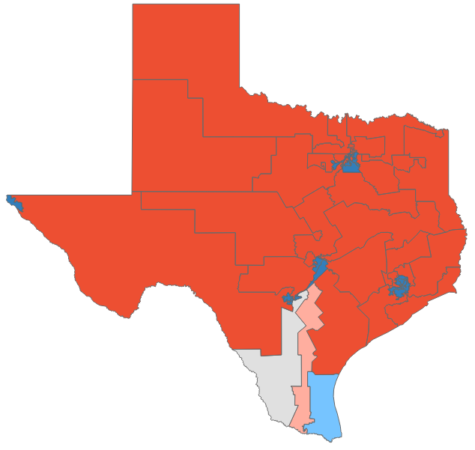
Texas primary dashboard
Primaries held March 1, runoffs May 24
POSITIONS ON THE BALLOT
KEY TAKEAWAYS
Federal and gubernatorial office only
Office | Seats | Incumbent party
House | 38 | 12 D, 23 R
Senate | 0 | -
Governor | 1 | R
1
Governor’s race set
Incumbent Governor Greg Abbott (R) and challenger Beto O’Rourke (D) scored decisive primary victories; Abbott received 66.6% of Republican votes while O’Rourke received 91.3% of Democratic votes
Abbott is still seen as the clear favourite against O’Rourke, who is widely seen by Democrats as their best chance of winning state-wide office
2
2022 GOP takes shape
STATE DISTRICT MAP
Former President Trump endorsed 33 candidates, all of whom either won primaries outright or headed to a runoff; however, Trump largely endorsed safe candidates
The GOP establishment prevailed over challenges from the far-right in the governor’s race and Morgan Luttrell’s victory over Christian Collins in the 8th CD
Partisan coloring based on Cook Political Report with Amy Walter Race Rating
SOURCE AP data as of 5/25/22, Ballotpedia, The Cook Political Report with Amy Walter, CNN, New York Times, The Hill, Texas Tribune
PRESENTATION CENTER 6/14/22
Notes:
Source:
James Barragan. “Texas Attorney General Ken Paxton easily defeats George P. Bush in GOP primary runoff” Texas Tribune, May 24, 2022
https://www.texastribune.org/2022/05/24/texas-attorney-general-runoff-results-ken-paxton-george-p-bush/
Reid J. Epstein. “Takeaways From the Texas Primary Elections” NY Times, March 2, 2022
https://www.nytimes.com/2022/03/02/us/politics/texas-primary-takeaways.html
Julia Manchester, Max Greenwood, and Tal Axelrod. “Five takeaways from the Texas primaries” The Hill, March 2, 2022
https://thehill.com/homenews/campaign/596468-five-takeaways-from-the-texas-primaries
Eric Bradner. “6 takeaways from the Texas primaries” CNN, March 2, 2022
https://www.cnn.com/2022/03/02/politics/texas-2022-primary-election-takeaways/index.html
“Texas Governor Primary Election Results” NY Times, accessed March 2, 2022
https://www.nytimes.com/interactive/2022/03/01/us/elections/results-texas-governor.html
“2022 House Race Ratings” The Cook Political Report with Amy Walter, updated May 24, 2022
https://www.cookpolitical.com/ratings/house-race-ratings
“United States congressional delegations from Texas” Ballotpedia, accessed May 25, 2022
https://ballotpedia.org/United_States_congressional_delegations_from_Texas
"AP Elections API" last accessed May 25, 2022
https://developer.ap.org/ap-elections-api/

Slide 85
Texas primary results (1/3)
Seat | Republican Primary Winner | Democratic Primary Winner | Cook Rating
TX-Governor | Greg Abbott* (66.5%) | Beto O'Rourke (91.4%) | Likely R
TX-1 | Nathaniel Moran (63.%) | Jrmar Jefferson (75.9%) | Solid R
TX-2 | Dan Crenshaw* (74.5%) | Robin Fulford (Uncontested) | Solid R
TX-3 | Keith Self** | Sandeep Srivastava (61.9%) | Solid R
TX-4 | Pat Fallon* (59.%) | Iro Omere (Uncontested) | Solid R
TX-5 | Lance Gooden* (Uncontested) | Tartisha Hill (52.7%) | Solid R
TX-6 | Jake Ellzey* (71.2%) | No Candidate | Solid R
TX-7 | Johnny Teague (63.7%) | Lizzie Fletcher* (Uncontested) | Solid D
TX-8 | Morgan Luttrell (52.1%) | Laura Jones (Uncontested) | Solid R
TX-9 | Jimmy Leon (Uncontested) | Al Green* (Uncontested) | Solid D
TX-10 | Michael McCaul* (Uncontested) | Linda Nuno (Uncontested) | Solid R
TX-11 | August Pfluger* (Uncontested) | No Candidate | Solid R
TX-12 | Kay Granger* (75.2%) | Trey Hunt (Uncontested) | Solid R
*Incumbent; **Self became the nominee due to the resignation of incumbent Rep. Van Taylor
SOURCE AP data as of 5/25/22
PRESENTATION CENTER 7/20/22
Notes:
Source:
"AP Elections API" last accessed May 25, 2022
https://developer.ap.org/ap-elections-api/

Slide 86
Texas primary results (2/3)
Seat | Republican Primary Winner | Democratic Primary Winner | Cook Rating
TX-13 | Ronny Jackson* (Uncontested) | Kathleen Brown (Uncontested) | Solid R
TX-14 | Randy Weber* (89.3%) | Mikal Williams (50.2%) | Solid R
TX-15 | Monica De La Cruz (56.5%) | Michelle Vallejo (50.1%) | Lean R
TX-16 | Irene Armendariz-Jackson (Uncontested) | Veronica Escobar* (88.%) | Solid D
TX-17 | Pete Sessions* (69.9%) | Mary Jo Woods (Uncontested) | Solid R
TX-18 | Carmen Montiel (Uncontested) | Sheila Jackson Lee* (Uncontested) | Solid D
TX-19 | Jodey Arrington* (Uncontested) | No Candidate | Solid R
TX-20 | Kyle Sinclair (Uncontested) | Joaquin Castro* (Uncontested) | Solid D
TX-21 | Chip Roy* (83.2%) | Claudia Zapata (63.5%) | Solid R
TX-22 | Troy Nehls* (87.2%) | Jamie Jordan (Uncontested) | Solid R
TX-23 | Tony Gonzales* (78.%) | John Lira (55.9%) | Solid R
TX-24 | Beth Van Duyne* (85.%) | Jan McDowell (51.2%) | Solid R
TX-25 | Roger Williams* (Uncontested) | No Candidate | Solid R
TX-26 | Michael Burgess* (66.8%) | No Candidate | Solid R
*Incumbent
SOURCE AP data as of 5/25/22
PRESENTATION CENTER 7/20/22
Notes:
Source:
"AP Elections API" last accessed May 25, 2022
https://developer.ap.org/ap-elections-api/

Slide 87
Texas primary results (3/3)
Seat | Republican Primary Winner | Democratic Primary Winner | Cook Rating
TX-27 | Michael Cloud* (72.5%) | Maclovio Perez (59.1%) | Solid R
TX-28 | Cassy Garcia (57.%) | Henry Cuellar (50.3%) | Toss Up
TX-29 | Robert Schafranek (60.2%) | Sylvia Garcia* (Uncontested) | Solid D
TX-30 | James Rodgers (56.9%) | Jasmine Crockett (60.6%) | Solid D
TX-31 | John Carter* (71.1%) | No Candidate | Solid R
TX-32 | Antonio Swad (57.%) | Colin Allred* (Uncontested) | Solid D
TX-33 | Patrick Gillespie (63.5%) | Marc Veasey* (69.5%) | Solid D
TX-34 | Mayra Flores (60.3%) | Vicente Gonzalez* (64.8%) | Lean D
TX-35 | Dan McQueen (61.2%) | Greg Casar (61.1%) | Solid D
TX-36 | Brian Babin* (Uncontested) | Jon Haire (Uncontested) | Solid R
TX-37 | Jenny Garcia Sharon (59.2%) | Lloyd Doggett* (79.3%) | Solid D
TX-38 | Wesley Hunt (55.3%) | Duncan Klussmann (60.8%) | Solid R
*Incumbent
SOURCE AP data as of 5/25/22
PRESENTATION CENTER 7/20/22
Notes:
Source:
"AP Elections API" last accessed May 25, 2022
https://developer.ap.org/ap-elections-api/

Slide 88

Utah primary dashboard
Primaries held June 28
POSITIONS ON THE BALLOT
KEY TAKEAWAYS
Federal and gubernatorial office only
Office | Seats | Incumbent party
House | 4 | 4 R
Senate | 1 | R
Governor | 0 | -
1
Hopeful Democrats
Democrats in Utah decided to rally their support and resources behind candidate Evan McMullin, a conservative-leaning independent who does not support former President Trump, in an attempt to defeat Sitting Sen. Mike Lee (R), who supports the former president
Sen. Lee easily defeated two other candidates to secure the GOP nomination, while McMullin ran unopposed
McMullin’s success amongst Utah conservatives in the 2016 presidential election boosts his chances of winning in November, making him a viable challenger for Sen. Lee
STATE DISTRICT MAP
Partisan coloring based on Cook Political Report with Amy Walter Race Rating
SOURCE AP data as of 06/29/22, Ballotpedia, The Cook Political Report with Amy Walter, Washington Post
PRESENTATION CENTER 6/29/22
Notes:
Source:
“2022 House Race Ratings” The Cook Political Report with Amy Walter, updated June 29, 2022
https://www.cookpolitical.com/ratings/house-race-ratings
“United States congressional delegations from Utah” Ballotpedia, accessed June 29, 2022
https://ballotpedia.org/United_States_congressional_delegations_from_Utah
"AP Elections API" last accessed June 29, 2022
https://developer.ap.org/ap-elections-api/

Slide 89
Utah primary results
Seat | Republican Primary Winner | Democratic Primary Winner | Cook Rating
UT-Senate | Mike Lee* (62.2%) | No Candidate | Likely R
UT-1 | Blake Moore* (58.8%) | Rick Jones (Uncontested) | Solid R
UT-2 | Chris Stewart* (72.9%) | Nick Mitchell (Uncontested) | Solid R
UT-3 | John Curtis* (71.2%) | Glenn Wright (Uncontested) | Solid R
UT-4 | Burgess Owens* (62.1%) | Darlene McDonald (Uncontested) | Solid R
*Incumbent
SOURCE AP data as of 6/29/22
PRESENTATION CENTER 7/20/22
Notes:
Source:
"AP Elections API" last accessed June 29, 2022
https://developer.ap.org/ap-elections-api/

Slide 90
Vermont primary dashboard
Primaries held August 9
POSITIONS ON THE BALLOT
KEY TAKEAWAYS
Federal and gubernatorial office only
Office | Seats | Incumbent party
House | 1 | 1 D
Senate | 1 | D
Governor | 1 | R
1
Breakthrough for women in Congress
Since the first woman was elected to Congress in 1916, nearly every state has voted to send at least one woman to Congress, Vermont being the exception
State Senate President Becca Balint (D-VT), backed by Senator Bernie Sanders, won the Democratic primary, putting her in a position to become the first women to hold congressional office in Vermont
Balint is a heavy favorite to win Vermont’s single congressional district in the upcoming general election
She will face GOP primary winner Liam Madden this November
STATE DISTRICT MAP
Partisan coloring based on Cook Political Report with Amy Walter Race Rating
2
Incumbent governor favored to win
Although Vermont rates solid blue for national and congressional elections, voters have historically been split on state level races
Incumbent Gov. Phil Scott (R) won the GOP primary as he seeks his fourth term
Scott will run against uncontested Democratic primary winner Brenda Siegel in the general election
SOURCE Ballotpedia, The Cook Political Report with Amy Walter, Washington Post, CNN, NYT
PRESENTATION CENTER 8/10/22
Notes:
Source:
“2022 House Race Ratings” The Cook Political Report with Amy Walter, updated June 29, 2022
https://www.cookpolitical.com/ratings/house-race-ratings
“United States congressional delegations from Vermont” Ballotpedia, accessed June 29, 2022
https://ballotpedia.org/United_States_congressional_delegations_from_Vermont
“Vermont Primary Election Results” accessed August 10, 2022
https://www.nytimes.com/interactive/2022/08/09/us/elections/results-vermont.html
Eric Bradner, Dan Merica, and Gregory Krieg, “Four takeaways from the Wisconsin, Vermont and Minnesota primaries” CNN, August 10, 2022
https://www.cnn.com/2022/08/09/politics/wisconsin-vermont-minnesota-primary-election-takeaways/index.htm
Aaron Blake, “Takeaways from the Minnesota, Vermont and Wisconsin primaries” The Washington Post, August 10, 2022
https://www.washingtonpost.com/politics/2022/08/10/takeaways-wisconsin-minnesota-vermont-primaries/

Slide 91
Vermont primary results
Seat | Republican Primary Winner | Democratic Primary Winner | Cook Rating
VT-Senate | Gerald Malloy (43%) | Peter Welch (87.4%) | Solid D
VT-Governor | Phil Scott* (69.2%) | Brenda Siegel (Uncontested) | Solid R
VT-AL | Liam Madden (41.4%) | Becca Balint (60.6%) | Solid D
*Incumbent
SOURCE AP data as of 8/10/22
PRESENTATION CENTER 8/10/22
Notes:
Source:
"AP Elections API" last accessed August 10, 2022
https://developer.ap.org/ap-elections-api/

Slide 92
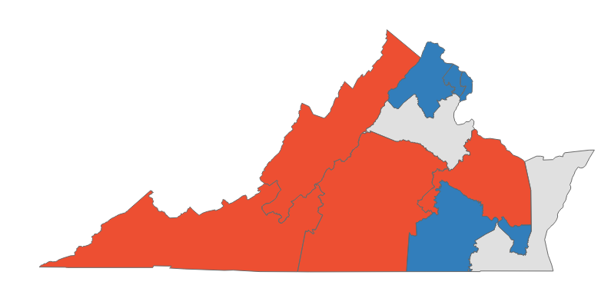
Virginia primary dashboard
Primaries held June 21
POSITIONS ON THE BALLOT
KEY TAKEAWAYS
Federal and gubernatorial office only
Office | Seats | Incumbent party
House | 11 | 7 D, 4 R
Senate | 0 | -
Governor | 0 | -
1
Frontrunning women
Republican voters selected two women to battle for Virginia’s two most competitive districts in the upcoming general election
Democratic incumbents Elaine Luria (D-VA-2) and Abigail Spanberger (D-VA-7) ran uncontested and will face off with GOP candidates Sen. Jen Kiggins (D-VA) and Yesli Vega in November
2
Democrats only
STATE DISTRICT MAP
Incumbent Rep. Donald Beyer (D-VA-8) faced a primary challenge for the first time in his four-term career and easily defeated his opponent Victoria Virsaingh in Virginia’s 8th CD, receiving 77.3% of the vote
Beyer will defend his safely Democratic seat against GOP candidate Karina Lipsman (R) in the upcoming general election
Partisan coloring based on Cook Political Report with Amy Walter Race Rating
SOURCE WTOP, The Washington Post, New York Times, The Cook Political Report with Amy Walter, Ballotpedia
PRESENTATION CENTER 6/27/22
Notes:
Sources:
“2022 House Race Ratings” The Cook Political Report with Amy Walter, updated June 21, 2022
https://www.cookpolitical.com/ratings/house-race-ratings
“United States congressional delegations from Virginia” Ballotpedia, accessed June 22, 2022
https://ballotpedia.org/United_States_congressional_delegations_from_Virginia
"AP Elections API" last accessed June 22, 2022
https://developer.ap.org/ap-elections-api/
The Washington Post. (2022, June 21). Va. Republicans pick two women to take on Luria, Spanberger in November. The New York Times. Retrieved June 8, 2022, from
https://www.washingtonpost.com/dc-md-va/2022/06/21/virginia-primaries-congress-results/
“Virginia Primary Election Results” The New York Times, accessed June 22, 2022
https://www.nytimes.com/interactive/2022/06/21/us/elections/results-virginia.html
Rick Massimo, “Va. results: Vega wins GOP primary in 7th District; Beyer Dem winner in 8th”, WTOP, June 22, 2022
https://wtop.com/local-politics-elections-news/2022/06/polls-close-in-virginia-primaries/

Slide 93
Virginia primary results
Seat | Republican Primary Winner | Democratic Primary Winner | Cook Rating
VA-1 | Rob Wittman* (Uncontested) | Herb Jones (Uncontested) | Solid R
VA-2 | Jen Kiggans (55.8%) | Elaine Luria* (Uncontested) | Toss Up
VA-3 | Terry Namkung (61.7%) | Bobby Scott* (Uncontested) | Solid D
VA-4 | Leon Benjamin (Uncontested) | Donald McEachin* (Uncontested) | Solid D
VA-5 | No Candidate | Joshua Throneburg (Uncontested) | Solid R
VA-6 | Ben Cline* (82.3%) | No Candidate | Solid R
VA-7 | Yesli Vega (28.9%) | Abigail Spanberger* (Uncontested) | Toss Up
VA-8 | No Candidate | Donald Beyer* (77.3%) | Solid D
VA-9 | Morgan Griffith* (Uncontested) | No Candidate | Solid R
VA-10 | No Candidate | Jennifer Wexton* (Uncontested) | Solid D
VA-11 | No Candidate | Gerry Connolly* (Uncontested) | Solid D
*Incumbent
SOURCE AP data as of 6/22/22
PRESENTATION CENTER 7/20/22
Notes:
Source:
"AP Elections API" last accessed June 22, 2022
https://developer.ap.org/ap-elections-api/

Slide 94
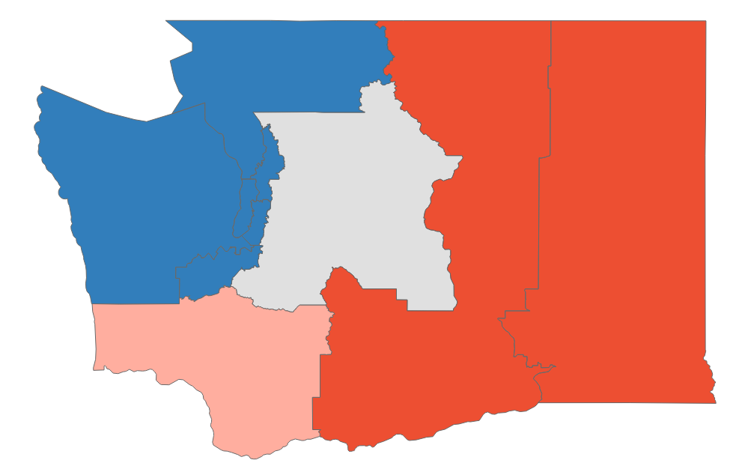
Washington primary dashboard
Primaries held August 2
POSITIONS ON THE BALLOT
KEY TAKEAWAYS
Federal and gubernatorial office only
Office | Seats | Incumbent party
House | 10 | 7 D, 3 R
Senate | 1 | D
Governor | 0 | -
1
Impeachment challenges
Reps. Jaime Herrera Beutler (R-WA-3) and Dan Newhouse (R-WA-4) voted to impeach former President Trump with inciting the Jan 6. Capitol attack, and both faced upward battles in their re-election campaigns against Trump-endorsed candidates
Newhouse narrowly won the most votes in his district’s open, non-partisan primary but Beutler ultimately lost her primary by 0.5%
2
Republican target: 8th CD
STATE DISTRICT MAP
Washington’s sole swing district is held by Rep. Kim Schrier (D-WA-8), who handily won her district’s crowded 11-person primary with 48.1% of the vote
Republican candidate Matt Larkin has the second most votes so far with 16.7% of the vote, followed by Republican candidate Reagan Dunn with 14.9% of the vote
Partisan coloring based on Cook Political Report with Amy Walter Race Rating
SOURCE Ballotpedia, The Cook Political Report with Amy Walter, CNN, The Hill, NYT, Seattle Times
PRESENTATION CENTER 8/3/22
Notes:
Source:
“Washington Primary Election Results” NY Times, accessed August 4, 2022
https://www.nytimes.com/interactive/2022/08/02/us/elections/results-washington.html
Max Greenwood. “Five takeaways from primaries in Arizona, Missouri and beyond” The Hill, August 3, 2022
https://thehill.com/homenews/campaign/3585737-five-takeaways-from-primaries-in-arizona-missouri-and-beyond/
Eric Bradner, Dan Merica, and Gregory Krieg. “Six takeaways from Kansas, Michigan, Missouri, Arizona and Washington primaries” CNN, August 3, 2022
https://www.cnn.com/2022/08/02/politics/arizona-michigan-missouri-primary-election-takeaways/index.html
Jonathan Weisman and Luke Boradwater. “A Long, Hard Year for Republicans Who Voted to Impeach After Jan. 6” NY Times, January 5, 2022
https://www.nytimes.com/2022/01/05/us/politics/republican-impeachment-votes-trump-jan-6.html
“2022 House Race Ratings” The Cook Political Report with Amy Walter, updated June 21, 2022
https://www.cookpolitical.com/ratings/house-race-ratings
“United States congressional delegations from Washington” Ballotpedia, accessed August 3, 2022
https://ballotpedia.org/United_States_congressional_delegations_from_Washington

Slide 95
Washington primary results
Seat | Top-Vote-Getter #1 | Top-Vote-Getter #2 | Cook Rating
WA-Senate | Patty Murray* (52.4%) | Tiffany Smiley (33.6%) | Solid D
WA-1 | Suzan DelBene* (62%) | Vincent Cavaleri (19.9%) | Solid D
WA-2 | Rick Larsen* (45.8%) | Dan Matthews (17%) | Solid D
WA-3 | Marie Perez (31%) | Joe Kent (22.8%) | Lean R
WA-4 | Dan Newhouse* (25.5%) | Doug White (25.2%) | Solid R
WA-5 | Cathy McMorris Rodgers* (51.5%) | Natasha Hill (30.1%) | Solid R
WA-6 | Derek Kilmer* (50.4%) | Elizabeth Kreiselmaier (23.8%) | Solid D
WA-7 | Pramila Jayapal* (84.9%) | Cliff Moon (7.6%) | Solid D
WA-8 | Kim Schrier* (47.9%) | Matt Larkin (17%) | Toss Up
WA-9 | Adam Smith* (56.3%) | Doug Basler (20.6%) | Solid D
WA-10 | Marilyn Strickland* (55.4%) | Keith Swank (34%) | Solid D
*Incumbent
SOURCE AP data as of 8/29/22
PRESENTATION CENTER 8/29/22
Notes:
Source:
"AP Elections API" last accessed August 3, 2022
https://developer.ap.org/ap-elections-api/

Slide 96
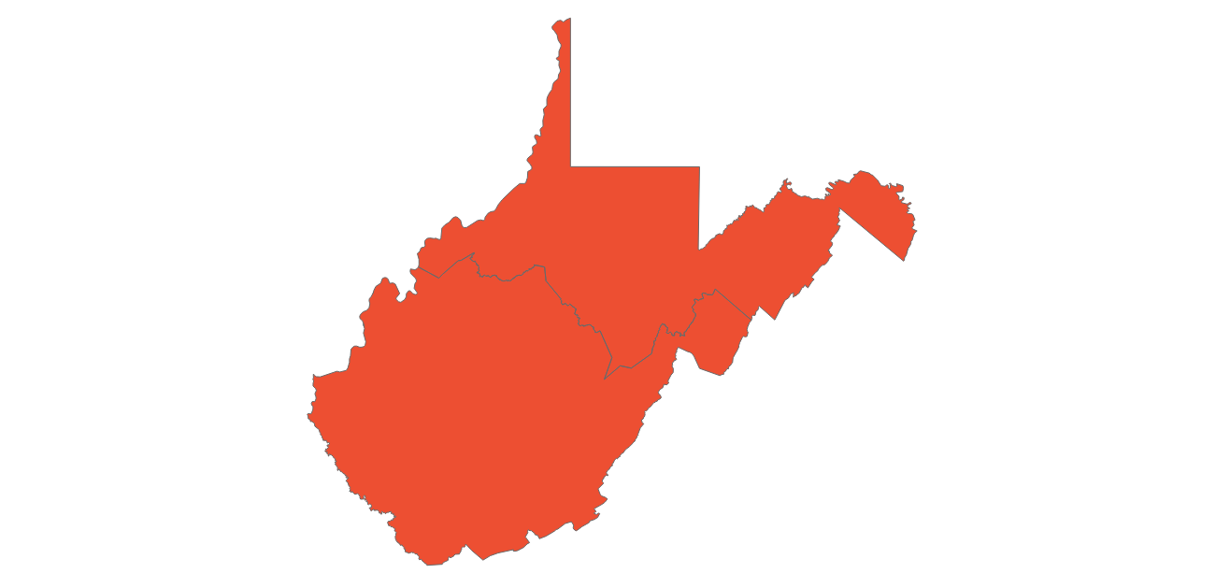
West Virginia primary dashboard
Primaries held May 10
POSITIONS ON THE BALLOT
KEY TAKEAWAYS
Federal and gubernatorial office only
Office | Seats | Incumbent party
House | 2 | 3 R
Senate | 0 | -
Governor | 0 | -
1
Trump’s influence
Redistricting in West Virginia’s 2nd CD pitted two incumbents against each other
Trump-endorsed Rep. Alex Mooney (R) defeated David McKinley (R), who was backed by Gov. Jim Justice (R) and Sen. Joe Manchin (D)
Rep. Mooney will face Barry Lee Wendell (D) in the November elections, but the district is still safely Republican
2
1st Congressional District
STATE DISTRICT MAP
Sitting Rep. Carol Miller (R) swiftly defeated 3 others in the West Virginia primaries
Miller will face Dem. candidate Lacy Watson, who ran uncontested, in a Republican stronghold district
Partisan coloring based on Cook Political Report with Amy Walter Race Rating
SOURCE CNN, ABC, New York Times, FiveThirtyEight, West Virginia Gazette, The Cook Political Report with Amy Walter, Ballotpedia
PRESENTATION CENTER 6/14/22
Notes:
Source:
ABC News Network. (n.d.). ABC News. Retrieved May 11, 2022, from https://abcnews.go.com/Politics/west-virginia-2022-primary-election-results/story?id=84596244
Baseballot. (2022, May 10). The West Virginia and Nebraska primaries will be the latest test for Trump's endorsement. FiveThirtyEight. Retrieved May 11, 2022, from https://fivethirtyeight.com/features/the-west-virginia-and-nebraska-primaries-will-be-the-latest-test-for-trumps-endorsement/
Chowdhury, M., Lee, J. M., & Macaya, M. (2022, May 11). Live updates: West Virginia and Nebraska election results 2022. CNN. Retrieved May 11, 2022, from https://www.cnn.com/politics/live-news/primary-election-results-west-virginia-nebraska-2022/index.html?tab=West+Virginia
Chowdhury, M., Lee, J. M., & Macaya, M. (2022, May 11). Live updates: West Virginia and Nebraska election results 2022. CNN. Retrieved May 11, 2022, from https://www.cnn.com/politics/live-news/primary-election-results-west-virginia-nebraska-2022/index.html?tab=West+Virginia
mtony@hdmediallc.com, M. T. (2022, May 11). Hunt gets Republican primary nod in State Senate race after opponent declared ineligible. Mail. Retrieved May 11, 2022, from https://www.wvgazettemail.com/news/politics/election_2022/hunt-gets-republican-primary-nod-in-state-senate-race-after-opponent-declared-ineligible/article_51e41d63-1646-5572-a95b-e27eead430e9.html
The New York Times. (2022, May 10). West Virginia state Senate Eighth district primary election results. The New York Times. Retrieved May 11, 2022, from https://www.nytimes.com/interactive/2022/05/10/us/elections/results-west-virginia-state-senate-district-8.html
The New York Times. (2022, May 10). West Virginia state senate third district primary election results. The New York Times. Retrieved May 11, 2022, from https://www.nytimes.com/interactive/2022/05/10/us/elections/results-west-virginia-state-senate-district-3.html

Slide 97
West Virginia primary results
Seat | Republican Primary Winner | Democratic Primary Winner | Cook Rating
WV-1 | Carol Miller* (66.4%) | Lacy Watson (Uncontested) | Solid R
WV-2 | Alexander Mooney*t (54.2%) | Barry Wendell (57.2%) | Solid R
*Incumbent
SOURCE AP data as of 5/11/22
PRESENTATION CENTER 7/20/22
Notes:
Source:
"AP Elections API" last accessed May 11, 2022
https://developer.ap.org/ap-elections-api/

Slide 98
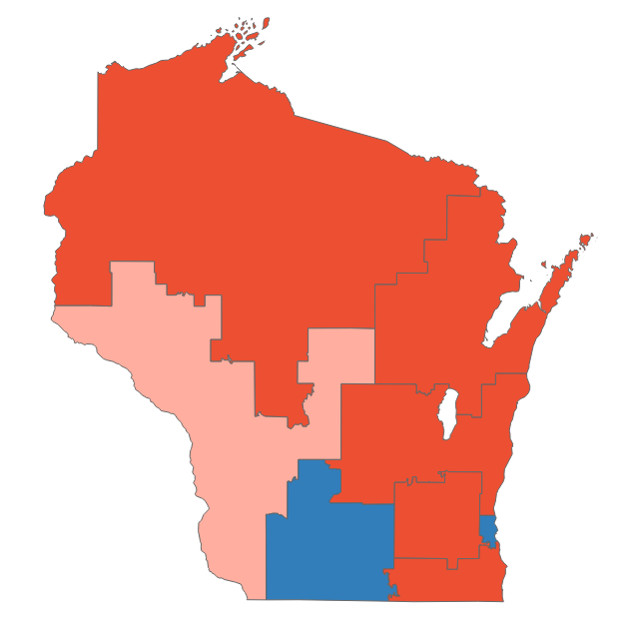
Wisconsin primary dashboard
Primaries held August 9
POSITIONS ON THE BALLOT
KEY TAKEAWAYS
Federal and gubernatorial office only
Office | Seats | Incumbent party
House | 8 | 3 D, 5 R
Senate | 1 | R
Governor | 0 | D
1
Governor race set
Tim Michels (R) defeated former Lt. Gov. Rebecca Kleefisch (R) in a primary race that has been considered a proxy war between former President Trump and former VP Pence, with Trump’s pick ultimately prevailing
Michels will face incumbent Gov. Tony Evers (D) in November as Evers seeks his second term; the race is considered one of the most critical of 2022
2
Senate match up
Sen. Ron Johnson (R) will face Lt. Gov. Mandela Barnes (D) in November in a race for one of just two open Senate seats that Republicans hold in a state where President Biden won in 2020
STATE DISTRICT MAP
Partisan coloring based on Cook Political Report with Amy Walter Race Rating
3
WI-03
Incumbent Rep. Ron Kind (D WI-03) announced his retirement last year, paving the way for an open seat race between state sen. Brad Pfaff (D) and Trump-endorsed former Navy SEAL Derrick Van Orden (R)
Van Orden is slightly favored in the general election and has outraised Pfaff $4.5 million to $722,000 as of July 20
SOURCE WaPo, NYT, CNBC, Politico, NPR, Ballotpedia, FEC, The Cook Political Report with Amy Walter
PRESENTATION CENTER 8/10/22
Notes:
Source:
“2022 House Race Ratings” The Cook Political Report with Amy Walter, updated June 6, 2022
https://www.cookpolitical.com/ratings/house-race-ratings
“United States congressional delegations from Wisconsin” Ballotpedia, accessed August 10, 2022
https://ballotpedia.org/United_States_congressional_delegations_from_Wisconsin
Blake, Aaron. “Takeaways from the Minnesota, Vermont, and Wisconsin primaries” Washington Post, August 10, 2022. https://www.washingtonpost.com/politics/2022/08/10/takeaways-wisconsin-minnesota-vermont-primaries/
Breuninger, Kevin. “Sen. Ron Johnson faces Democratic challenger Mandela Barnes in Wisconsin general election” CNBC, August 9, 2022. https://www.cnbc.com/2022/08/09/sen-ron-johnson-faces-democratic-challenger-mandela-barnes-in-wisconsin-general-election.html
Hawkins, Ari. “Sarah Godlewski suspends Wisconsin Senate campaign, endorses Barnes” Politico, July 29, 2022. https://www.politico.com/news/2022/07/29/sarah-godlewski-suspends-wisconsin-senate-campaign-endorses-barnes-00048717
“Here are the key primary elections results from Wisconsin” NPR, August 9 2022. https://www.npr.org/sections/2022-live-primary-election-race-results/2022/08/09/1115695802/wisconsin-primary-election-results
Mutnick, Ally et. al. “Rep. Ron Kind announces retirement in boon to GOP’s House hopes” Politico, August 10, 2021. https://www.politico.com/news/2021/08/10/kind-reelection-503343
“Wisoncin’s 3rd Congressional District Election, 2022” Ballotpedia, August 10 2022. https://ballotpedia.org/Wisconsin%27s_3rd_Congressional_District_election,_2022
“Wisconsin – House District 03” Federal Election Commission, August 2022 https://www.fec.gov/data/elections/house/WI/03/2022/
Wang, Amy. “Michels wins GOP primary for Wisconsin governor” Washington Post, August 9, 2022 https://www.washingtonpost.com/politics/2022/08/09/primaries-wisconsin-vermont-minnesota-connecticut/

Slide 99
Wisconsin primary results
Seat | Republican Primary Winner | Democratic Primary Winner | Cook Rating
WI-Senate | Ron Johnson* (83.7%) | Mandela Barnes (77.8%) | Toss Up
WI-Governor | Tim Michels (47.2%) | Tony Evers* (Uncontested) | Toss Up
WI-1 | Bryan Steil* (Uncontested) | Ann Roe (Uncontested) | Solid R
WI-2 | Not Yet Called | Mark Pocan* (Uncontested) | Solid D
WI-3 | Derrick Van Orden (Uncontested) | Brad Pfaff (38.9%) | Lean R
WI-4 | Tim Rogers (74.8%) | Gwen Moore* (Uncontested) | Solid D
WI-5 | Scott Fitzgerald* (Uncontested) | Mike Van Someren (Uncontested) | Solid R
WI-6 | Glenn Grothman* (82.5%) | No Candidate | Solid R
WI-7 | Tom Tiffany* (86.6%) | Richard Ausman (Uncontested) | Solid R
WI-8 | Mike Gallagher* (84.6%) | No Candidate | Solid R
WI-2 has been called by some outlets; *Incumbent
SOURCE AP data as of 8/29/22
PRESENTATION CENTER 8/29/22
Notes:
Source:
"AP Elections API" last accessed August 10, 2022
https://developer.ap.org/ap-elections-api/

Slide 100
Wyoming primary dashboard
Primaries held August 16
POSITIONS ON THE BALLOT
KEY TAKEAWAYS
Federal and gubernatorial office only
Office | Seats | Incumbent party
House | 1 | 1 R
Senate | 0 | -
Governor | 1 | R
1
Liz Cheney defeated
Rep. Liz Cheney (R-AL), former chair of the House Republican Conference, was defeated by Harriet Hageman following sustained opposition from pro-Trump Republicans
Cheney drew increasing criticism from the GOP in the last few years for her perceived disloyalty to Trump, manifested in her leadership on the House Jan. 6 Committee and her vote to impeach the former President
Following her defeat, Cheney announced she’s considering running for president
STATE DISTRICT MAP
2
Statewide races set
Partisan coloring based on Cook Political Report with Amy Walter Race Rating
Incumbent Gov. Mark Gordon (R) defeated two GOP challengers in his reelection bid despite internal concerns that his relatively strict COVID-19 measures would hamstring his campaign
Trump-backed state Rep. Chuck Gray (R) won the GOP primary to replace retiring Sec. of State Ed Buchanan (R)
Gray’s campaign centered on election integrity and alleged 2020 election fraud—a position which his opponent Sen. Tara Nethercott (R) rejected, saying there is no evidence to support such claims of fraud
SOURCE Washington Post, Politico, Wyoming Public Media, Associated Press, New York Times, The Cook Political Report with Amy Walter
PRESENTATION CENTER 8/17/22
Notes:
Sources:
“2022 House Ratings” Cook Political Report, August 2022. https://www.cookpolitical.com/ratings/house-race-ratings
John Wagner and Mariana Alfaro. “After losing in Wyoming, Cheney says she’s considering a run for president.” The Washington Post, August 17, 2022. https://www.washingtonpost.com/politics/2022/08/17/cheney-wyoming-giuliani-georgia-trump/
Alex Isenstadt. “How Team Trump Systematically Snuffed Out Liz Cheney’s Reign in Congress.” Politico, August 16, 2022. https://www.politico.com/news/2022/08/16/trump-world-campaign-liz-cheney-wyoming-00052299
Shane Goldmacher. “What Liz Cheney’s Lopsided Loss Says about the State of the GOP.” New York Times, August 17, 2022. https://www.nytimes.com/2022/08/17/us/politics/liz-cheney-republicans.html
Kamila Kudelska. “In a Tight Race, Chuck Gray Comes Out as Winner for Secretary of State Republican Nomination.” Wyoming Public Media, August 16, 2022. https://www.wyomingpublicmedia.org/politics-government/2022-08-16/in-a-tight-race-chuck-gray-comes-out-as-winner-for-secretary-of-state-republican-nomination
Mead Gruver and James Anderson. “Gov. Gordon Wins Wyoming GOP Primary for 2nd Term.” Associated Press, August 17, 2022. https://apnews.com/article/2022-midterm-elections-covid-health-presidential-biden-cabinet-1532e6899d83c777eb2f2cc667b1469b

Slide 101
Wyoming primary results
Seat | Republican Primary Winner | Democratic Primary Winner | Cook Rating
WY-Governor | Mark Gordon* (61.7%) | Theresa Livingston (71.2%) | Solid R
WY-1 | Harriet Hageman (66.3%) | Lynnette GreyBull (62.3%) | Solid R
*Incumbent
SOURCE AP data as of 8/17/22
PRESENTATION CENTER 8/17/22
Notes:
Source:
"AP Elections API" last accessed August 17, 2022
https://developer.ap.org/ap-elections-api/

Slide 102

Ways to edit these slides
Looking to customize these slides yourself?
Looking for assistance with customization?
No problem.
The slides in this deck can be edited to suit your needs. However, if you alter text, data or images on our slides, we ask that you remove National Journal logos and branding prior to distribution or public use. Look for:
We’re here to help.
If you’d like our team of policy researchers and data visualization specialists to customize this deck with your vision in mind, contact your Dedicated Advisor or email service@nationaljournal.com.
This service is included in most membership packages.
Feel free to delete this slide before presenting.

