Slide 1



Modern Vinyl
Part 1: Responsible Vinyl Manufacturing
Notes:
Hi. I am Jay Thomas, Vice President of Sustainability for the Vinyl Institute and today we will be discussing Part 1 in a four part educational series on Modern Vinyl.

Slide 2
Presentation Description
Vinyl products are an essential building material. With their unique performance characteristics, they are often the best selection for applications where durability, aesthetics, and value are vital. ​
Modern vinyl production is a closely controlled and regulated process with an exceptional record of safety in the chemical industry. ​
This presentation is part one in a four-part series on today's modern vinyl.
  Part One - Modern Vinyl – Demystifying today's responsible PVC manufacturing.
  Part Two - Evaluating Hazard & Risk – Understanding the importance of multi-attribute product specification.
  Part Three - Resource Efficiency – How to use life cycle analysis, embodied carbon and circularity to tell the story of today’s modern vinyl.
  Part Four – Manufacturer Responsibility – How industry sustainability standards verify responsible manufacturing and help drive business success.
Notes:
Today's presentation, entitled Responsible Vinyl Manufacturing, will provide an in-depth understanding of the production of vinyl resin and the role of industry manufacturer sustainability programs in advancing industry progress, reputation and success. In Part 2 we will discuss the facts about PVC hazard vs. Risk and common misperceptions, in Part 3, we will review vinyl recycling programs and progress and in Part 4 we will review the role of manufacture responsibility programs like +Vantage Vinyl in product specification and selection. This presentation is available to VSC members at +Vantagevinyl.com in the member portal. Feel free to download the slides and use them in your presentations.
There is a common theme that runs throughout the presentation, and its the term "Modern Vinyl". There is a perception of vinyl that has its roots in industrial production prior to the Clean Air Act in the 1970's. Remarkably this still influences perceptions today. So we emphasize the idea of today's modern vinyl and the idea of "Responsible PVC Manufacturing" to help draw the distinction between the way things used to be done and how they are done responsibly today.

Slide 3

Learning Objectives
Gain an understanding of the basics of vinyl material production, regulations that govern vinyl production, and improvements in emissions performance​
Explore the many uses and applications of vinyl products​
Explore programs that govern and verify sustainability
compliance parameters, simplifying the specification of
sustainable vinyl products
Notes:
After reviewing this presentation, you will be able to describe how vinyl is made from two abundant natural ingredients and the voluntary and regulatory updates to the production of modern vinyl; understand how the product supply chain impacts company sustainability commitments; and the role of company sustainability verification standards in evaluating and recommending product suppliers.

Slide 4
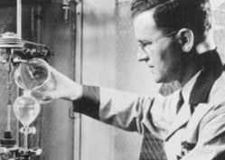
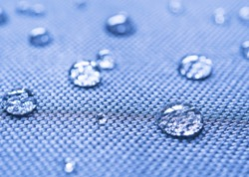
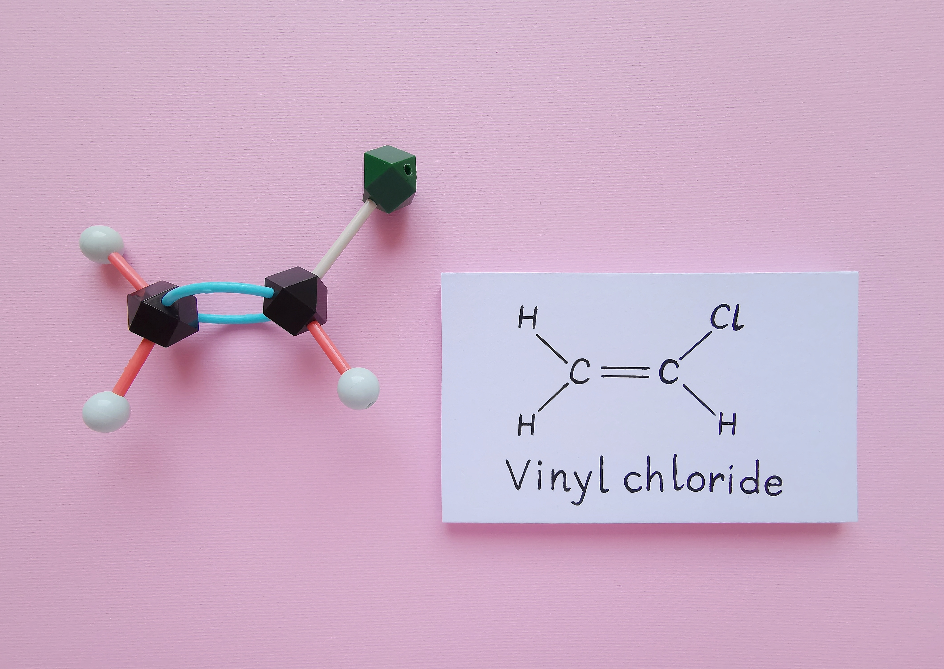
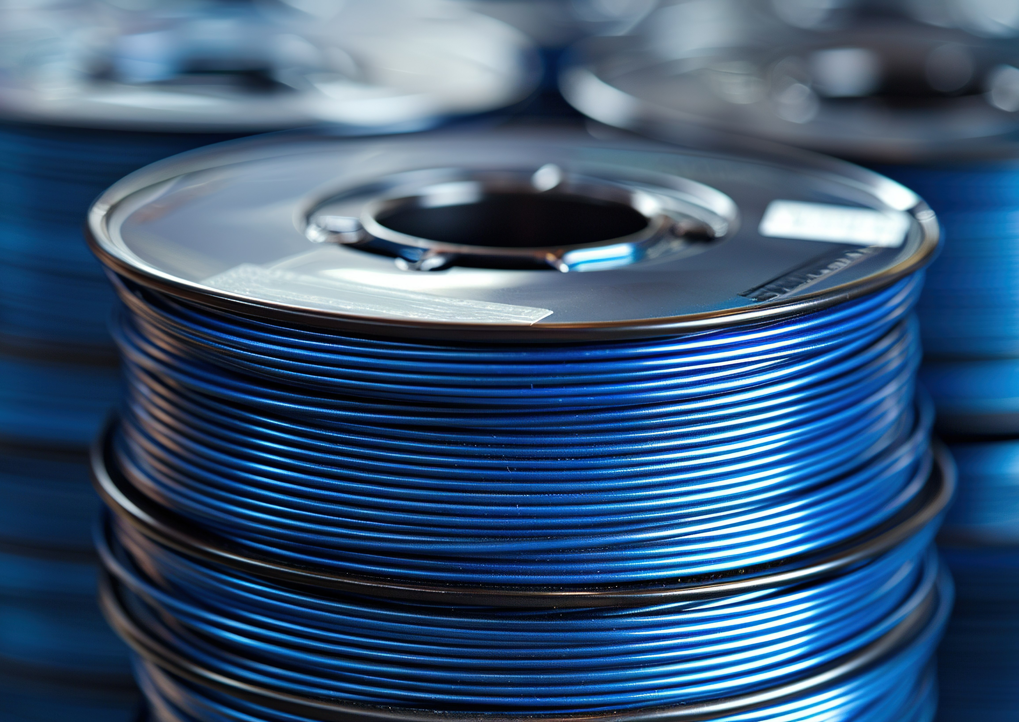
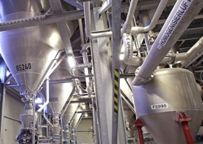
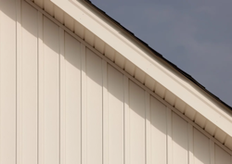
Modern Vinyl​
What is Vinyl?​
Polyvinyl chloride, known as PVC, or vinyl, is a synthetic thermoplastic material made
by polymerizing vinyl chloride ​
Discovered in the 19th century and commercialized in the 1920s
Vinyl is the 3rd largest plastic produced in the world by volume​
Today’s vinyl manufacturers are committed to a high standard
of health, safety and environmental performance​
Notes:
Polyvinyl Chloride, also known as PVC or vinyl , was first discovered in the late 19th century but was not commercialized until 1926 when Waldo Semon, a chemical engineer at B.F. Goodrich discovered a method to make it flexible by blending it with a variety of additives.
Soon after his discovery, PVC-based products such as insulated wire, raincoats and shower curtains were introduced to the market. As more uses for vinyl were discovered, industry developed more ways to produce and process the new plastic including a wide variety of building products.
Vinyl’s performance, aesthetics and value led it to become the third-largest plastic produced in the world by volume.
The manufacturing processes for vinyl production have continuously improved over the years and today’s modern vinyl is produced under highly controlled and regulated health and safety conditions.

Slide 5
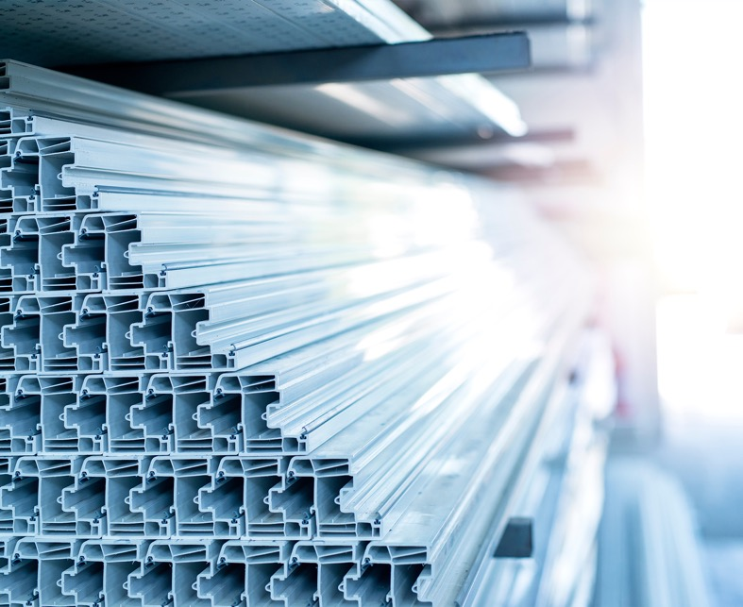
Vinyl material composition,
production,
& regulation ​
Notes:
To evaluate a material, it is helpful to know the basics about how it is made. So lets dive into that and try to demystify the process.

Slide 6
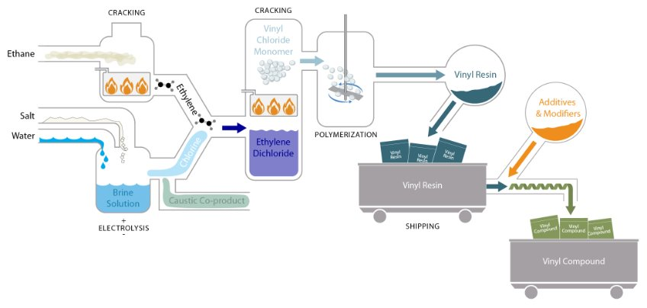
Vinyl Production process
Vinyl Institute, Production, Complex Chemistry Based on Common Salt, https://www.vinylinfo.org/production/
Notes:
Like all plastic materials, vinyl results from a series of processing steps that convert hydrocarbon-based raw materials into unique synthetic products called polymers. The vinyl polymer is unusual, however, because it is based only in part on hydrocarbon feedstocks. In the United States ethylene is obtained by processing, or cracking, natural gas or petroleum. More than half of the vinyl polymer is based on the natural element chlorine.

Slide 7
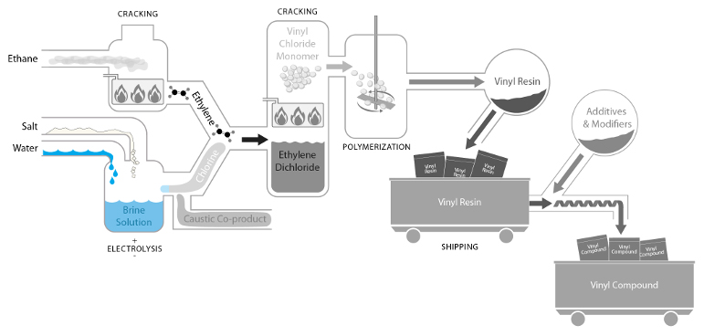
Vinyl Production process
Notes:
Chlorine gives vinyl two advantages. First, chlorine is derived from brine — a solution of common salt and water, that is abundant and readily available. Second, chlorine has excellent inherent flame-retardant properties. These properties are passed on directly to vinyl end-products, making vinyl an excellent choice for applications such as electrical conduit and wiring that require high resistance to ignition and flame spread. Once chlorine is processed into vinyl, it is chemically locked into the product.

Slide 8
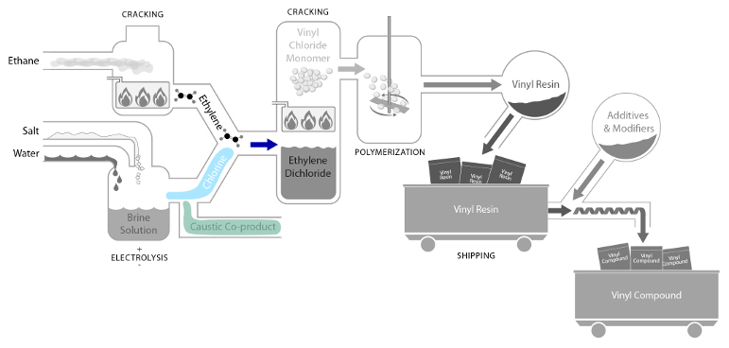
Vinyl Production process​
Notes:
In the electrolytic disassociation of sodium chloride, chlorine gas and liquid caustic are yielded as coproducts. About 50% of chlorine is used for water disinfection and the remainder is sequestered in PVC during the resin production process.
The liquid caustic soda co-product is essential for everything from medicine to cleaning products, to paper and aluminum among many other products in commerce.
Most people are unaware of this important chlor-alkali ecosystem and the important role that vinyl plays in maintaining the economic balance of these ingredients for a very large number of products that we rely on every day. Without the market for PVC, availability of chlorine for water disinfection and caustic soda for hundreds of other products would likely be less available and at a higher cost.

Slide 9
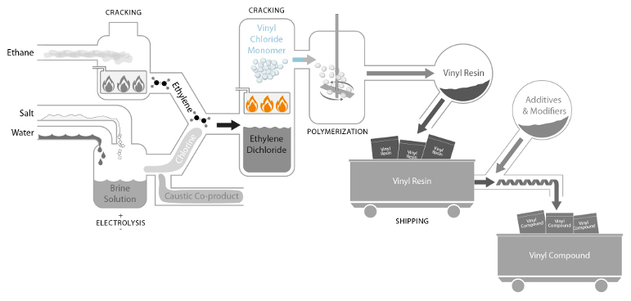
Vinyl Production process
Notes:
Through a chemical reaction, ethylene and chlorine combine to form ethylene dichloride which, in turn, is transformed into a gas called vinyl chloride. Vinyl chloride is a carcinogen and so its processing is very closely controlled and regulated.

Slide 10
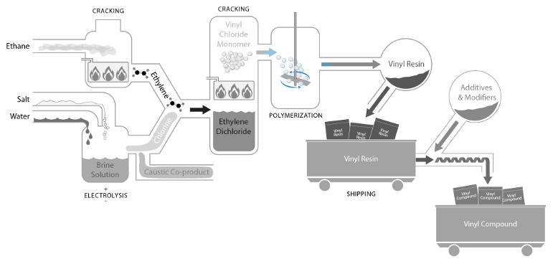
Vinyl Production process
Notes:
The manufacture of vinyl resin occurs when vinyl chloride monomer is polymerized into vinyl resin.
Polymerization is a chemical reaction in which two or more molecules combine to form larger molecules that contain repeating structural units, similar to combining links of a chain. Since the 1970's the manufacture and use of vinyl chloride is completed in a closed process and a combination of engineering and administrative controls and personal protective equipment are used to help ensure the health and safety of employees and the compliance with Occupational Safety and Health Administration (OSHA) employee exposure limits.

Slide 11
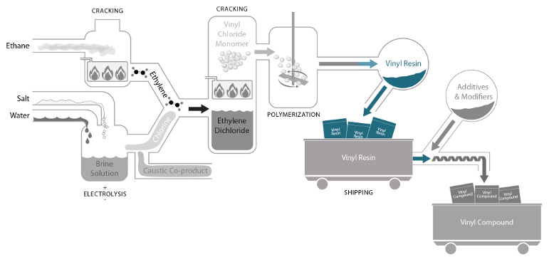
Vinyl Production process​
Notes:
Vinyl resin is the result of the polymerization process and is produced in the form of a powder. When vinyl chloride monomer (or VCM) is turned into PVC, the PVC is inert, and can’t return back to the VC monomer. Like with eggs, once you transform it by frying you can’t go back to its original form.
Residual vinyl chloride levels in all grades of PVC resin typically are significantly below acceptable regulatory levels and resulting fabricated products are typically at non detect levels to very low parts-per-billion (ppb).

Slide 12
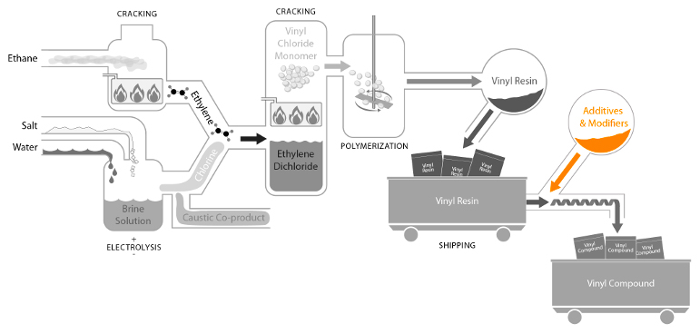
Vinyl Production process​
Notes:
One more step remains before the resin becomes a useful material. Besides looking like flour, vinyl resin is analogous to flour in another way. Just as flour can be combined with other ingredients to make cake or bread, vinyl resin can be combined with a variety of additives and modifiers to make many different kinds of products.

Slide 13
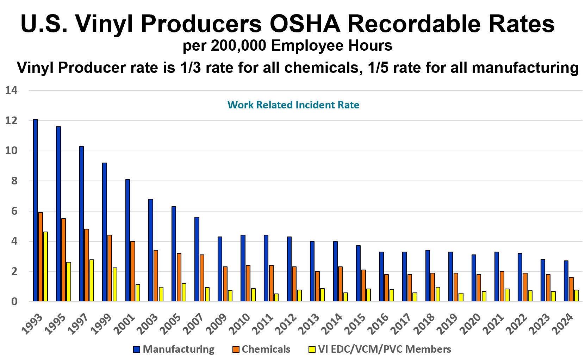
Vinyl Production Safety Performance ​
In 2024, 28 production facilities manufacturing EDC, VCM, PVC resin or PVC/CPVC compounds received 41 safety and environmental performance awards, including: ​
Zero OSHA recordable injuries or illnesses​
Zero OSHA recordable incidents for more than 5 years​
PVC production sites are significantly safer than the national manufacturing average​
Notes:
Evidence of the safety of US vinyl production can be seen in the overall, U.S. vinyl producer OSHA recordable rates which is 1/3rd the rate for all chemicals, and 1/5th the rate for all manufacturing. (Source for these statistics are VI Survey and US Bureau of Labor Statistics.)

Slide 14
Cancer risks in the louisiana industrial corridor ​
5.5% lower in the corridor
Source: https://louisianahealthfacts.com/how-we-compare/
Notes:
Human health is a high priority for the vinyl industry and has been a focus of process improvements over the decades. The Louisiana industrial corridor is home for many industrial companies, a relatively small portion of which is vinyl resin production. This area is often referred to as "Cancer Alley" by anti-chemical organizations. The facts do not support this allegation. In fact, Louisiana's industrial corridor has some of the best health outcomes compared to the rest of the state. Cancer incident rates are 5.5% lower in the corridor than the rest of the state.

Slide 15
Cancer risks in the louisiana industrial corridor​
7.3% lower in the corridor
Source: https://louisianahealthfacts.com/how-we-compare/
Notes:
And cancer mortality rates are 7.3% lower.

Slide 16



Vinyl Production Regulations​
Vinyl production has been highly regulated since the 1970s​
Employee Safety Standard 1910.1017 - VCM
Exposure less than 1 ppm averaged over
any 8-hour period​
Exposure no greater than 5 ppm averaged over any period not exceeding 15 minutes​
Clean Air Act Standard​
Emissions of hazardous air pollutants from PVC production are regulated under the Clean Air Act via the National Emission Standard for Vinyl Chloride 40 C.F.R. Part 61 Subpart F and the National Emissions Standards for Hazardous Air Pollutants for Polyvinyl Chloride and Copolymers Production 40 C.F.R. Part 63 Subparts DDDDDD and HHHHHHH.
Transportation Standard ​
Special packaging and labeling stating hazardous materials​
Detailed shipping paperwork with hazardous properties outlined​
Special training for
transporting material​
Rigorous reporting on spills
or incidents during shipping
Notes:
It is important to identify specifically how extensively vinyl production is regulated. Manufacturing of PVC in the U.S. is regulated through several programs and statutes administered by federal agencies. As previously mentioned, the Occupational Safety and Health Administration (OSHA) regulates employee exposure to vinyl chloride. The Clean air act regulates emissions through several regulatory standards and the Dept. of Transportation regulates shipping. Suffice it to say that the vinyl industry is one of the most regulated industries in the United States.
OSHAA VCM standard 1910.1017.
According to the standard,
1910.1017(c)(1)
No employee may be exposed to vinyl chloride at concentrations greater than 1 ppm averaged over any 8-hour period, and
1910.1017(c)(2)
No employee may be exposed to vinyl chloride at concentrations greater than 5 ppm averaged over any period not exceeding 15 minutes.
1910.1017(c)(3)
No employee may be exposed to vinyl chloride by direct contact with liquid vinyl chloride.
Emissions of hazardous air pollutants from PVC production are regulated under the Clean Air Act via the National Emission Standard for Vinyl Chloride 40 C.F.R. Part 61 Subpart F and the National Emissions Standards for Hazardous Air Pollutants for Polyvinyl Chloride and Copolymers Production 40 C.F.R. Part 63 Subpart J. The PVC MACT is codified in 40 C.F.R. Part 63 specifically the subparts covering Polyvinyl Chloride and Copolymers Production and regulates the following:
Emissions of HAPs such as vinyl chloride, hydrogen chloride, and dioxins/furans from PVC production processes
Emission points including process vents, stripped resin, wastewater, equipment leaks, and storage vessels
Requirements are technology-based, benchmarked to best-performing facilities, as required by the Clean Air Act MACT framework
Transport of certain chemicals in the PVC value chain are regulated through the U.S. DOT, Pipeline and Hazardous Materials Safety Administration. 40 C.F.R Parts 171 – 180.

Slide 17

US Vinyl Chloride Ambient Emissions
On Unit Basis, Down 92% Per Lb. Produced Since 1987
Sources: US EPA TRI Data, Air and Water Data and American Chemistry Council resin report
17
Notes:
The result of the air regulations is that vinyl chloride emissions have declined by more than 92% per lb produced since 1987.

Slide 18
US Ethylene Dichloride Ambient Emissions
On Unit Basis, Down 97.4% Per Lb. Produced Since 1987
Sources: US EPA TRI Data, Air and Water Data and American Chemistry Council resin report
18
Notes:
... while releases of Ethylene Dichloride to the air and water have declined by 97% on a unit basis during the same time period.

Slide 19
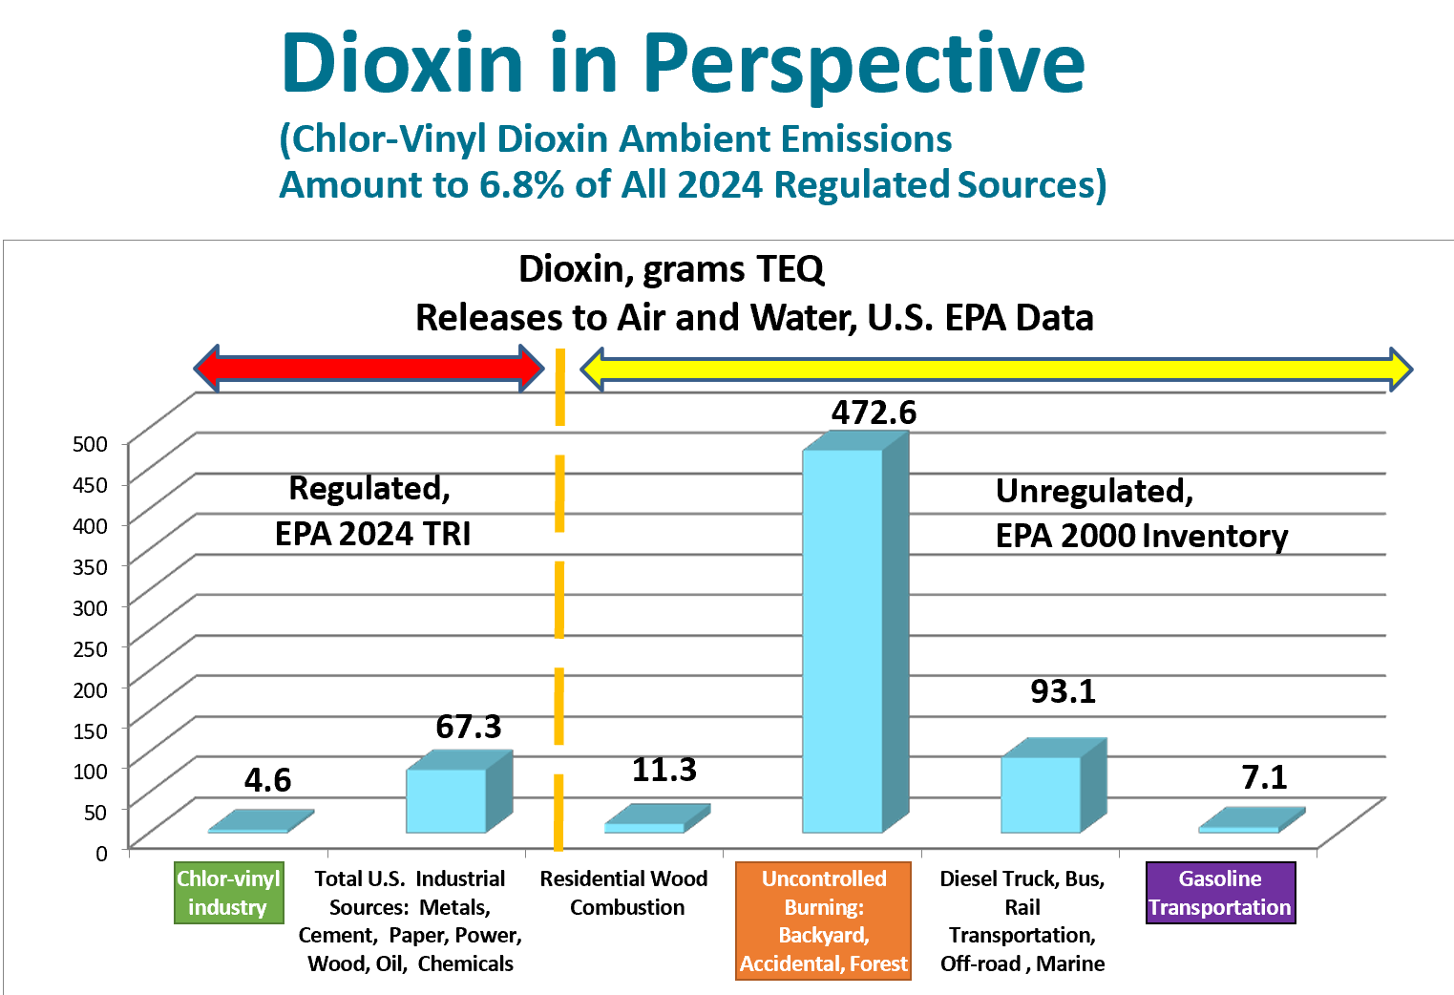
Vinyl Production Emissions Performance ​
TEQ + Toxic equivalent potency
U.S. EPA Toxic Release Inventory data air and water from all regulated sources in the U.S.
Notes:
This chart puts the vinyl industry's contribution to dioxin emissions in perspective. The industry is responsible for less than 7 percent of all regulated sources of dioxin to air and water and less than 0.6 percent of all total sources of Dioxin in the United States. Unregulated sources such as recreation wood burning and home heating from residential fireplaces, forest fires, and volcanic eruptions omit more dioxin into the atmosphere than the PVC industry.

Slide 20
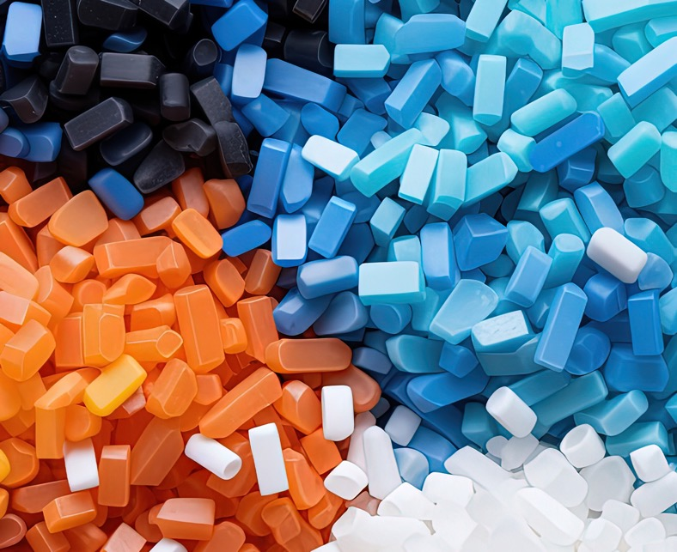
Vinyl uses AND APPLICATIONs
Notes:
Now lets transition to talk a little about vinyl product applications and why it has become the third-highest volume plastic and the most widely used in construction.

Slide 21
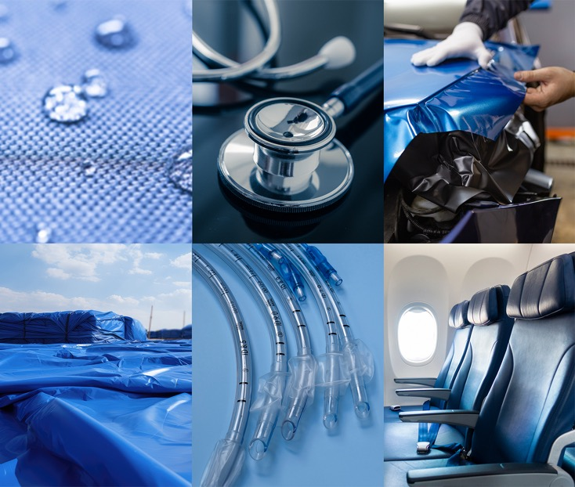
Vinyl is Essential to Everyday Life
Healthcare
Aerospace
Automotive
Packaging
Building construction
Notes:
Vinyl products are in fact, essential to modern life, playing an important role in applications from critical to convenient. Lives are saved on a daily basis because of vinyl blood bags and other medical devices. Electricity, voice and data, the backbones of our modern society are carried on vinyl insulated wiring. Safe drinking water is delivered to homes via vinyl pipes, food is kept fresh and safe with vinyl packaging and millions of tons of CO2 are saved through lightweighting of vehicles and aircraft with vinyl products.

Slide 22
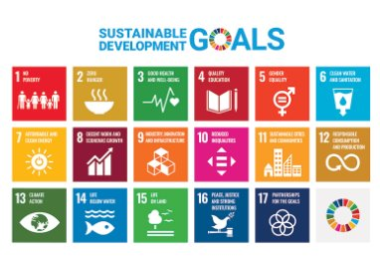
Vinyl and the Sustainable Development Goals
Notes:
While the vinyl industry can contribute to each of the seventeen U.N. Sustainable Development Guides (or SDGs) to varying degrees, the four SDGs to which vinyl industry sustainability efforts contribute most substantially are:

Slide 23
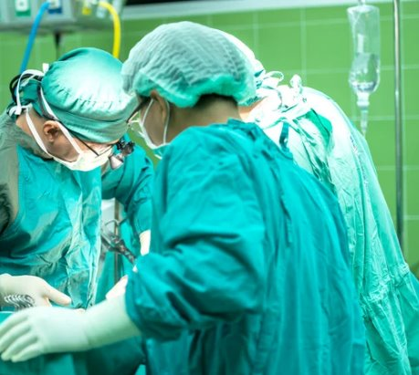
Vinyl and SDG 3: Good Health and Well-Being
One-quarter of all medical devices use PVC due to its performance and cost-effectiveness.
PVC blood bags preserve blood for up to 42 days
PVC flooring, wall protection, and coated fabrics help prevent the spread of infectious bacteria
PVC medical applications protect healthcare professionals and caregivers from serious contagions
Notes:
SDG 3: Good Health and Well-being. - One-quarter of all medical devices use PVC due to its performance and cost-effectiveness. In fact, PVC saves lives everyday by safely preserving the blood supply longer than any other material, up to 42 days. The requirement for sterile environments requires harsh cleaning, disinfection and sanitation protocols that PVC can withstand but cause many other materials to degrade prematurely and fail. And, PVC is one of the only materials that meet strict requirements for personal protective equipment (PPE) – face shields, goggles, and gloves – for doctors, nurses, and caregivers treating virulent diseases like Ebola.

Slide 24
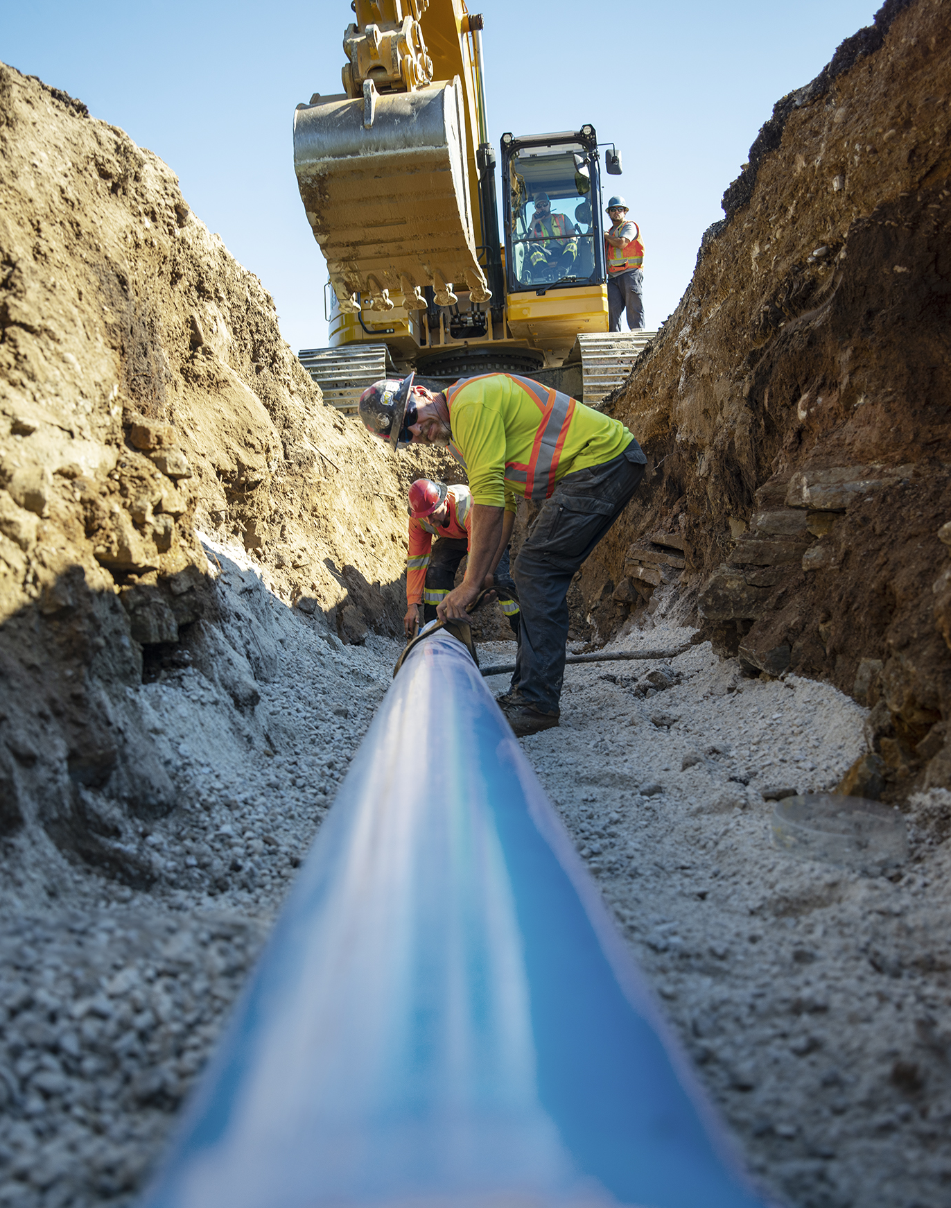
Vinyl and SDG 6: Clean Water and Sanitation
PVC pipes safely deliver clean water and wastewater.
NSF standards in the United States ensure that PVC and CPVC safely deliver clean drinking water.
The durability and non-corrosiveness of PVC pipes make them critical components of desalination plants.
PVC pipe is often used as a core component of water wells because they are long lasting, easy to install, and cost-effective.
The non-corrosiveness of PVC pipe prevents loss of clean water and seepage of sewage in regions with corrosive soil conditions.
Notes:
SDG 6: Clean Water & Sanitation. - PVC pipes are a preferred solution for safely delivering clean water and wastewater. Their durability and non-corrosiveness provides for a longer life, less water wasted from leakage and less pumping horsepower to achieve similar flowrates to metal pipes.

Slide 25

Vinyl and SDG 11: Sustainable Cities and Communities
PVC pipes are a lower carbon solution for infrastructure.
PVC pipe can remain in operation for 100 years and has an extremely low failure rate^{.1}
PVC piping systems require less energy to pump water resulting in cost, energy, and carbon savings. ²
PVC pipe is easy to install and cost effective.
PVC is cost effective – up to 70% less in some cases. ³
1 Folkman, S. (May 2014): “PVC Pipe Longevity Report: Affordability and the 100+ Year Benchmark Standard.” Mechanical and Aerospace Engineering Faculty Publications. Paper 170. p 7 https://digitalcommons.usu.edu/mae_facpub/170
2 Sustainable Solutions Corporation (April 2017): “Lifecycle Sustainability of PVC Water Pipe and Sewer Pipe and Comparative Sustainability Analysis of Pipe Materials.” p 60
3 Anderson, R. (March 2013): “Municipal Procurement: Procurement Process Improvements Yield Cost-Effective Public Benefits.” U.S. Conference of Mayors. p 12-13 https://issuu.com/unibellargos/docs/uscm_muncipalprocurement_onepage_1
Notes:
SDG 11: Sustainable Cities & Communities. - Due to their long life, lightweight and reduced pump size requirements, PVC pipes are a lower carbon solution for infrastructure. When compared against alternative materials, PVC is the lower carbon solution.

Slide 26
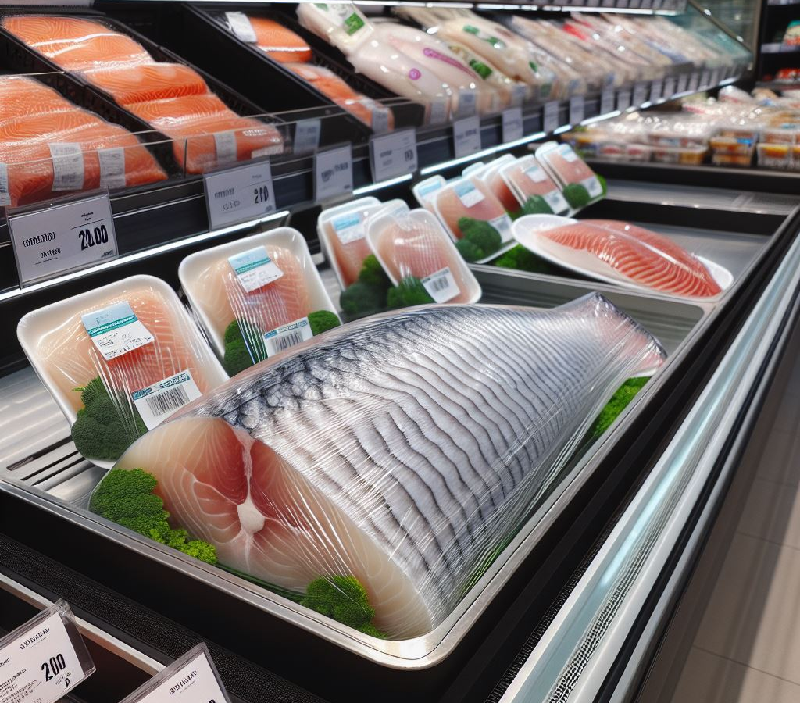
Vinyl and SDG 12: Responsible Consumption and Production
PVC applications provide food safety and security, and stop waste.
PVC films protect food products from microorganisms that breed quickly on uncovered food and help prevent food waste.
Used as an interior metal can liner, vinyl coatings protect the can contents and protect the can from corroding due to acids in the food or beverage thereby increasing product shelf-life.
Vinyl sealants provide airtight seals for caps and closures on food and beverage bottles and jars keeping food fresh and bacteria out – also preventing food and beverage waste.
Notes:
SDG 12: Responsible Consumption & Production. - Food safety and freshness are enhanced by the use of PVC packaging to prevent harmful microorganisms and premature spoilage leading to human health risk and food waste.

Slide 27

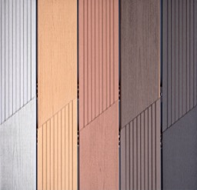
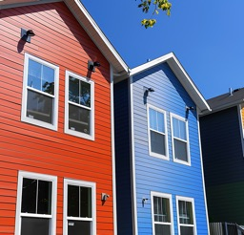

An Ideal Building Material
System Performance
Resists moisture, chemicals and corrosion
Can last 50+ years
Easy to Install
Design
Numerous colors textures and
styles available
Offers customization and creative freedom
Building Performance
Cost effective
Meets building code requirements
Helps reduce building energy consumption
Minimal maintenance
Environmental Performance
Low relative embodied carbon
Low VOCs
Recyclable
Durable
Notes:
In building construction, vinyl is used in a wide variety of durable uses including windows, flooring, siding, roofing, trim, decking, wallcovering, upholstery, pipe and wire and cable.

Slide 28
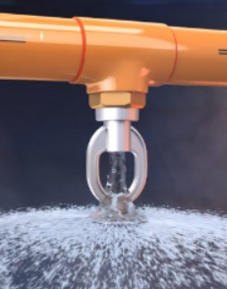
Fire Safety
Vinyl is inherently flame resistant, waterproof, and flexible
Chlorinated vinyl pipe is used for fire suppression in homes, multifamily housing, hotels, dormitories, and schools
Chlorinated vinyl is slightly different than standard vinyl
Notes:
One reason vinyl is the largest volume plastic in building construction is because it contributes to fire safety. The basic material is inherently flame-resistant, so vinyl products do not readily ignite or support combustion when a flame source is removed. Other reasons are because it is waterproof, flexible and a good electrical insulator. Vinyl is used to insulate wire and cable for both low-voltage and line-voltage applications. Vinyl also enables fire safety in the form of building fire suppression sprinkler systems. A growing option for sprinkler pipe is chlorinated PVC, also known as CPVC, which is a formulation slightly different from regular PVC pipe.

Slide 29

Flooring & Specialty Flooring
Vinyl is widely used in commercial and residential
flooring applications
Used for carpet tile backing and vinyl flooring
Sold in tiles, sheets, and planks
Appropriate for retail, hospitality, and healthcare segments
Vinyl resilient flooring is available in sheet, composition tile and “luxury vinyl” categories
Stylized woven cushion flooring is designed for stadiums
and gymnasiums
Appropriate for K-12 multipurpose spaces
Notes:
Vinyl is widely used in commercial and residential flooring applications. It is a common backing for carpet tiles because it prevents delamination, pile fraying and it is dimensionally stable. It also usually has a high recycled material content in these applications. Vinyl resilient flooring is available as vinyl composition tile (VCT), sheet vinyl, and as products in the ‘luxury vinyl’ (or ‘LV’) category. LV products come in tile, sheet and planks and all are designed to meet customer demand for durability, limited maintenance, ease of cleaning and high quality aesthetics.

Slide 30

Fabrics and Furniture for Infection Control
Vinyl materials offer cleanability critical to infection control in healthcare applications
Vinyl’s wide range of design options and durability make it the best choice for flooring, upholstery fabrics, and wall protection for healthcare settings
Photo: Cannon Design: University Hospital Seidman Cancer Center, Cleveland, Ohio
Notes:
Healthcare settings demand products that are easily cleanable and withstand infection control. That's why vinyl is often the preferred solution for flooring, upholstery fabrics, furniture and wall protection. Products in this setting also need to look good and last until the next facility renovation, which may be a decade away.

Slide 31
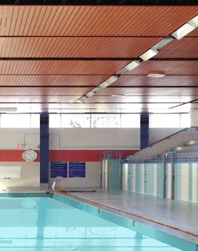
Ceilings
Vinyl ceilings resist damage from moisture
and chemicals
Appropriate for natatorium spaces, hospitality spaces, and other spaces that require resistance to chemicals and the elements
Notes:
Damp or high humidity conditions such as natatoriums require both aesthetics and performance in a challenging environment. Ceiling products made from rigid vinyl can perform in these conditions without corrosion or deterioration.

Slide 32

Wall Coverings
Cost-effective paint alternative
Stain-resistant, cleanable wall protection
Custom designs are easy and affordable with digital images and film technology
Notes:
Wallcovering can be cost effective when compared to paint. It resists most stains and adds to aesthetic appeal, cleanability and wall protection. And, maintenance is greatly reduced as compared to painted walls.
In addition, digital images and film technology make dramatic and custom design easy and affordable
Vinyl is also widely used as wall protection components like corners and rub rails in critical applications like patient rooms and is often more cost-effective and resilient than other materials.

Slide 33
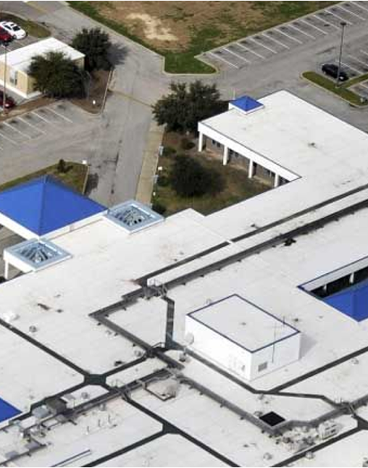
Vinyl Roofing membrane
Single-ply vinyl roofing membrane offers water-tight performance and long-term durability with clean aesthetic looks
Many vinyl roofing membrane systems last for 30+ years
Photo: Hancock Medical Center in Bay St. Louis, Mississippi
Notes:
Vinyl roof membranes have been in service throughout the world for many years. In the U.S., there are many roofs in service that were installed more than 30 years ago. The project pictured here is the Hancock Medical Center in Bay St. Louis, Mississippi. When it was time to reroof the building, aesthetics and visual appeal were important factors. Sloped roofs are a significant architectural element and the medical center wanted the appearance of standing seam metal (pictured in blue), while the white reflective membrane reflects the sun's UV rays reducing heat load to the building and lowering cooling costs. The water-tight performance and durability of single-ply PVC membrane roofing made it the ideal choice because it provided the desired look with long-term reliability.

Slide 34
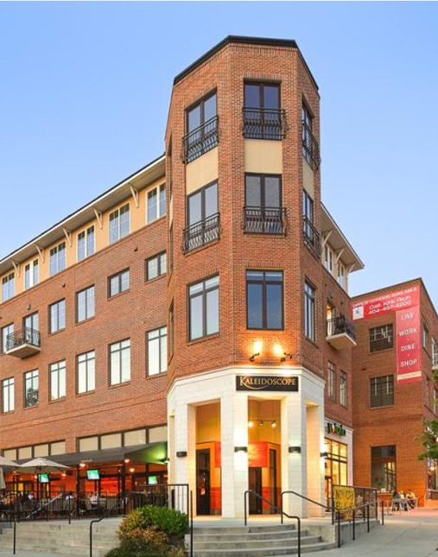
Windows & Cladding
Vinyl window frames now come in larger sizes thanks to new bending capacity similar to aluminum extrusions
Vinyl film technology allows for more color options on window frames to coordinate with designs
Vinyl window frames exhibit energy savings due to lower thermal conductivity compared to metal
Brookhaven Multi-Use Facility Photo Courtesy of Veka
Notes:
Vinyl windows have been used in residential applications for many years in the United States. Their use in commercial projects is growing due to two major innovations. One is the use of structural inserts giving window frames bending capacity similar to aluminum extrusions. This means that storefront size openings are now possible. The second innovation is the use of vinyl film technology for window frames. The frames can now be dark colors, or they can look like aluminum or a range of other visual effects. Vinyl window frames have the advantage of lower thermal conductivity when compared to metal, exhibiting energy savings without compromising on installed cost or overall performance.

Slide 35

Cladding & Trim
Easy to Install
Maintenance-free
Available in a wide range of aesthetic and stylistic effects
Cellular vinyl trim components are lightweight, colors are integral throughout, and the material requires essentially no maintenance
Notes:
Vinyl cladding and trim are easily installed and are available in a wide range of aesthetic and stylistic effects.
Vinyl siding accounts for about 50% of all residential and light commercial building exteriors. It offers more benefits than other options including durability, ease of maintenance, and low cost of installation.
It is generally considered to have a life span of between 20 and 40 years depending on local climate, quality of installation, and maintenance. With good maintenance it can last even longer.
Cellular vinyl trim components are lightweight, colors are integral throughout, and the material requires essentially no maintenance.

Slide 36
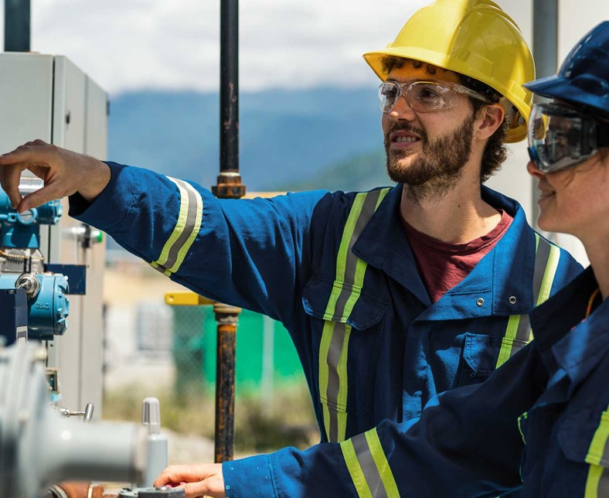
Verifying Responsible Vinyl Manufacturing
Notes:
So how do we measure and verify responsible PVC manufacturing? A good place to start is connecting product performance requirements with certified products sourced from companies verified to sustainability criteria.

Slide 37
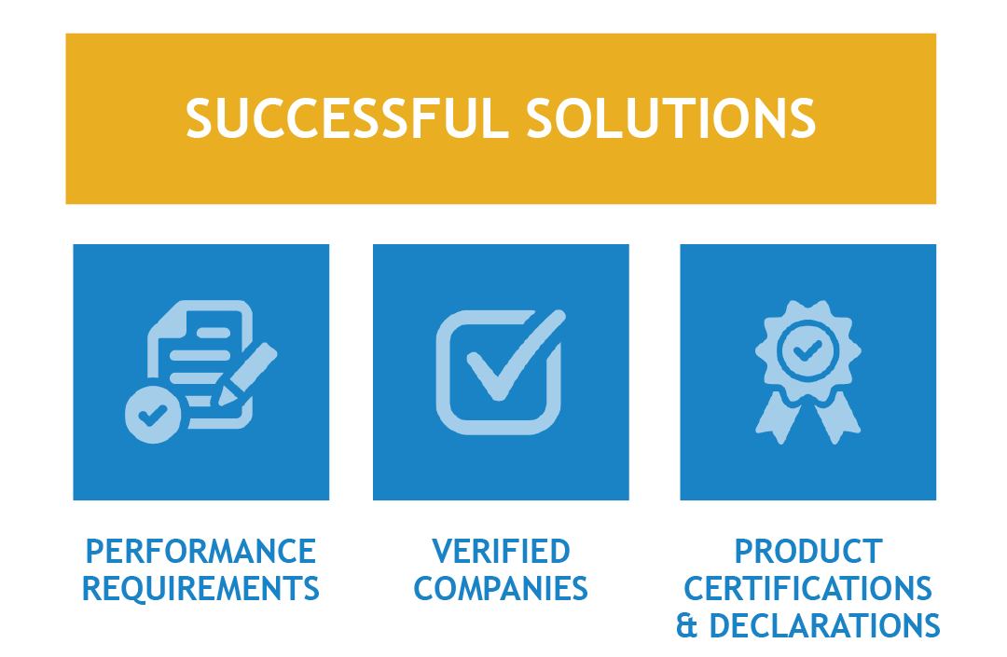
Responsible vinyl Manufacturing
Notes:
Company and product ecolabels, certifications, and declarations can all be useful to identify various sustainable and product health attributes that are part of the specification process and used for compliance to green building rating systems for building certification. Selecting certified products from companies that have undergone 3rd party sustainability performance verification makes selecting best-in-class sustainability performance a much more manageable task. One without the other (product certifications and company verification) is missing the mark. As an example, purchasing clothing made from certified organic cotton that is manufactured by a company that uses forced labor is not an optimum solution.

Slide 38
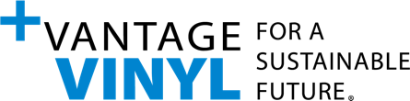
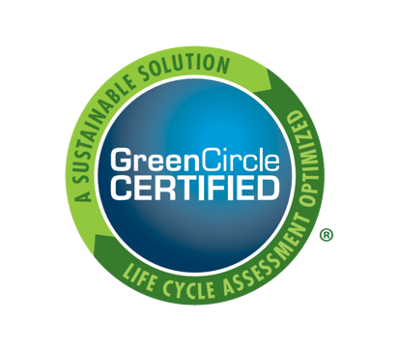
+Vantage Vinyl
  Annual sustainable performance reporting
  Re-verification every three years
  Improved industry performance
    Three material impact categories
    Resource efficiency, emissions, and people & community
    Sustainability efforts are verified by GreenCircle Certified, an independent third-party
  People, planet and governance criteria includes 5 pillars
Notes:
+Vantage Vinyl is a sustainability standard that helps product specifiers and consumers identify companies that are committed to sustainable operations. +Vantage Vinyl is framed around five pillars aligned with People, Planet and Governance criteria. Within each pillar are a series of guiding principles that set the direction and parameters for what a company will achieve over time on its journey of continuous improvement. The guiding principles support improved industry performance across three material impact categories: resource efficiency, emissions, and people and community.
+Vantage Vinyl verified companies demonstrate a commitment to responsible PVC manufacturing and continuous improvement. Selecting a +Vantage Vinyl verified company provides assurance of compliance with the standard, reducing the complexity of evaluating and selecting companies committed to sustainability performance.

Slide 39
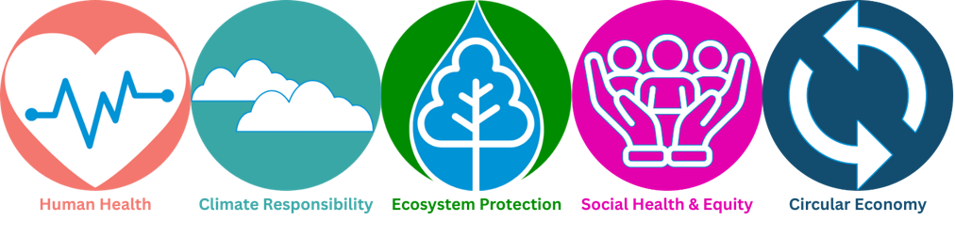
The +Vantage Vinyl Program's FIVE Pillars
Notes:
Company sustainability performance is measured against compliance to 29 Guiding Principles of sustainability aligned with these 5 Pillars of sustainability. The Guiding Principles and Pillars are in alignment with the AIA materials pledge and the Mindful Materials Common Materials Framework.

Slide 40
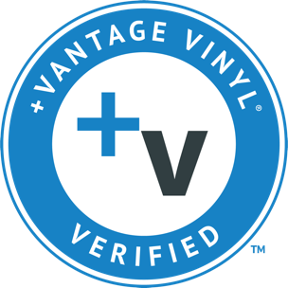
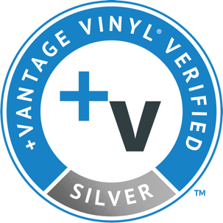
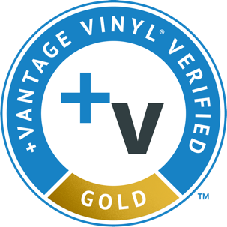
+Vantage Vinyl: Three Levels of Verification
Find verified companies at vantagevinyl.com/vantage-vinyl-verified-companies/
Notes:
+Vantage Vinyl-verified companies are the industry’s sustainability leaders actively working to improve their sustainability performance in each of the industry’s impact categories – resource efficiency, emissions, and people & community.
Their sustainability efforts are verified by GreenCircle Certified, an independent third party. Companies displaying the +Vantage Vinyl mark are:
Committed to sustainable business operations
Advance sustainability performance in the vinyl industry.
Focus on continuous improvement in all three impact categories – resource efficiency, emissions, and people & community.
Are transparent about their sustainability activities and reporting their progress on an annual basis and,
Raise the bar for industry best practices.

Slide 41
In Summary
Vinyl manufacturing is highly regulated and has best-in-class safety records
Vinyl is a safe and versatile building material, and for many applications, the best solution
Vinyl products from manufacturers that have undergone third-party verification for sustainability performance to get best-in-class performance
Notes:
In summary, today's vinyl manufacturing is a resource efficient and highly regulated industry. When considering sustainability of materials it is important to keep in mind that no material can claim to be inherently sustainable. It is the way a material is sourced, processed and put to use and reused at end of life to meet societal needs that determines its sustainability. Third party verification of company commitments to transparent and credible sustainability standards can be useful to help assure working with responsible vinyl manufacturers.

Slide 42
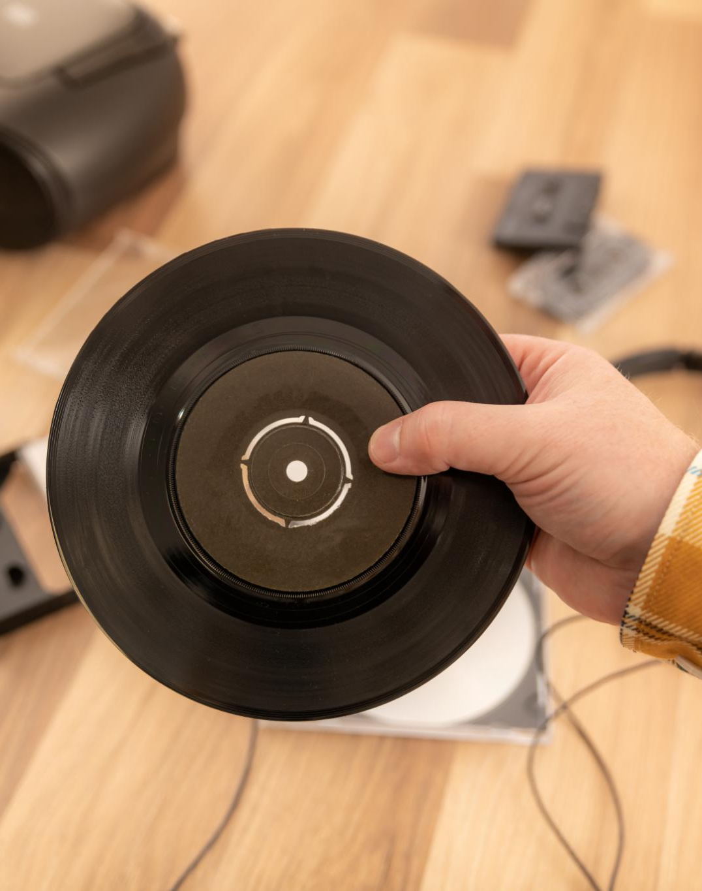
Join the Vinyl Movement
Stay Informed
  Signing up for the Vinyl Institute newsletter keeps you updated on industry trends, news and innovations.
Commit to Sustainability
  Becoming a +Vantage Vinyl Verified company highlights dedication to sustainable practices and environmental responsibility.
Participate
  Participations connects you with a network of professionals shaping the future of the vinyl industry.
  Email jarmstrong@vinylinfo.org or visit vantagevinyl.com to learn more!

Slide 43
Resources
American Academy of Healthcare Interior Designers. AAHID, n.d., https://aahid.org/. Accessed Feb. 2024.
American Society of Interior Designers and American Chemistry Council. Chemistry in Material Selection and Specification: Key Considerations. ASID, n.d., https://learn.asid.org/products/chemistry-in-material-selection-specification-key-considerations#tab-product_tab_overview. Accessed Feb. 2024.
American Society of Heating, Refrigerating and Air-Conditioning Engineers. ASHRAE, n.d., https://www.ashrae.org/. Accessed Feb. 2024.
Building Transparency. BuildingTransparency.org, n.d., https://www.buildingtransparency.org/.
Accessed Feb 2024.
The Center for Health Design. Safety Risk Assessment
Toolkit. CHD, 2017, https://www.healthdesign.org/sra. Accessed Feb. 2024.
Centers for Disease Control and Prevention. U.S. Department of Health and Human Services, n.d., https://www.cdc.gov/. Accessed Feb. 2024.
“Disinfection and Sterilization.” 24 May 2019, https://www.cdc.gov/infectioncontrol/guidelines/disinfection/index.html. Accessed Feb. 2024.
CFFA Performance Products.
Chemical Fabrics and Film Association, Inc., n.d., https://www.cffaperformanceproducts.org/.
Accessed Feb. 2024.
“CFFA Healthcare Standard Certification Program.” n.d., https://www.cffaperformanceproducts.org/healthcare.asp. Accessed Feb. 2024.
“CFFA-Healthcare-201C Standard.” n.d. https://www.cffaperformanceproducts.org/content/pdfs/CFFAHC201CertificationSummary.pdf. Accessed Feb. 2024.
“ecomedes Product Database.” ecomedes. ecomedes, inc., n.d., https://products.ecomedes.com/.
Accessed Feb. 2024.
Notes:
Resources

Slide 44
Resources
“Emergency Department CAHPS (ED CAHPS).” CMS.gov. Centers for Medicare & Medicaid Services, 26 Oct. 2021, https://www.cms.gov/Research-Statistics-Data-and-Systems/Research/CAHPS/ED. Accessed Feb. 2024.
Durable Coated Fabrics Task Group, n.d., https://aahid.wpengine.com/resources/durable-coated-fabrics/. Accessed Feb. 2024.
Facility Guidelines Institute, n.d., https://fgiguidelines.org/. Accessed Feb. 2024.
“Guidelines.” N.d., https://fgiguidelines.org/.
Accessed Feb. 2024.
“Resources.” N.d., https://fgiguidelines.org/resources/. Accessed Feb. 2024.
Fitwel. Center for Active Design, n.d., https://www.fitwel.org/ . Accessed Feb. 2024.
Green Building Advisory Committee of the GSA.
“Advice Letters and Resolutions.” U.S. General Services Administration, 23 Sept. 2021, https://www.gsa.gov/governmentwide-initiatives/federal-highperformance-green-buildings/policy/green-building-advisory-committee/advice-letters-and-resolutions. Accessed Feb. 2024.
Green Building Initiative. Green Building Initiative,
Inc., n.d., https://thegbi.org/. Accessed Feb. 2024.
Green Globes. Green Building Initiative, Inc., n.d., https://thegbi.org/greenglobes/. Accessed Feb. 2024.
International Code Council. International Code Council, Inc., n.d., https://www.iccsafe.org/. Accessed Feb. 2024.
International Green Construction Code.
International Code Council, Inc., 2021, https://codes.iccsafe.org/content/IGCC2021P1.
Accessed Feb. 2024.
Notes:
Resources

Slide 45
Resources
“LEED Pilot Credits.” USGBC, n.d., https://www.usgbc.org/pilotcredits. Accessed Feb. 2024.
NSF International, n.d., https://www.nsf.org/.
Accessed Feb. 2024.
Senior Living Sustainability Guide®. With Seniors in Mind, Inc., n.d., http://www.withseniorsinmind.org/slsg-download. Accessed Feb. 2024.
Sustainable Facilities Tool. U.S. General Services Administration, n.d., https://sftool.gov/.
Accessed Feb. 2024.
“Buildings and Health.” n.d., https://sftool.gov/learn/about/576/buildings-health. Accessed Feb. 2024.
“Health and Wellness Guidance Crosswalk.” n.d., https://sftool.gov/learn/crosswalk . Accessed Feb. 2024.
The Vinyl Institute. n.d. https://www.vinylinfo.org/. Accessed Feb. 2024.
U.S. Environmental Protection Agency, Oct. 2021, https://www.epa.gov/. Accessed Feb. 2024.
“DfE-Certified Disinfectants.” 29 Sept. 2021, https://www.epa.gov/pesticide-labels/dfe-certified-disinfectants . Accessed Feb. 2024.
“Toxic Substances Control Act (TSCA)
and Federal Facilities.” 9 Feb. 2021, https://www.epa.gov/enforcement/toxic-substances-control-act-tsca-and-federal-facilities . Accessed Feb. 2024.
https://www.epa.gov/pfas/pfas-explained
+Vantage Vinyl ecomedes Database. ecomedes, n.d. https://vantagevinyl.ecomedes.com/. Accessed Feb. 2024.
+Vantage Vinyl. Vinyl Sustainability Council, n.d., https://vantagevinyl.com/. Accessed Feb. 2024.
Notes:
Resources

Slide 46
Resources
Vinyl Recycling Directory. The Vinyl Institute, n.d., https://www.vinylinfo.org/recycling-directory/. Accessed Feb. 2024.
Vinyl Verified, n.d., https://vinylverified.com/. Accessed Feb. 2024.
WELL. International WELL Building Institute, n.d., https://www.wellcertified.com/. Accessed Feb. 2024.
Carmen, R. (Jan. 1993): The Selection of Plastic Materials for Blood Bags, Transfusion Medicine Reviews, Vol. VII, No. 1
2 Centers for Disease Control/Blood Safety https://www.cdc.gov/blood-safety/hcp/diagnosis-testing/?CDC_AAref_Val=https://www.cdc.gov/bloodsafety/basics.html
PVC Med Alliance, Fighting Ebola with PVC (Mar. 10, 2018) https://pvcmed.org/fighting-ebola-with-pvc
PVC Pipe Association https://www.uni-bell.org/About-Us/Public-Health
PVC Pipe Association Environmental Product Declaration
https://www.uni-bell.org/communication/images/environmental_product_declaration_for_water_and_sewer_piping.pdf
10 McKinsey and Company, Climate Impact of Plastics (July 2022)
11 2022 cadeo Study Agriculture Energy Efficiency https://www.vinylinfo.org/wp-content/uploads/2022/12/Ag-Efficiency.pdf
Notes:
Resources

